Slide 1
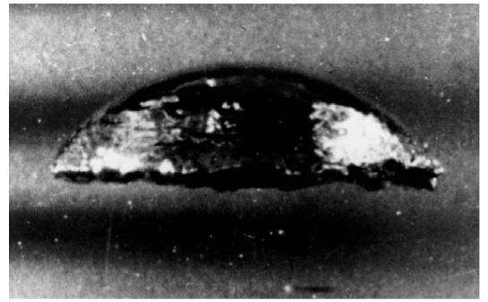
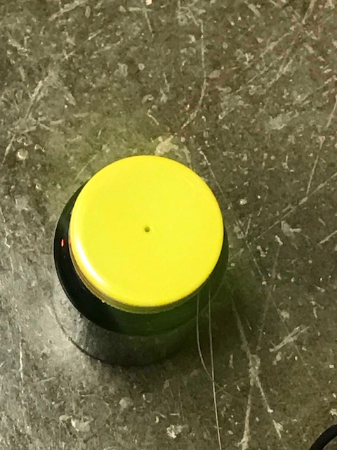
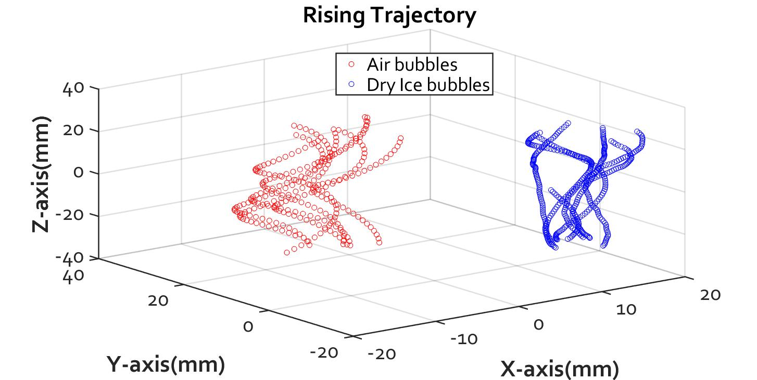
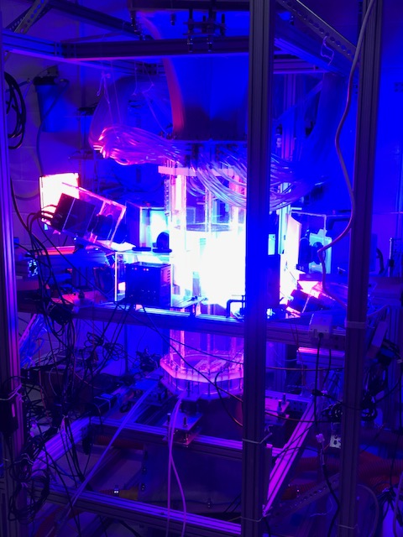
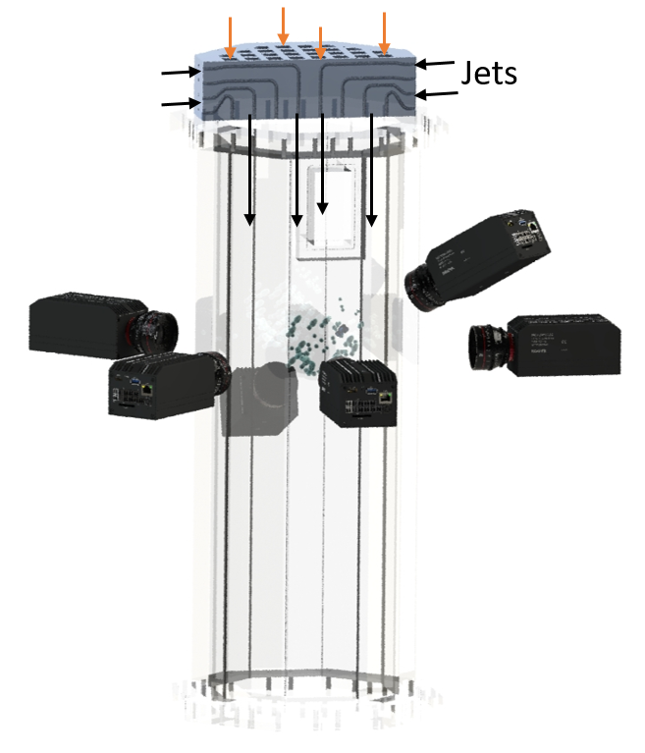
Multiphase Flow: Influence of interfacial mass transfer on bubble dynamics
Kenechukwu Ezenduka, Ashik Masuk, Chee Hau Teoh
Faculty Advisor: Dr Rui Ni
Department of Mechanical and Nuclear Engineering
The Pennsylvania State University
Objective: To compare and contrast the dynamics of air bubbles with dry ice bubbles
Motivation
Dry ice bubbles, unlike air bubbles, experience interfacial mass transfer as they rise in quiescent water. Most experiments on the dynamics of bubbles have been carried out using air bubbles and therefore do not include the impact of interfacial mass transfer. However, since understanding the dynamics of bubbles with interfacial mass transfer is key in numerous engineering processes, it is imperative to study the bubble dynamics of dry ice to discern the impact of interfacial mass transfer on bubbles.
Experiment layout &Tools
Dry ice was put in a bottle filled with water which was then lowered into a water tank surrounded by six high speed cameras. The dry ice was segmented into cubes of various sizes to control the sizes of the bubbles produced. Images of rising bubbles were captured with the cameras and an in- house image processing code was used to get the rising velocities and trajectories of bubbles from the captured images.
Results
Figure E: Dry Ice bubble rising
Figure F: Air bubble rising
Figure A: Bottle containing Dry Ice
Figure G: The trajectories of the dry ice & air bubble
Figure B: Water Tunnel
Figure H: Rising velocity of dry ice and air bubbles of varying
As shown in figure G &H the dynamics of the dry ice bubbles vary significantly from that of the air bubbles in terms of both trajectory and rising velocity. The dry ice bubbles rise faster and more linearly than air bubbles of the same size. This indicates that interfacial mass transfer indeed impacts the dynamics of bubbles, specifically increasing the rising velocity and reducing lateral spread of the trajectory. Such findings creates an opportunity to explore the influence of mass transfer on bubble dynamics in further detail from different aspects such as wake instability and momentum coupling, which is the next step in this project.
Figure C & D: Water tunnel & High speed cameras (CAD view) with bubble images
Acknowledgements
Financial support for this project was provided by CERI REU
Reference
Brennen, Christopher E. “Spherical Bubble Dynamics.” Cavitation and Bubble Dynamics, pp. 168., doi:10.1017/cbo9781107338760.003.

