Slide 1
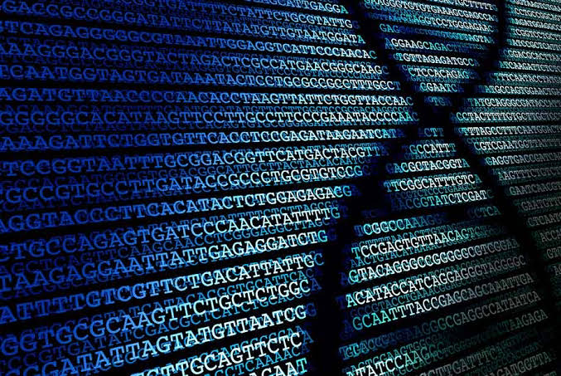
NEXT GENERATION SEQUENCING

Slide 2
OUTLINE
INTRODUCTION
WORKFLOW
APPLICATIONS
ADVANTAGES AND DISADVANTAGES

Slide 3
INTRODUCTION
Next-generation sequencing (NGS), also known as high-throughput sequencing, is the catch-all term used to describe a number of different modern sequencing technologies.
This technique utilizes DNA sequencing technologies that are capable of processing multiple DNA sequences in parallel. Also called massively parallel sequencing and NGS
The principle behind Next Generation Sequencing (NGS) is similar to that of Sanger sequencing, which relies on capillary electrophoresis.

Slide 4
INTRODUCTION
The Sanger method required separate steps for sequencing, separation (by electrophoresis) and detection, which made it difficult to automate the sample preparation and it was limited in throughput, scalability and resolution. The NGS method uses array-based sequencing which combines the techniques developed in Sanger sequencing to process millions of reactions in parallel, resulting in very high speed and throughput at a reduced cost.

Slide 5
WORKFLOW
Next generation methods of DNA sequencing have three general steps:
Library preparation: libraries are created using random fragmentation of DNA, followed by ligation with custom linkers
Amplification: the library is amplified using clonal amplification methods and PCR
Sequencing: DNA is sequenced using one of several different approaches
Analysis: Interpretation of results

Slide 7
LIBRARY PREPARATION
Firstly, DNA is fragmented either enzymatically or by sonication (excitation using ultrasound) to create smaller strands. Adaptors (short, double-stranded pieces of synthetic DNA) are then ligated to these fragments with the help of DNA ligase, an enzyme that joins DNA strands. The adaptors enable the sequence to become bound to a complementary counterpart.

Slide 9
AMPLIFICATION
Library amplification is required so that the received signal from the sequencer is strong enough to be detected accurately.
Emulsion PCR
Emulsion oil, beads, PCR mix and the library DNA are mixed to form an emulsion which leads to the formation of micro wells
Bridge PCR
The surface of the flow cell is densely coated with primers that are complementary to the primers attached to the DNA library fragments The DNA is then attached to the surface of the cell at random where it is exposed to reagents for polymerase based extension.

Slide 11
SEQUENCING
Pyrosequencing
Pyrosequencing is based on the 'sequencing by synthesis' principle, where a complementary strand is synthesised in the presence of polymerase enzyme
pyrosequencing instead detects the release of pyrophosphate when nucleotides are added to the DNA chain. It initially uses the emulsion PCR

Slide 13
SEQUENCING BY SYNTHESIS
Sequencing by synthesis (SBS) technology uses four fluorescently- labeled nucleotides to sequence the tens of millions of clusters on the flow cell surface in parallel. During each sequencing cycle, a single labeled deoxynucleoside triphosphate (dNTP) is added to the nucleic acid chain.
Each cycle consists of:
* DNA base synthesis on ssDNA by PCR
* Addition of all 4 modified dNTPs and Detection of complentary nucleotide
* Removal of reactants to restart cycle

Slide 15
ION TORRENT SEMICONDUCTOR SEQUENCING
Ion torrent sequencing uses a "sequencing by synthesis" approach, in which a new DNA strand, complementary to the target strand, is synthesized one base at a time. A semiconductor chip detects the hydrogen ions produced during DNA polymerization
Following polony formation using emulsion PCR, the DNA library fragment is flooded sequentially with each nucleoside triphosphate (dNTP), as in pyrosequencing. The dNTP is then incorporated into the new strand if complementary to the nucleotide on the target strand. Each time a nucleotide is successfully added, a hydrogen ion is released, and it detected by the sequencer's pH sensor.

Slide 17
SOLiD
Sequencing by ligation relies upon the sensitivity of DNA ligase for base-pairing mismatches. The target molecule to be sequenced is a single strand of unknown DNA sequence, flanked on at least one end by a known sequence. A short "anchor" strand is brought in to bind the known sequence.
A mixed pool of probe oligonucleotides is then brought in (eight or nine bases long), labeled (typically with fluorescent dyes) according to the position that will be sequenced. These molecules hybridize to the target DNA sequence, next to the anchor sequence, and DNA ligase preferentially joins the molecule to the anchor when its bases match the unknown DNA sequence. Based on the fluorescence produced by the molecule, one can infer the identity of the nucleotide at this position in the unknown sequence.the SOLiD technique is highly accurate and inexpensive

Slide 19
ANALYSIS
Each NGS experiment generates large quantities of complex data consisting of short DNA reads.
Analysis can be divided into three steps: primary, secondary, and tertiary analysis

Slide 20
PRIMARY ANALYSIS
Primary analysis is the processing of raw signals from instrument detectors into digitaized data done via base caller(a program which detects the signals at each sequencing cycle and determines what bade it likely is based on said specific signals and calculates the probability that the signal detected is for a particular base taking into consideration sequencing errors that may occur.
This probability is known as the ogres quality score and the output of the primary analysis is the other quality score and files containing the base call-FASTQ FILES

Slide 21
SECONDARY ANALYSIS
Secondary analysis involves sorting out the base calls based on ogres scores and aligning then to a reference genome or assembling them into a novel genome and variant calling(involves identifying different variations between the bases of the sample and regency genome and is arranged into BAM files.

Slide 22
TERTIARY ANALYSIS
Tertiary analysis involves interpretation of data into meaningful clinical information and is the hardest part as it requires advanced technical expertise.

Slide 23
APPLICATIONS

Slide 25
ADVANTAGES
• Creating personalized plans to treat disease may be possible based not only on the mutant genes causing a disease, but also other genes in the patient’s genome.
* Genotyping cancer cells and understanding what genes are misregulated allows physicians to select the best chemotherapy and potentially expose the patient to less toxic treatment since the therapy is tailored.
* Previously unknown genes may be identified as contributing to a disease state. Traditional genetic testing looks only at the common “troublemaker” genes.
* Lifestyle or environmental changes that can mediate the effects of genetic predisposition may be identified and then moderated.
Higher sensitivity to detect low-frequency variants. Faster turnaround time for high sample volumes. Comprehensive genomic coverage.

Slide 26
DISADVANTAGES
* The role of most of the genes in the human genome is still unknown or incompletely understood. Therefore, a lot of the “information” found in a human genome sequence is unusable at present.
* Most physicians are not trained in how to interpret genomic data.
* Large capacity and data processing unit needed
* An individual’s genome may contain information that they DON’T want to know. For example, a patient has genome sequencing performed to determine the most effective treatment plan for high cholesterol. In the process, researchers discover an unrelated allele that assures a terminal disease with no effective treatment.

Slide 27
REFERENCES
https://www.thermofisher.com/ng/en/home/products-and-services/promotions/life-science/focused-next-generation-sequencing-applications.html?CID=fl-sharpenyourfocus
https://www.illumina.com/content/dam/illumina-marketing/documents/products/illumina_sequencing_introduction.pdf
https://www.ebi.ac.uk/training/online/courses/functional-genomics-ii-common-technologies-and-data-analysis-methods/next-generation-sequencing/
https://www.ebi.ac.uk/training/online/courses/functional-genomics-ii-common-technologies-and-data-analysis-methods/next-generation-sequencing/

