Slide 1
HYPOTHALAMIC PITUITARY GONADAL AXIS & DISORDERS
DR TM ADAJA
2022

Slide 2
OUTLINE
GENERAL FUNCTION OF HPG AXIS
HPT AXIS IN MALE
HPO AXIS IN FEMALE/MENSTRUAL CYCLE
HORMONAL SECRETION AND REGULATION
FUNCTIONS OF HORMONES IN HPG AXIS

Slide 3
The HPG axis
The hypothalamo-pituitary-ovarian axis is essentially a complex but necessary interplay between the hypothalamus, the pituitary and the gonads in such a way that they behave like one neuroendocrine organ.
The hypothalamic-pituitary-gonadal axis is the key regulator of sex development and reproduction, processes that are initiated through the decapeptide GnRH/kisspeptin.
The axis is functionally involved in the development of primary and secondary sexual characteristics, the control of oogenesis and by extension reproduction.

Slide 4
HPG AXIS
It is an important control mechanism mainly involved in the development and regulation of the reproductive system and immune system.
It is also involved in the ageing process.
As with other hypothalamic-pituitary related axes, regulation is through a negative feedback loop.

Slide 5
Hypothalamic-Pituitary-Gonadal axis

Slide 6
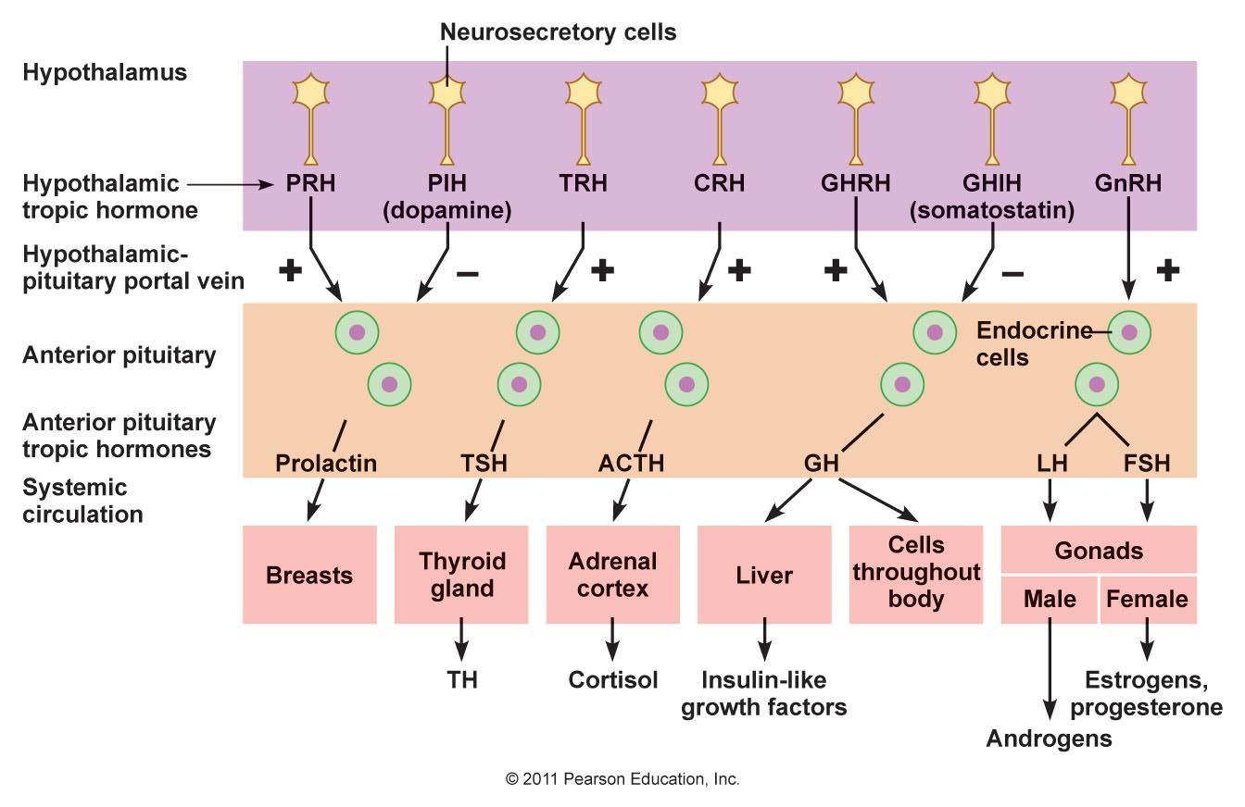
Hypothalamic → Pituitary→ Gonadal axis
lactotropes
Thyrotropes
Corticotropes
Somatotropes
Gonadotropes

Slide 7
REGULATION OF HPG AXIS
The hypothalamus produces a hormone called gonadotropin-releasing hormone (GnRH).
When GnRH is released, it travels along the hypophyseal portal system and binds to secretory cells of the anterior pituitary (adenohypophysis).
Binding of GnRH stimulates these cells to produce luteinizing hormone (LH) and follicle-stimulating hormone (FSH), which are then secreted into the bloodstream.
LH and FSH go on to produce different effects in both sexes, namely through the production of estrogen in females and testosterone in males.

Slide 8
INTERGRATION OF THE AXIS, CONTROL AND REGULATION
Control and communication between the hypothalamic-pituitary unit and the ovaries is essential for the normal physiology of the reproductive cycle and the functions required of it.
It is important for the higher components of the axis (hypothalamus and pituitary) to modulate their secretions in response to the secretions and activity the ovary.

Slide 9
INTEGRATION OF THE AXIS, CONTROL AND REGULATION
The pituitary secretion of LH and FSH is influenced by the following,
Hypothalamic GnRH pulse frequency and amplitude,
The number of GnRH receptors,
Post receptor signaling,
Phasic negative and positive feed- back effects from estradiol ,progesterone, peptides (inhibin) kisspeptins, and neurotransmitter substances.

Slide 10
FEMALE HPG AXIS
In females, the HPG axis is mainly involved in the regulation of the menstrual and ovarian cycle.
Once the anterior pituitary releases LH and FSH into the bloodstream, these hormones signal the ovaries to produce estrogen and inhibin, which play important roles in the reproductive cycle.
Both estrogen and inhibin possess properties that can suppress the production of GnRH.
Estrogen directly inhibits GnRH production via a negative feedback loop. Inhibin indirectly inhibits GnRH production by inhibiting the protein complex activin.

Slide 12
fHPG
The preparation of the ovarian follicle is done through a positive-feedback loop that involves both estrogen and LH.
Release of the ovarian follicle into the uterus leads to the production of progesterone from the ovary.
Progesterone has a negative effect on the positive-feedback loop of estrogen and LH as it inhibits the hypothalamus and consequently the anterior pituitary.

Slide 13
This production of progesterone from the ovary is taken over by the fetus if conception occurs.
If it does not occur, the level of progesterone in the bloodstream decreases and this decreases the negative-feedback on the hypothalamus.
Thus stimulate the anterior pituitary to produce and release FSH and LH, preparing the female for the preparation of the next ovarian follicle.

Slide 14
MENSTRUAL CYCLE
The HPG axis is involved in all three phases of the menstrual cycle.
The hormones of the HPG axis play an important and vital role in the proliferation phase, secretory phase, and the menstrual phase.

Slide 15
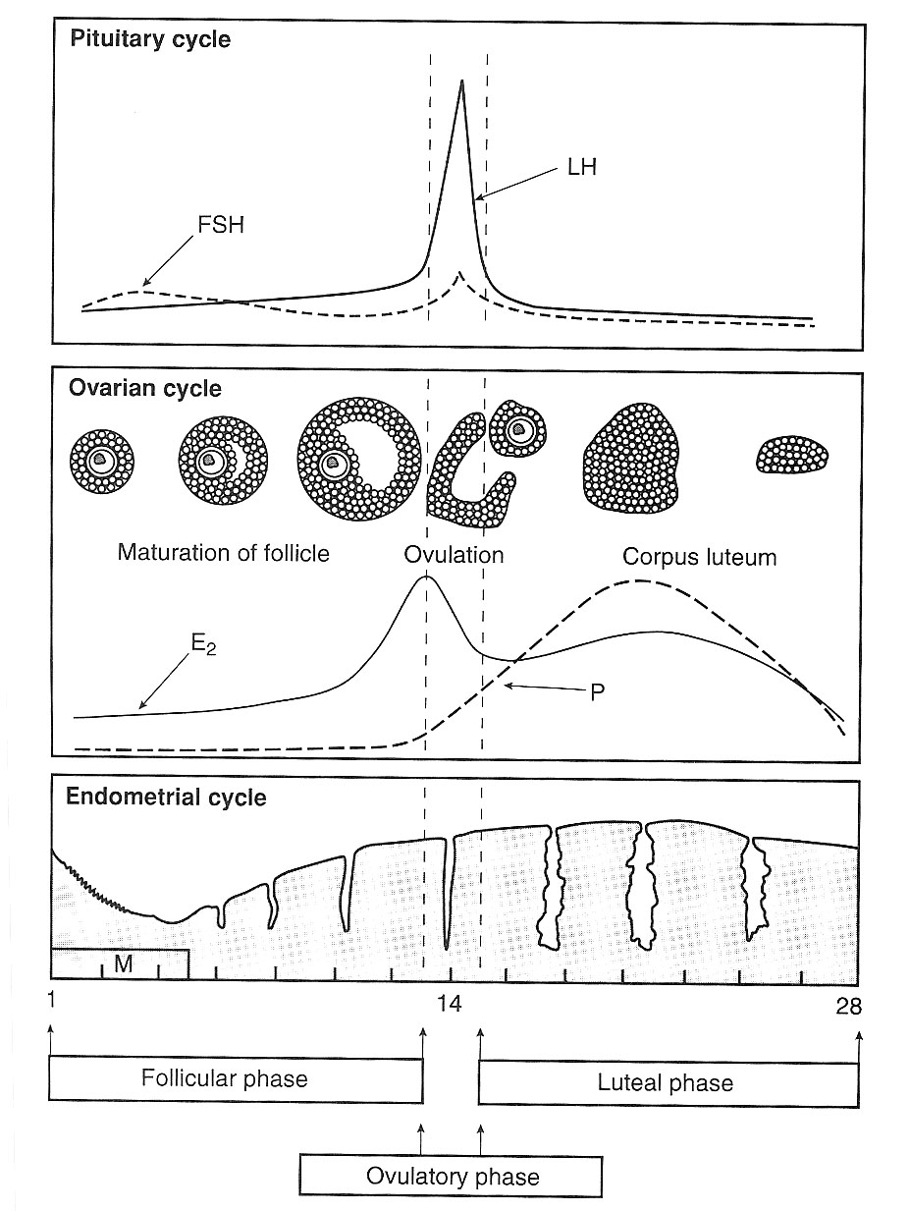

Slide 16
MALE HPG AXIS
In males, the HPG axis is mainly involved in the regulation of the production of testosterone and the process of spermatogenesis.
LH is involved in the synthesis of testosterone via binding to the interstitial cells of the testes while FSH is involved in production of spermatozoa (spermatogenesis).

Slide 17
Control of male sexual functions by hormones from the hypothalamus and anterior pituitary gland
GnRH is secreted intermittently for few minutes every 1 to 3 hrs.
– The secretion of LH by the anterior pituitary is also cyclical following the pulsatile release of GnRH. Conversely, FSH secretion increases and decreases only slightly with each fluctuation of GnRH secretion
Testosterone
Spermatogenesis

Slide 18
.
HORMONES OF THE HPG AXIS

Slide 19
Hypothalamic-Pituitary-Gonadal axis

Slide 20
KISSPEPTINS
Kisspeptins are a family of structurally related peptides, encoded by the KISS1/Kiss1 gene, that act through binding and subsequent activation of the G protein-coupled receptor GPR54.
Kisspeptin-expressing neurons are found in the anteroventral, periventricular and arcuate nuclei, these send projections into the preoptic area, where there is an abundance of GnRH cell bodies and act via the GPR54 to stimulate the secretion of GnRH.
However, for kisspeptin to be involved in the regulation of GnRH release, it must also be sensitive to circulating sex steroid levels.

Slide 21
GONADOTROPIN RELEASING HORMONE
A decapeptide that plays a key role in the process of reproduction. It is produced by hypothalamic neurosecretory cells and released into the hypothalamo-hypophyseal portal circulation, and transported to the anterior pituitary gland.
Binding to its receptor (type I GnRH receptor) stimulates the biosynthesis and secretion of LH and FSH, which in turn regulate gonadal steroidogenesis and gametogenesis in both sexes
Two isoforms have been identified in humans; GnRH 1 most abundant in the brain, placenta, uterus and ovary and GnRH 2 found mainly in the kidneys, bone marrow and prostate.

Slide 22
FOLLICLE STIMULATING HORMONE /LUTEINIZING HORMONE
Follicle stimulating hormone (FSH) and luteinizing hormones are heterodimeric glycoprotein hormones produced by the gonadotrophic cells of the anterior pituitary gland.
Essential for follicular development and ovulation.
LH secretion is inhibited by testosterone, Oestradiol and Dihydroxytestoterone, while FSH is inhibited by inhibin.

Slide 23
Anti Mullerian Hormone.
Anti-Mullerian hormone (AMH) [also known as Mullerian-inhibiting substance (MIS)] is a marker of ovarian reserve and decline in reproductive capacity, as well as response to ART
Low levels are associated with low follicular antral cell count.

Slide 24
INHIBIN A/B
Inhibins : multifunctional glycoproteins A and B
Inhibin A(αß_{A}) is low in early follicular phase, high in the luteal phase ;inhibin B(αß_{B}) parallels FSH
Inhibin B synthesized in granulosa cells and inhibin A in corpus luteum cells.
increase theca cell androgen production

Slide 25
ACTIVINS
Activins : disulfide-linked dimers of the ß-subunits of inhibin.
Activin A produced in the ovary augments the effects of FSH
Activin B produced in the gonadotropes increases FSH secretion

Slide 26
OESTROGENS
Three main physiologic types; Estrone, Estriol and Estradiol .
The principal and most abundant oestrogen secreted by the ovary is estradiol 17-β.
Mainly bound (96%) to SHBG and albumin.
Estrogens promote the development of secondary sexual characteristics, uterine growth, thickening of the vaginal mucosa, thinning of the cervical mucus.

Slide 27
PROGESTERONE
Progesterone, is similar to the oestrogens, maintains the accessory organs during the menstrual cycle hormone is especially important in and maintaining pregnancy.
Progesterone is secreted mainly by the corpus luteum in non-pregnant women.
Minor sources are the adrenal cortex in both sexes and the testes in men.

Slide 28
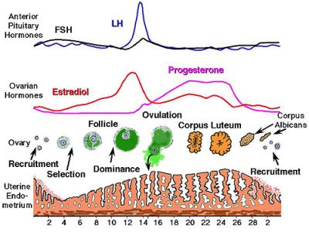
PROGESTERONE
Progesterone is a key hormonesone in feryility. After ovulation progesterone production is triggered by Luteinizing Hormone (LH) which stimulates the corpus luteum (the remnant egg sac) in the ovary to produce progesterone.
One of the main actions of progesterone with fertility is to help support a developing embryo.
If pregnancy occurs, the production of progesterone from the corpus luteum continues for about 7 weeks (it is then produced by the placenta for the duration of the pregnancy). If pregnancy did not occur, the period begins approximately 14 days after ovulation.
When fertilization does not occur the corpus luteum disintegrates, which causes the level of progesterone to fall and the endometrial tissue starts to break-down and shed as menstruation.

Slide 29
ROLE OF PROGESTERONE IN FERTILITY
Progesterone maintains the lining of the uterus which makes it possible for a fertilized egg to attach and survive
Allows the embryo to survive
Prevents immune rejection of the developing baby
Allows for full development of the fetus through pregnancy
Helps the body use fat for energy during pregnancy
Prevents secondary sexual development
Increases libido around ovulation
Activates osteoblasts to increase new bone formation
Protects against endometrial, breast, ovarian and prostate cancer

Slide 30
PROGESTERONE TEST
The most appropriate time to measure serum progesterone is mid luteal phase (either 7 days after ovulation, or 7 days prior to expected menses). This is when you’re most likely to catch the peak progesterone level. This day will vary according to a woman’s cycle length (for example, for a 28 day cycle, day 21 progesterone testing is appropriate; but for a 35 day cycle, progesterone would ideally be measured around day 28).

Slide 31
INTERPRETATION OF RESULTS
In general, normal serum progesterone test results fall in the following ranges: men, postmenopausal women, and women at the beginning of their menstrual cycle: 1 ng/mL or under. women in the middle of their menstrual cycle: 5 to 20 ng/mL. pregnant women in their first trimester: 11.2 to 90 ng/mL.
Results below 10ng/ml indicates a low Progesterone level.
Women who do not produce enough of the hormone progesterone after ovulation experience the luteal phase defect.
Deficiency in the amount of progesterone produced after ovulation may result in a uterine lining that is less able to have an embryo implant which is why some women with this problem may see their period come a short time after ovulation.
Low progesterone may indicate ectopic pregnancy. This can result in miscarriage or fetal death.
Without progesterone to complement it, estrogen may become the dominant hormone causing symptoms such as weight gain, decreased sex drive, mood swings, and depression, PMS, irregular menstrual cycle, heavy bleeding, breast tenderness, fibrocystic breasts, fibroids and gallbladder problems

Slide 32
ANDROGENS
Testosterone (most abundant), dihydrotestosterone and androstenedione.
Testosterone is 96% bound to CBG (1-2%), Albumin (50%) and SHBG (45%), while <4% is free.
Free testosterone index.

Slide 33
Testosterone & DHT
Testosterone
Male reproductive development (foetal & pubertal)
Male secondary sex characteristics
Spermatogenesis
Bone mass (male & females)
Also effects on erythropoiesis, lipids
Dihydrotestosterone
Peripheral conversion from testosterone by 5α-reductase (prostate, skin)
Testosterone has direct & indirect effects
In some tissues testosterone is a prohormone for DHT
Male reproductive development requires both
DHT measurement indicated in investigating some DSD

Slide 34
Prolactin
Produced by lactotrophs of anterior pituitary
Negative control by dopamine
Positive feedback by oestrogens and TRH
Direct effects
Milk production
Measure in females with:
Oligo or amenorrhoea
Galactorrhoea
Subfertility
Measure in males with
Hypogonadotrophic hypogonadism with unknown cause

Slide 35
PROLACTIN is a hormone secreted from the pituitary gland.
Prolactin has a wide variety of effects.
It stimulates the mammary glands to produce milk (lactation)
Elevated levels of prolactin decrease the levels of sex hormones — estrogen in women and testosterone in men
Prolactin also stimulates proliferation of oligodendrocyte precursor cells. These cells differentiate into oligodendrocytes, the cells responsible for the formation of myelin coatings on axons in the central nervous system.
Other actions include contributing to pulmonary surfactant synthesis of the fetal lungs at the end of the pregnancy and immune tolerance of the fetus by the maternal organism during pregnancy.
Prolactin promotes neurogenesis in maternal and fetal brains

Slide 36
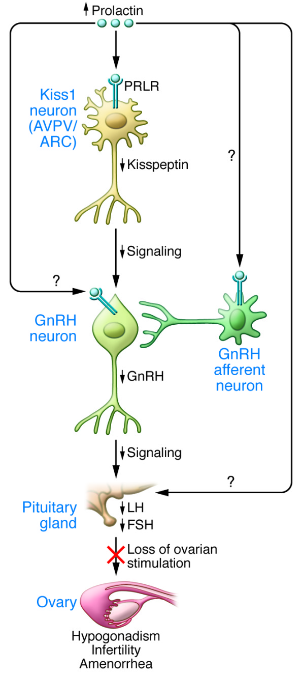
PROLACTIN AND INFERTILITY
Prolactin is a hormone that plays a role in fertility by inhibiting FSH and GnRH.
Increased serum prolactin (PRL) levels result in decreased kisspeptin expression in Kiss1 neurons in both the hypothalamic arcuate (ARC) and anteroventral periventricular (AVPV) nuclei, mediated by prolactin receptors (PRLR) expressed on both populations of Kiss1 neurons.
Suppression of kisspeptin, in turn, reduces GnRH release and results in loss of the ovulatory GnRH surge.
This leads to reduced pituitary gonadotropin (LH and FSH) secretion and loss of ovarian stimulation, which results in hypogonadism, infertility, and amenorrhea.

Slide 37
PROLACTIN TEST
A PRL test is usually done to assess the level of prolactin in the body.
The natural levels of prolactin in the body change throughout the day. Levels gradually rise overnight and are at their highest in the morning.
Doctors usually ask to take a blood sample 3 to 4 hours after a person has woken up
Normal Prolactin levels are: females: less than 25 ng/mL males: less than 17 ng/mL

Slide 38
INTERPRETATION OF RESULTS
Prolactin levels of between 30 ng/mL and 200 ng/mL are considered moderately high
Conditions related to raised levels of prolactin include: pituitary disorders, hypothyroidism, polycystic ovary syndrome (PCOS), kidney disease, liver disease, anorexia nervosa.
Some medications can cause high prolactin levels, including: opiates, antidepressants drugs containing estrogen, such as birth control pills, medication used to treat hypertension, some medications used to treat acid reflux and even Marijuana.
If test results show high levels of prolactin, further tests may be needed. If a doctor suspects that a prolactinoma is causing high levels, they may recommend a CT or MRI scan.

Slide 39
For women, high levels of prolactin in the blood can stop the ovaries from making the hormone estrogen.
Low levels of estrogen can cause irregular periods or stop periods completely, reduce sex drive, and cause vaginal dryness. A person may also find it more challenging to get pregnant.
For men, high levels of prolactin can cause erectile dysfunction and low sex drive.
This effect in men is because prolactin can stop the testes from producing the hormone testosterone. In some cases, it may cause infertility, but this is rare

Slide 40
ASSESSMENT OF OVARIAN RESERVE
Basal serum FSH and E2: a rise in basal FSH is an indicator of ovarian aging, day 3 FSH concentrations >20 to 25 IU/L are considered to be elevated and associated with poor reproductive outcome.
Basal E2 concentrations >75 to 80 pg/mL are also associated with poor response to ovarian stimulation and pregnancy

Slide 41
DISEASES IN HPG
Hypogonadism
Gonadal dysgenesis
Polycystic ovary syndrome : overproduction of androgens ( hirsutism, obesity,irregular menses,impaired fertility)
Hypergonadism
Granulosa-theca cell tumors
Persistent trophoblastic tissue : benign hydatiform mole and its malignant form , choriocarcinoma
Infertility
Elevated testosterone,decreased SHBG
DHEA sulphate :adrenal ;androstenedione : ovary

Slide 42
Evaluation of the Infertile Couple
History and physical examination
Semen analysis
Determination of gonadal function
Determination of ovulation
Measurement of Prolactin and Thyroid hormones

Slide 43
ROLE OF THE LABORATORY IN HPG AXIS EVALUATION
Preanalytical considerations/Test selection
Analysis / Immunometric assays
Postanalytics: Result interpretation and advisory/oversight functions.
Treatment.

Slide 44
Investigations of hypogonadism
▪Measurement of basal levels of testosterone, estrogens, FSH, and LH.
▪Measurement of urinary FSH and LH: This can be done in males as FSH and LH levels in males may be undetectable in blood due to the pulsatile nature of secretion.
▪GnRH stimulation test: In individuals with hypogonadotropic hypogonadism this will help to distinguish hypothalamic causes from pituitary lesions. If administration of GnRH results in increased FSH and LH levels, this means the pituitary is functional.

Slide 45
.
▪Clomiphene stimulation test: Clomiphene has anti-estrogenic effects. Estrogen inhibits the release of GnRH from the hypothalamus. Administration of clomiphene in normal individuals results in release of GnRH, which in turn causes FSH and LH levels to rise.
▪hCG (human chorionic gonadotropin) stimulation test: This is done in males with low testosterone levels. hCG binds to LH receptors and stimulates testosterone production by the Leydig cells.

Slide 46
INVESTIGATIONS
Female endocrine system evaluation[fertility profile]
Pelvic factor investigation
Cervical factor investigation

Slide 47
Female endocrine system evaluation (Fertility profile)
Female fertility profile is a comprehensive set of laboratory tests that provide a foundation with any hormonal imbalances as they relate to reproductive issues.
Hormonal imbalance consists of 18% of causes of infertility.
Fertility profile is recommended for
1 women who have abnormal menstrual cycle
2 Abnormal or heavy vaginal bleeding
3 Infertility
4 Hormonal alterations; moodiness, low sex drive,sudden body fat increase
5 symptoms of menopause

Slide 48
Fertility profile
This investigations includes;
FSH test
LH test
Progesterone ovarian function test
Testosterone (free and total) hormone test
Estradiol hormone blood test
Thyroid peroxidase antibody test
DHEAS hormone test
Complete thyroid function panel test (T4free, T3free, TSH)
Prolactin test

Slide 49
Pelvic factor investigation
Investigates the female pelvic cavity to detect disorders eg tubal disease, endometriosis, uterine problems, fibroids, PCOS, ovulatory disorders and ovarian failure.
Pelvic cavity defects account for 22% causes of infertility
The investigations include
1 Hysteroscopy
2 Ultransonograhy – detects myoma, adenomyosis, pelvic masses, PCOS
3 Magnetic resonance imaging – detects intrauterine lesions
4 Laparascopy- Evaluates uterus fallopian tubes ovaries and pelvic surfaces.
5 Hysterosapingogram- uses xray to visualize the uterus and fallopian tubes

Slide 50
Cervical factor investigation
This checks for
Quality of cervical mucus
Quantity of cervical mucus
Abnormal cervical defects
Immunologic reactions
Infections
These account for 9% of causes of infertility.

Slide 51
These investigations include
1) Post coital test
-it is a timed test that Helps in identifying sexual dysfunction, poor cervical mucus, infection, low sperm count and/ or motility and presence of antibodies.
The test is not very accurate
A count of more than 20 actively motile sperm per high power is normal.
2) Antisperm antibody test
3) Female cervical culture – for E. coli, gonorrhea, chlamydia and mycoplasma to identify infection.

Slide 52
Polycystic Ovary Syndrome(PCOS)
Overview
Polycystic ovary disease is a hormonal disorder common among women of reproductive age characterized by irreguar or no menstrual periods, acne, obesity, and excess hair growth.
PCOS is a disorder of chronically abnormal ovarian function and hyperandrogenism.

Slide 53
Features
Irregular periods
Excess androgen
Polycystic ovaries

Slide 54
Signs and symptoms
Amenorrhea or oligomenorrhea
Hirsutism
Weight gain
Thinning hair and alopecia
Acne
Reduced fertility
Sleep apnoea
Mood changes-including anxiety and depression

Slide 55
Causes
The cause of PCOS is unknown,
Resistance to insulin
Hormone imbalance
Genetics

Slide 56
Diagnosis
Concise and clear history
Pelvic examination
Pelvic ultrasound(sonogram)
Blood test: the following hormone levels are assayed for;
FSH: might be lower than norml or even normal
LH: could be higher than normal
Testosterone:higher in PCOS
Estrogens: normal or elevated
Sex hormone binding globulin(SHBG):low
Androstenedione:high
Anti-mullerian hormone(AMH): it is elevated in PCOS

Slide 57
Diagnosis cont'd
Lipid profile: cholesterol and triglycerides assay because patients with PCOS are likely to develop heart diseases
Glucose test
Insuin

Slide 58
Treatment
There is no cure for PCOS
But the symptoms can be treated
1. Healthy habits
2. Medical treatment- with hormones and medications
3. If fertility medications are ineffective, a simple surgical procedure called Laparoscopic Ovarian Drilling(LOD)

Slide 59
Complications
Infertility
Diabetes Mellitus
Metabolic syndrome: this is a group of symptoms that raise the risk of cardiovascular disease, such as high triglycerides, low HDL, high blood pressure and high blood sugar levels.
weight gain
acne
sleep apnoea
anxiety

Slide 60
AMENORRHEA

Slide 61
DEFINITION
Amenorrhea simply means the absence of menstration(more than one missed periods).
Women who have missed atleast three menstral periods in a row have amenorrhea, as do girls who haven’t begun menstration by the age of 15

Slide 62
CAUSES
Causes of amenorrhea can be :
Physiological.
Pathological.
Iathrogenic.
Lifestyle factors.

Slide 63
Physiological causes include; breast feeding, pregnancy, and menopause.
Pathological causes include; polycystic ovarian syndrome, Thyriod malfunction, pituitary tumour, and premature menopause.
Structural causes include; uterine scarring, lack of reproductive organs, structural abnormality of the vaginal.
Iatrogenic causes include use of medications such as contraceptives, Antipsychotics, Anticancer drugs, Antidepresants, Blood pressure drugs and anti allergy medications
Lifestyle factors include low body weight, excessive exercise and stress

Slide 64
RISK FACTORS
Factors that may increase your risk of amenorrhea may include;
family history
eating disorders
athlectic training

Slide 65
COMPLICATIONS
INCLUDE ;
infertility
osteoporosis.

Slide 66
DIAGNOSIS
A variety of blood tests maybe necessary including;
Pregnancy tests
Thyroid function test
Ovary function test
Prolactin test
Ultrasound
Computerized tomography
Magnetic resonance imaging
Heteroscopy

Slide 67
TREATMENT
Hormone Therapies.
Surgery should be performed if a tumour is present and causing a blockage.

Slide 68
Menopause
Physiological ovarian failure resulting in permanent cessation of menstruation when all the follicles have atrophied.
Occurs about 50 years of age but if earlier, known as premature ovarian failure
Results in ↓oestrogens and ↑FSH (and to a lesser extent ↑LH) after removal of the negative feedback to the pituitary.
oestrogen deficiency increases LDL cholesterol, with risk of atherosclerosis, and osteoporosis; long-term oestrogen replacement, carries the risks of inducing breast and uterine cancer

Slide 69
THANKS

