Slide 1
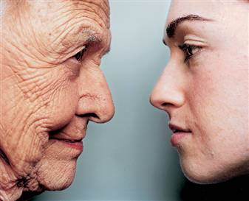
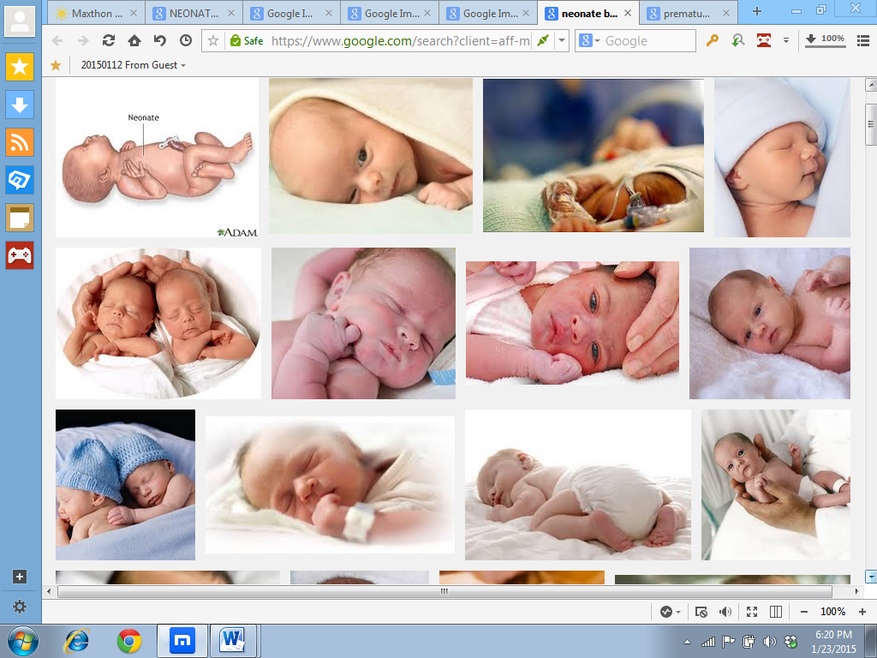
CHEMICAL PATHOLOGY OF THE NEONATE AND THE ELDERLY
DR. IDOGUN E.S
(CONSULTANT AND PROFESSOR OF CHEM PATH)
(MB.ChB, MSc(Pharm&Toxic), MWCP, FMCpath, MPH)
January, 2016
FACULTY OF
PATHOLOGY
UPDATE, ABUJA
03/02/2016

Slide 2
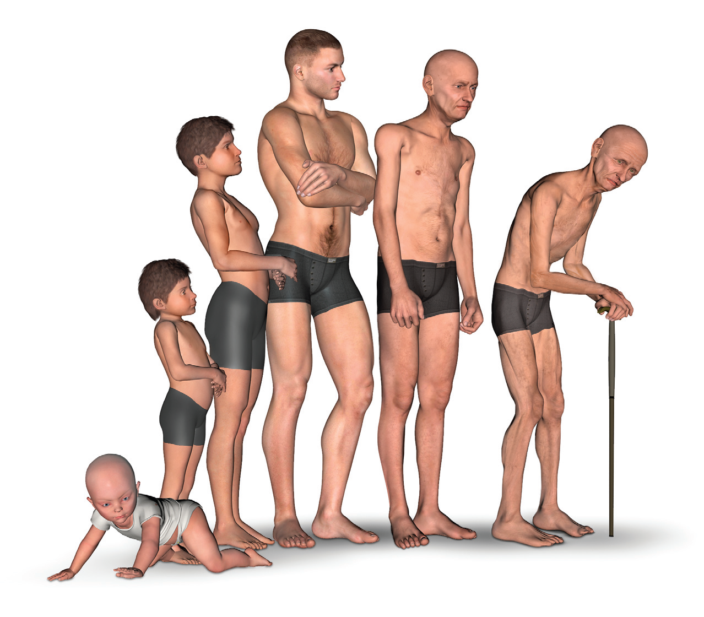
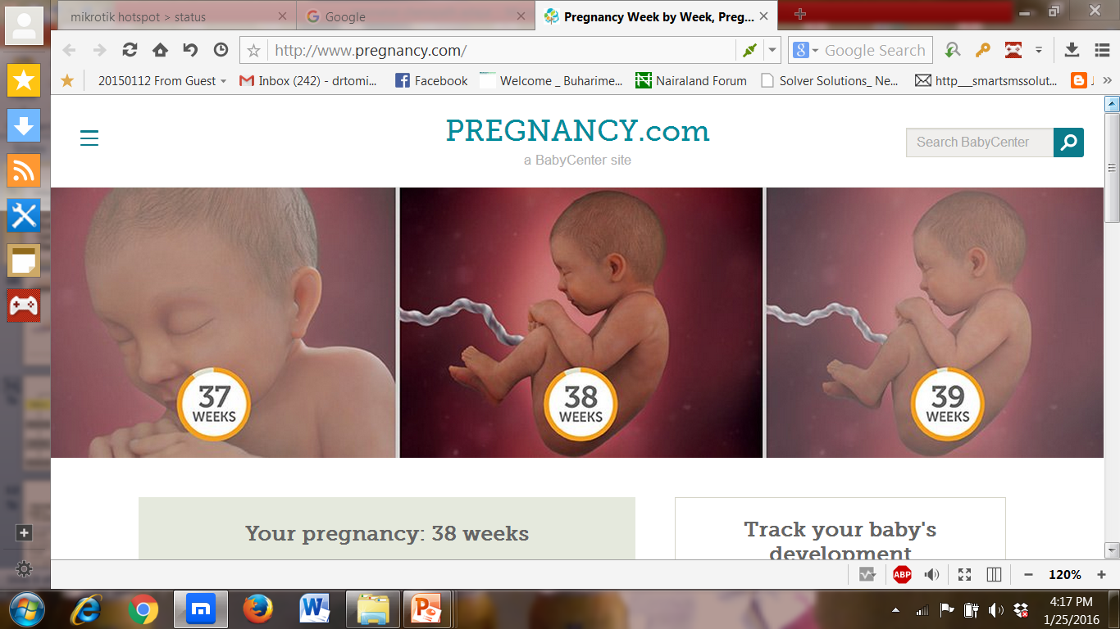
Notes:
http://lifescienceevents.com/online-conferences/ageing/

Slide 3
OBJECTIVES
To understand systemic adaptation of fetus to extrauterine life.
To point out major biochemical differences in common analytes between neonates/paediatric age group and adult.
To describe the theories of aging
To describe the biochemical changes in the elderly

Slide 4
OUTLINE
Definitions
Systemic adaptations to extrauterine life
Systemic changes in neonatal organ-systems[kidney,lungs,GIT,liver,thyroids,bone,immune system]
Neonatal common problems
Preanalytical concerns in investigation of neonates
The elderly
Theories of aging
Biochemical and Physiologic changes of aging
Clinical chemistry results and aging
References

Slide 5
NEONATES

Slide 6
Definitions
NEWBORN-The first 24 hrs of life
NEONATE-from birth to under four weeks(<28 days)
TERM NEONATE-between 37 to < 42 gestational week
PRETERM NEONATE-<37 gestational week
POST TERM NEONATE-> or equal to 42 gestational week
LOW BIRTH WEIGHT(LBW) <2500 GRAM irrespective of birth weight
VERY LOW BIRTH WEIGHT(VLBW) <150O GRAM
EXTREMELY LOW BIRTH WEIGHT(ELBW) < 1000 GRAM

Slide 7
DEFINITION OF TERMS
Ageing; To grow older
Elderly; People older than 65years
Geriatrics; Branch of health care concerned with the care of the aged
Gerontology; The study of the ageing process
Ageism; When older aldults are sterotyped

Slide 8
Senescence ; The decline of fitness. components of an individual with increasing age, owing to internal deterioration
Biogerontology; The study of the biology of ageing and longevity

Slide 9
INTRODUCTION
The demand on the health care system by geriatric patients is different from the rest of the population
As the population ages, increases in chronic disease are expected
This poses a challenge to the nation’s health care, social system and clinical laboratory

Slide 10
NEONATES
The newborn (neonatal) period begins at birth (regardless of gestational age) and includes the 1st month of life.
During this time, marked physiologic transitions occur in all organ systems, and the infant learns to respond to many forms of external stimuli.

Slide 11
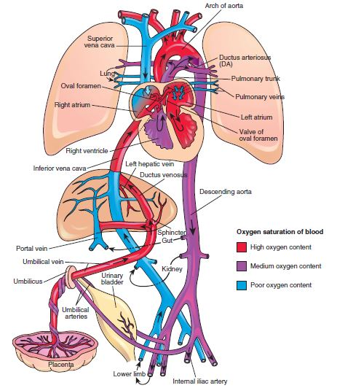
FOETAL
CIRCULATION
SUPERIOR VENA CAVA
RIGHT ATRIUM
RIGHT VENTRICLE
PULMONARY TRUNK
DUCTUS ARTERIOSUS
DESCENDING AORTA
UMBILICAL ARTERIES
PLACENTA

Slide 12
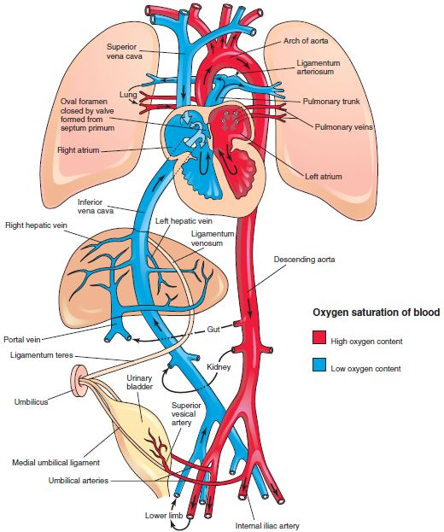
CIRCULATION
AFTER BIRTH
CHANGES OCCUR IN:
PULMONARY CIRCULATION
  (LUNGS FUNCTIONAL)
SYSTEMIC CIRCULATION
  (PLACENTA REMOVED)
… RESULTING IN CLOSURE OF:
FORAMEN OVALE
DUCTUS ARTERIOSUS
DUCTUS VENOSUS
FIG. #2

Slide 13
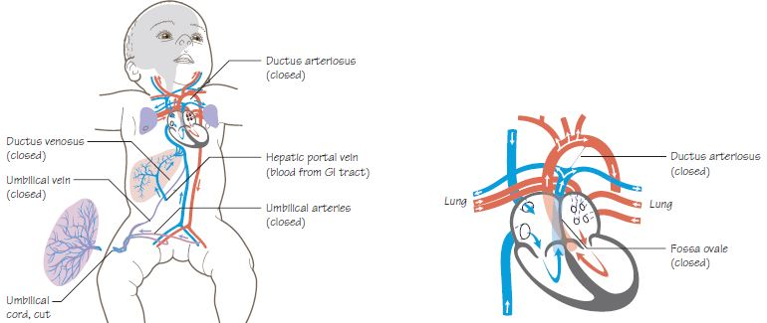
KEY FUNCTIONAL CHANGES AFTER BIRTH
5
4
2
1
3
1 & 2 – UMBILICAL CORD CLAMPED (CLOSURE OF UMBILICAL ARTERIES AND VEIN)
3 – FORAMEN OVALE CLOSED.
4 – DUCTUS ARTERIOSUS CLOSED.
5 – DUCTUS VENOSUS CLOSED.
FIG. #3

Slide 14
CONSTRICTION OF UMBILICAL VESSELS
REASON:
UMBILICAL CORD CUT TO DETACH NEONATE FROM PLACENTA ,
AS LUNGS ARE NOW FUNCTIONAL.
METHOD:
ARTERIES CONSTRICT INITIALLY;
REDUCES FOETAL BLOOD LOSS TO THE PLACENTA .
VEIN CONSTRICTS LATER;
NUTRIENT-RICH BLOOD FROM PLACENTA CAN STILL REACH INFANT AFTER BIRTH.
CONVERSION OF VEIN AND DISTAL PART OF ARTERIES TO FIBROUS LIGAMENTS .
PROXIMAL PARTS OF UMBILICAL ARTERIES PERSIST, SUPPLYING URINARY BLADDER.

Slide 15
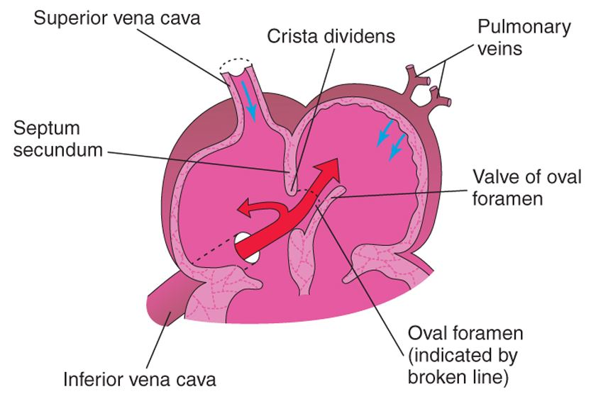
CLOSURE OF OVAL FORAMEN
(CONNECTS R. TO L. ATRIUM)
REASON:
PRESSURE DIFFERENTIALS BETWEEN LEFT
AND RIGHT ATRIUM REVERSE
(RIGHT: LOW//LEFT: HIGH)
BLOOD PREVENTED FROM FLOWING
LEFT TO RIGHT.
METHOD:
VALVE OF OVAL FORAMENT APPOSED WITH
SEPTUM SECUNDUM, CREATING FOSSA OVALIS.
*PATENT FORAMEN OVALE: (ASYMPTOMATIC)
ATRIAL SEPTAL DEFECT
FIG. #4

Slide 16
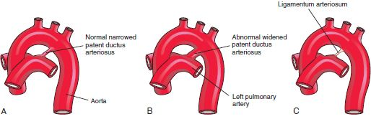
CLOSURE OF DUCTUS ARTERIOSUS
(CONNECTS PULMONARY A. TO AORTA)
REASON:
INCREASE IN SYSTEMIC PRESSURE ;
INCREASED PRESSURE IN LEFT SIDE OF HEART AND AORTA.
DECREASE IN PULMONARY RESISTANCE;
DECREASED PRESSURE IN PULMONARY ARTERIES.
BLOOD PREVENTED FROM FLOWING FROM AORTA TO PULMONARY TRUNK.
METHOD:
SMOOTH MUSCLE CONSTRICTION (INDUCED BY INCREASED OXYGEN TENSION, RELEASE OF BRADYKININ & REDUCTION IN CIRCULATING PROSTAGLANDINS)
* PATENT DUCTUS ARTERIOSUM: (SYMPTOMATIC)
DECREASED OXYGEN SATURATION OF AORTIC BLOOD.
FIG. #5

Slide 17
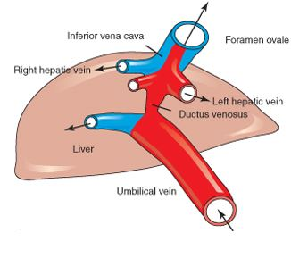
CLOSURE OF DUCTUS VENOSUS
(CONNECTS UMBILICAL V. TO INFERIOR VENA CAVA)
REASON:
FULL LIVER FUNCTION REQUIRED;
PREVENTION OF ITS BYPASS BY BLOOD.
METHOD:
CONTRACTION OF SPHINCTER NEAR
UMBILICAL VEIN
INCREASES PRESSURE IN PORTAL VEIN.
CONVERSION TO FIBROUS LIGAMENT.
* PORTOSYSTEMIC SHUNT: (SYMPTOMATIC)
FAILURE TO CLOSE,
BLOOD CONTINUES BYPASSING LIVER.
FIG. #6

Slide 18
STRUCTURAL CHANGES
(FOETAL: ADULT)
UMBILICAL ARTERIES:
DISTALLY: MEDIAL UMBILICAL LIGAMENTS
PROXIMALLY: SUPERIOR VESICULAR ARTERIES
UMBILICAL VEIN: LIGAMENTUM TERES HEPATIS
DUCTUS VENOSUM: LIGAMENTUM VENOSUM
FORAMEN OVALE: FOSSA OVALIS
DUCTUS ARTERIOSUS: LIGAMENTUM ARTERIOSUM

Slide 19
FOETAL & ADULT CIRCULATION
SHUNTS:
    DUCTUS VENOSUS
    DUCTUS ARTERIOSUS
    FORAMEN OVALE
  OXYGENATION:
  VIA PLACENTA
  PVR: HIGH
  SVR: LOW
  HEART: CHAMBERS PUMP IN PARALLEL,
  RIGHT SIDE DOMINANT.
(FOETAL)
(ADULT)
REMNANTS; NON-FUNCTIONAL.
OXYGENATION VIA LUNGS
LOW PVR
HIGH SVR
CHAMBERS PUMP IN SERIES,
LEFT SIDE DOMINANT.

Slide 20
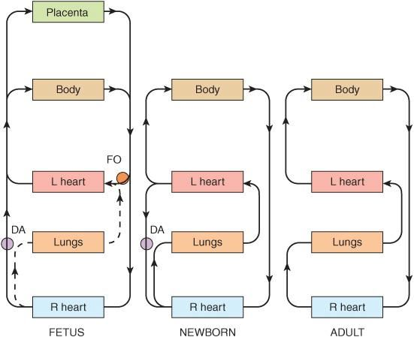
SUMMARY
Placental circulation provides foetus with oxygen and nutrients.
Pulmonary and systemic changes at birth lead to alterations in circulation in the neonate, enabling the infant to adjust to extra-uterine life.
Main changes include closure of the following, and eventual formation of their derivatives:
UMBILICAL VEIN (Lig. Teres Hepatis)
UMBILICAL ARTERIES (DISTAL: Medial Umbilical Ligaments, PROXIMAL: Superior Vesicular Arteries)
FORAMEN OVALE (Fossa Ovalis)
DUCTUS ARTERIOSUS (Lig. Arteriosum)
DUCTUS VENOSUS (Lig. Venosum)
FIG. #7

Slide 21
TRANSITION AT BIRTH
Successful transition from fetal to postnatal circulation requires:
clamping of umbilical cord and removal of the placenta
increased pulmonary blood flow,
Shunt closure

Slide 22
Physical Evaluation at birth
Assessment:
The initial assessment:
APGAR scoring system
Purpose:
is to assess the newborn´S immediate adjustment to extrauterine life

Slide 23
First extra uterine activities
Transitional assessment (Periods of reactivity):
I) First period of reactivity:
Stage 1: during the first 30 min. through which the baby is characterized as Physiologically unstable ( ), very alert, cries vigorously, may suck a fist greedily, & appears very interested in the environment.

Slide 24
Stage 2: it lasts for about 2-4 hours, through this period; all V.S & mucus production are decreased. The newborn is in state of sleep and relative calm.

Slide 25
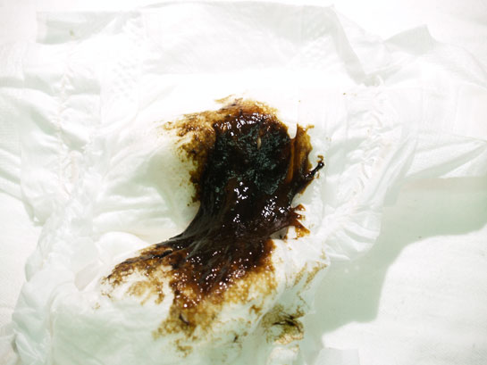
Passage of meconium

Slide 26
Adaptation to Extrauterine Life
Adaptation to Extrauterine Life
Cardiovascular:
Newborn must initiate respirations & sustain extrauterine oxygenation
When they are born, infants are forced to take in oxygen thru lungs.
Shunts are closed & vessels clot off & regress
Notes:
26

Slide 27
Respiratory Changes
What part do each of these factors play in initiation of respirations in the neonate?
Mechanical
Initiation
of
Breathing
Chemical
Sensory/ Thermal
Notes:
3

Slide 28
Changes at birth….mechanical
Compression of fluid from the fetal lung during delivery establishes the lung volume
Negative inspiratory pressures of up to 70-100 cm H2O are initially required to expand the alveoli which facilitate lung expansion by overcoming:
Airways resistance
Inertia of fluid in the airways
Surface tension of the air/fluid interface in the alveolus
As the chest passes
through the birth canal
the lungs are compressed
Subsequent recoil of the chest wall produces passive inspiration of air into the lungs

Slide 29
Chemical Events
1. With cutting of the cord, remove oxygen supply
2. Asphyxia occurs
3. CO₂ and O₂ and pH = ACIDOSIS
4. Acidotic state-- stimulates the respiratory center in the medulla and the chemoreceptors in carotid artery to
initiate breathing
Notes:
4

Slide 30
Sensory / Thermal Events
Thermal--the decrease in
environmental temperature after
delivery is a major stimulus of breathing
Tactile--nerve endings in the skin
are stimulated
Visual--change from a dark world to
one of light
Auditory--sound in the extrauterine
environment stimulates the infant
Notes:
7

Slide 31
Respiratory:
First breath also in response to temperature & pressure changes, light & noise.
    1st breath requires great amt.of pressure; 40-70 cm H2O. Small amt of fluid present in lungs.
    1/3 rd of this fluid forced out by pressure of vaginal birth; rest absorbed by lung tissue. C/S infants may need more suctioning & oxygen therapy.

Slide 32
Renal
EXCRETORY FUNCTION
1 million nephrons is present by 34 weeks ’gestation.
The glomeruli and nephrons are immature at birth
Low GFR and limited concentrating ability.
Susceptible to both dehydration and volume overload
Lack of renal medulla osmotic gradient and absence of medullary tubules limit urinary concentrating ability, half that of the adult (1200-1400 mOsm/kg)
Glycosuria and aminoaciduria are commonly detected because of immature active transport pumps in the proximal tubule.
ENDOCRINOLOGY
Renal immaturity affects vitamin D formation and calcium homeostasis.
The fetus and neonate have a high calcium and phosphate requirement for bone formation and growth.

Slide 33
RENAL FUNCTION
Full compliment of the nephron at 36th week but renal functions develop fully at 2years.
Fetal urine is produced at 9th week but first urine is voided within few hrs of birth.
Glomerular function develops more rapidly than tubular function.
Urea conc is low in the newborn despite the relatively low GFR as more nitrogen is used in anabolic processes rather that urea synthesis.

Slide 34
Renals
Plasma urea conc fluctuates with nutritional states, metabolic rate and the state of hydration.
Plasma creatinine at birth is similar to the mother. It decreases rapidly at first to approx 35μmol/l (slower in preterm) and then rise gradually until the adult level is reached later in life.
Renal dysfunction in neonates can be due to hypotension,birth asphyxia, renotoxic drugs,renal agenesis,septicemia,dehydration etc..

Slide 35
Gastrointestinal:
GI tract is sterile @ birth; bacteria enters GI tract thru the mouth within 24 hrs.of life. Bacteria needed for prod. Vit.K
Infant: limited ability to digest fats & starches
The GIT flora are important in bilirubin metabolism
Meconium passed 1st 24-48 hrs. of life
By 2nd - 3rd day, transitional stool passed

Slide 36
Body Fat and Temperature Control
Brown fat : helps conserve body heat; produces heat.
Found in upper chest, back of neck, around abdomen.
Is deposited in 2nd trimester; Helps regulate body temp>delivery.
Radiant warmer - helps regulates body temp. by conservaing heat.
Newborns can produce sufficient heat in optimal thermal
Environment if warm enough.
Rapid heat loss occurs in suboptimal environment [cooler].
Infants do not shiver; can go into cold stress quickly.
Uses up extra glucose & oxygen to thermoregulate.
Cold can leads to:
metabolic acidosis; respiratory distress
Hypoglycemia; Jaundice; decreased surfactant production

Slide 37
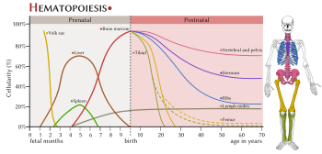
Haematology
NB blood contains both adult (HbA)
and fetal haemoglobin at birth
HbF
70-80% up to 90% in preterm
Four globin chains alpha2 and delta2
Greater affinity for oxygen and helps maintain the molecular structure and function in a more acidic environment
Facilitates oxygen transfer across the placenta from maternal HbA.
Replaced with HbA at approximately 6 month of age.

Slide 38
BODY FLUID COMPOSITION
75% of TBW,80-85% IN PRETERM
Reduced to 60-65% BY one year
ECF:ICF IS 2:1,
The diuresis reduces the extracellular water (30% of TBW) and ICF increases due to growth of cells-
reaches adult value by 1 yr
Blood volume
Full term-85 ml /kg
Preterm90-100 ml /kg(50 ml/kg is plasma)

Slide 39
WATER HOMEOSTASIS IN NEONATES
80% of the weight of the neonates consists of water as against 60% in adults.
At birth , there is more water in the extracellular compartments than intracellular space.
At 1st week,the ECF contracts , hence the reduction in weight during this period.
Renal concentrating capacity is reduced in the newborn and increases during the first 2 years with maximum Urine osm=500-700mosm/kg even after exogenous ADH

Slide 40
WATER
Countercurrent mech is inefficient because loops do not penetrate deeply into the medulla as found in adult and the low rate of urea production.
The ratio of body surface area to body volume is high hence increased insensible water loss through the skin as the epidermis is not fully developed,little subcut fat,high metabolic and respiratory rates.
Other factors: phototherapy, radiant baby warmer.

Slide 41
SODIUM HOMEOSTASIS
Total body Na in a 1 kg newborn=100mmol/L , adult=3000mmol/L
Daily requirement: Preterm=6mmol/kg,full-term infant=2-4mmol/kg. Adults=1.5mmol/kg
In preterm infants renin, aldosterone and angiotensin II are HIGH. However, renal conservation of Na is inefficient because of immature renal tubular functions.

Slide 42
Sodium
Total body Na and plasma sodium may fluctuate because the tubules are immature.
Common causes of hyponatremia in neonates:prolong maternal infusion of oxytocin,inappropriate ADH secretion, infusion of water in excess of sodium, acute renal disease, diuretic treatment, CAH, adrenal insuff, hypothyroidism,cystic fibrosis……..
Presenting as hypotension, drowsiness and convulsion.

Slide 43
Sodium
Predominant water depletion from insensible water loss and impaired urinary water retention from immature renal tubules cause hypernatremia.
This is also aggravated by hyperventilation, diarrhoea and vomiting.
Other causes of hypernatremia in neonates are sodium bicarbonate infusion and excess salt, rarely by nephrogenic DI.

Slide 44
Potassium
Same requirement as that of Na
Artefactual causes of abnormal K+ conc must be excluded.
Reduced K+: diarrhoea,alkalosis,pyloric stenosis, RTA 1&2, diuretic use.
Elevated K+:iathrogenic,AKI,EBT, Tissue damage[bruising/hematoma],CAH,

Slide 45
Neonatal lung functions & Acid base balance
Fetal lung fluid production stops at birth as a result of increased adrenaline during delivery.
Labour squeezes fluid from the mouth and the remaining fluid is absorbed via pulmonary lymphatics and capillaries.
Type 2 pneumocytes produce surfactant which reduces lung surface tension thus helping lung expansion.

Slide 46
Lungs
Neonatal pO2=8-11kPa
Plasma bicarbonate is usually 3mmol/l lower in newborn infants than adults as a result of renal immaturity and low conc of urinary buffer thus impairing bicarbonate reabsorption and regeneration.
This shld be interpreted with caution as bicarbonate will be artefactually low in very small samples.

Slide 47
Metabolic acidosis in neonates
Renal dysfunction,lactic acidosis( tissue hypoxia,IEM like G6Ptase def) inborn error of aa or organic acids
Congenital heart dx and PDA
Acute blood loss.

Slide 48
Respiratory acidosis in neonates
Commonest cause is RDS. Others include pneumonia, meconium aspiration during birth.
RDS occurs due to immaturity of the enzymes responsible for the synthesis of pulmonary surfactants. Synthesis begins at 20th wk and increases rapidly after 34th wk.
Surfactant deficiency is common among male infants, infants of DM mothers , those with asphyxia and hypothermia.

Slide 49
Respiratory alkalosis in neonates
Commonly caused by septicaemia,meningitis, hyperammonaemia and hepatic failure.

Slide 50
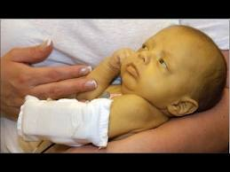
Hepatic
Most enzymatic pathways are:
inactive at birth
become fully active at 3 months
Albumin level low-more free drug in circulation
Risk of hypoglycemia-low glycogen stores and decreased synthetic function
UNCONJUGATED HYPERBILIRUBINEMIA
Unconjugated bilirubin levels rise during the first 48 hours
Rapid breakdown of HbF
Poor conjugating abilities of the immature liver.
Exacerbated in presence of haemolysis, sepsis, dehydration or excessive bruising;
Can cross the blood brain barrier
Kernicterus and subsequent developmental delay.
Bilirubin levels gradually fall over the first 2weeks,
Jaundice in term infants being rare beyond this period

Slide 51
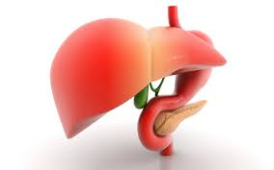
Neonatal liver functions.
The GIT begins to function as from 26th wk.
Plasma transaminase activities are up to twice the upper limit of the adult reference interval during the first 3months of life and fall to the adult level at about 1 yr.

Slide 52
BILIRUBIN METABOLISM
More unconjugated bilirubin reaches the liver in the new born infants than adults due to:
Delayed cord clamping,bruises during childbirth,shorter red cell half life.
Physiological jaundice is a mild jaundice which is not present at birth but develops during the first few days and continues during the first 10days of life for which there is no pathological reasons.
Occurs in about 50% of normal babies within 48hrs.
Tbil may be >200μmol/l with Dbil˂40.

Slide 53
Bilirubin Met (cont)
Physiol jaundice is aggravated by prematurity, infection,dehydration,hypoxia, poor nutrition etc.
If bilirubin concentration exceeds albumin-binding capacity,the unbound fat soluble unconjug bil crosses the cell membrane and deposited in the brain causing kernicterus.
Risk factors for kernicterus=prematurity,high unconj bil,hypoalbuminemia,drugs,acidosis…….

Slide 54
Causes of Jaundice during the first 24hrs of birth
Maternofetal rhesus or ABO incompatibility
Inherited erythrocyte abnormality
Intrauterine infections

Slide 55
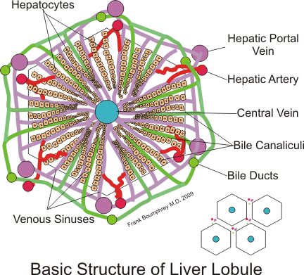
Causes of Conjugated hyperbilirubinemia
Congenital biliary atresia (Byler’s dx)
Biliary obstruction,TPN,alpha1 antitrypsin def, tyrosinemia, galactosemia, CF, hepatitis, Dubin-Johnson synd

Slide 56
Glucose metabolism in Neonates
Hypoglycemia is common
Hepatic glycogen stores increases 3x and adipose tissue is laid down during the last 10weeks of pregnancy.
Causes of neonatal hypoglycemia:SGA baby, prematurity,birth asphyxia, sepsis,poor nutrition, hypothermia,congenital heart dx.
GSD Type 1,organic acidemias, ddrs of :fatty oxidation,gluconeogenesis,amino acid,leucine sensitivity

Slide 57
Other causes of hypoglycemia
Neonates born by DM mothers , nesidioblastosis[islet cell hyperplasia],insulinoma,erythroblastosis fetalis
Hypothyroidism,hypopituitarism,adrenal insuff,CAH

Slide 58
NEONATAL CALCIUM/PHOSPHATE METABOLISM
Fetal plasma calcium is higher than that of the mother due to active calcium transport across the placenta.
The relatively high calcium suppresses PTH , hence a transient hypoparathyroidism at birth but spontaneously regain adult concentration on the 3rd day of birth.
Plasma phosphate conc is higher in actively growing infants and children, just as ALP

Slide 59
Plasma proteins
At birth, TP is 1.2g/dl lower than the adult TP. This reaches the adult value at 6 months.
IgG is transferred through the placental but degraded after birth.
Adult concentrations of IgM, IgG, and IgA are reached at 9months,3-5yrs , and 15yrs respectively.
Elevated IgM from cord blood or within the 1st month indicates intrauterine of neonatal infection

Slide 60
Ammonia
This should be ˂100μmol/L in neonates and infants, and ˂200μmol/L in preterm.
Common causes of hyperammonemia:sepsis,ccf,valproate treatment,urea cycle ddrs,acute hepatic failure
Clinical feature=seizures,coma,lethargy, resp alkalosis.

Slide 61
Neonatal thyroid metabolism
TSH increases immediately after birth in response to stress……. About 15x the adult value. This peaks after the first hour and drops after a week.
T4 peaks within the first 24-48hr and then fall gradually..
Screening for congenital hypothyroidism should be delayed for about a week after birth to allow TSH stabilizes.
TSH may not increase in preterm babies after birth and thus give false negative result………repeat test at 40wks.

Slide 62
Immunologic Adaptation
Active acquired immunity
  Pregnant woman forms antibodies herself
Passive acquired immunity
  Mum passes antibodies to the fetus
  Lasts for 4-8 months
  Newborn begins to produce own immunity about 4 weeks of age

Slide 63
.
IMMUNOLOGIC:
Newborn still prone to infection, handwashing important!
IgG: Infant born with passive immunity from mom. Fetus makes own starting @ 20 wks
IgM too large to cross; makes own after delivery.
IgA do not cross placenta. Produced by infant after birth @ 6-12 wks. Found in breast milk.

Slide 64
EXPECTED VALUES RELATIVE TO THE ADULTS
ELECTROLYTES
METABOLITES
PLASMA PROTEINS
ENZYMES &MARKERS OF TISSUE TURNOVER
NUTRIENTS
HORMONES

Slide 65
SIMILAR MEDIAN ADULT AND NEONATAL NORMAL VALUES
ELECTROLYTES:Na,K, Cl,Total CO2, Ca,Mg,Osm,pCO2,pH,
METAB:Ammonia,lactate,uric acid
PLASMA PROT:Alpha 1 antitrypsin, apoA,apoB,IgG
ENZ&MARKERS:ALT,lipase
NUTRIENTS:FE,Zn
HORMONES:DHEA,DHEA-S,Gastrin, 11-Deoxycortisol

Slide 66
NEONATAL VALUES HIGHER THAN ADULTS
ELECTROLYTES:Phosphate
METAB:bilirubin
PLASMA PROT:AFP, cystatin-C, CRP
ENZ&MARKERS:ALP,AST,CPK,GGT,LD,Cardiac troponin
NUTRIENTS:
HORMONES:Aldosterone,oestradiol,17-OH progesterone, Prolactin, Renin,TSH, free T4

Slide 67
NEONATAL VALUES LOWER THAN ADULTS
ELECTROLYTES:base excess
METAB:carnitine,creatinine,glucose, urea
PLASMA PROT:albumin,caeruloplasmin, haptoglobin, compliments C3,C4,IgA, IgM, Prealbumin,RBP, Total protein, transferrin,
ENZ&MARKERS: Amylase
NUTRIENTS:cholesterol,Cu, Se, triglycerides,Vitamins A, E,25-OH vitamin D
HORMONES:Cortisol,IGF-1,PTH,Androgen

Slide 68
ANALYTES WHERE AGE-RELATED REFERENCE INTERVALS MUST BE CONSIDERED [Bolarin,2001]
ANALYTES | COMMENTS
ALBUMIN | LOW IN NEWBORN
PLASMA PROTEIN | LOW……DUE TO DEFICIENT LIVER FUNCTION, Attains adult level @ puberty
Ammonia | Higher in infants due to incomplete liver circulation, OTC Def, hyperalimentation
ALP | Increases in children due to bone growth
bilirubin | Increased due to poor liver fxn
cortisol | No diurnal variation in the newborn

Slide 69
Analytes | Comments
DRUGS | in neonates due to immature metabolic pathways
PLASMA ENZYME | in newborn eg CK,GGT,AST,ALT,….but decreases during childhood to adult levels at puberty or earlier
CREATININE | At birth, its similar to the mother.
freeT3 | in paediatric subjects,to assume adult level in late adolescence
FSH GLUCOSE | Adult level is seen at puberty in newborn.Adult level is seen when baby is 1 month

Slide 70
Analytes | Comments
IGF | Changes with age throughout life
TSH | Increases in newborn due to stress of birth, attains adult level @ 1month
Mg2+ | Decreases in newborn esp in premature
Urine catecholamine | Varies with age until adulthood
Urea | Decreases in newborn. Urea:Creatinine ratio=15:1 to 24:1
Phosphate Sodium Uric acid | Increases in actively growing infants and childhood Same reference as in adult bot not well controlled Increases at birth,but decreases until adolescence

Slide 71
Preanalytical concerns in investigation of the neonates.
Small amount of sample can be taken without causing volume depletion and anaemia
Contamination by interstitial fluid and cellular debris when capillary blood is used.
Difficult interpretation results.
Application of continuous pressure on capillary area increased K⁺,Mg^{2+,}HPO4³⁻,LDH
Minute volume is affected by light,heat, and pollution. HCO3⁻ decreases.
Timed urine collection is strenuous in neonates.

Slide 72
Analytical and Postanalytical concerns
Capillary blood clot coats electrodes with proteins, alters analytes and increases maintenance costs.
Interferences from by fetal adrenal steroids up to 40wks of conception
Establishment of accurate reference intervals…..a problem in paediatric chem pathology.

Slide 73
.
THE ELDERLY

Slide 74
Older Adult
Young Old 65-74
Middle Old 75-84
Old Old 85 & older
Presently: 12.8% of population
2030: will increase to 20% of population
Notes:
In our society senior citizen are 65 or older…depends
Personally…as old as you feel.

Slide 75
Theories of Aging
Most experts believe that a combination of genetic and stochastic (random) events are responsible for aging.
Stochastic: Explain aging as events that occur randomly and accumulate over time
Nonstochastic: View aging as certain predetermined, timed phenomena

Slide 76
Stochastic Theories
Error Theory
Free Radical Theory
Cross-Linkage Theory
Wear & Tear Theory

Slide 77
1. Error Theory
Originally proposed in 1963
Basis:
  1)errors can occur in the transcription in any step of the protein synthesis of DNA
  2) error causes the reproduction of an enzyme or protein that is not an exact copy
  3) As transcription errors to occur, the end product would not even resemble the original cell, thereby compromising its functional ability

Slide 78
2. Free Radical Theory
Free radicals are byproducts of metabolism--can increase as a result of environmental pollutants.
When they accumulate, they damage cell membrane, decreasing its efficiency.
The body produces antioxidants that scavenge the free radicals.

Slide 79
In animal studies, administration of antioxidants postpones the appearance of diseases such as cardiovascular disease and CA
Free radicals are also implicated in the development of plaques associated with Alzheimer’s

Slide 80
3. Cross-Linkage Theory
Some proteins in the body become cross-linked, thereby not allowing for normal metabolic activities
Waste products accumulate
Result: tissues do not function at optimal efficiency

Slide 81
4. Wear and Tear Theory
Proposed first in 1882
Cells simply wear out over time because of continued use--rather like a machine

Slide 82
Nonstochastic Theories:
Programmed Theory
Immunity Theory

Slide 83
Programmed (Hayflick Limit) Theory
Based on lab experiments on fetal fibroblastic cells and their reproductive capabilities.
Cells can only reproduce themselves a limited number of times.
Life expectancies are seen as preprogrammed within a species-specific range

Slide 84
Telomeric Theory
This is an extension of the “Hayflick Limit.”
Telomeres are specialized DNA sequences at the end of chromosomes.
  They shorten with each cell division.
  When the telomeres become too short, the cell enters the senescence stage
In the normal process of DNA replication, the end of the chromosome is not copied exactly, which leaves an unreplicated gap.

Slide 85

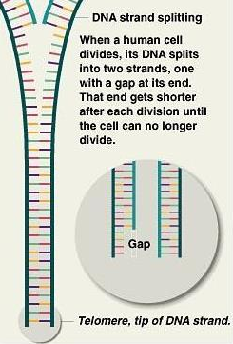

Slide 86
Telomeric Theory
The enzyme, telomerase, fills the gap by attaching bases to the end of the chromosomes.
As long as the cells have enough telomerase to do the job, they keep the telomeres long enough to prevent any important information from being lost as they go through each replication.
  With time, telomerase levels decrease.
  With decreasing telomerase levels, the telomeres become shorter and shorter.

Slide 87
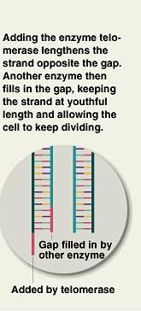

Slide 88
Telomeric Theory and Cancer
90% of cancer cells have been found to possess telomerase.
  Telomerase prevents the telomere from shortening.
  This allows the cancer cells to reproduce, resulting in tumor growth.
Research areas
  Measuring telomerase may help detect cancer.
  Stopping telomerase may fight cancer by causing death of cancer cells.
  Telomerase may be used to help with wound healing or the immune response.

Slide 89
Immunologic Theory
A programmed decline in the immune system leads to an increased vulnerability to disease, aging and death
Example- Decreased T cells (helper cells) in adults
  Increased diseases in older adults
  Increased autoimmune diseases in adults

Slide 90
Biochemical and physiological changes in the elderly

Slide 91
General Physiological Changes
All systems decline in overall functioning
Decreased physiological reserves , and the rate of decline depend on factors such nutrition , lifestyle and hereditary
Notes:
Physiological reserves- illness…stress…risk for complex reactions…increased chance of complications..

Slide 92
There is an age associated decrease in
Total body water
Muscle mass
Bone mass with osteoporosis
Respiratory function
Cardiovascular function
Renals
Liver
Gastrointestinal
Immune
Neurologic
Endocrine system function

Slide 93
There is an increase in lipids
Total cholesterol
HDL Cholesterol
Triglycerides

Slide 94
Differentiating between age associated decline and pathologic conditions may be difficult in the elderly patient because disease presentation may be atypical with non specific complaints and no classic signs.

Slide 95
Diseases and disorders commonly associated with ageing
Atherosclerosis eg Myocardiac Infaction, Renal disease, stroke
Cancer
Diabetes mellitus
Hyperparathyroidism
Hyperthyroidism
Hypothyroidism
Monoclonal gammopathies eg multiple myeloma.
Osteoporosis

Slide 96
Ten top leading cause of death in the elderly
Heart disease
Cancer
Stroke
Chronic Lower respiratory disease
Accidental death due to unintentional injury
Diabetes
Alzeheimer’s disease
Influenza or pneumonia
Nephritis, nephrotic syndrome, or nephrosis
Septicemia

Slide 97
Cardiovascular and lipid changes in the elderly
Cardiovascular disease is an important cause of death in the elderly
Atherosclerosis is the major cause of death from cardiovascular disease.
Fatty accumulation in the vascular wall and this increases with age
Results of atherosclerosis include hypertension , hemorrhage, thrombosis, stroke, and coronary heart disease ( Ischaemic heart disease)

Slide 98
Pulmonary function and Electrolyte changes
Pulmonary function declines during the ageing process as a result of changes in the lungs, thoracic cage, respiratory muscle, and respiratory centres in the CNS
Pulmonary function is more affected by personal habits ( smoking and environmental pollutant)

Slide 99
Decreased vital (lungs ) capacity in most elderly
decrease PO₂ , increase PCO₂ . Increase bicarbonate will compensate for the increase PCO₂ and maintain the blood pH value
Blood pH value remains fairly constant or decrease slightly
Sodium remain fairly constant
Chloride remain fairly constant with slight increases in people older than 90
Potassium increase slightly from age 60 to 90

Slide 100
Respiratory related disease are prevalent in elderly people and account for 25% of deaths in those older than 85years
These include chronic bronchitis, chronic obstructive pulmonary disease, neoplasm, and lungs infections particularly tuberculosis and pneumonia

Slide 101
Hepatic function changes
Atrophy and decreased liver weight as well as liver fxn( synthetic, excretory and secretory, detoxification and drug metabolism) are common in the elderly
Tiets et al reported a slight decrease of total protein in fit ageing people
Albumin and transferrin show a decline as well
The existence of malnutrition , alchoholic liver disease, depression and poor nutrient intake in the ambulatory elderly population cannot be discounted

Slide 102
Type 2 DM associated with non alchoholic steatosis and steatohepatitis ( fatty liver) which will lead to decreased albumin and transferrin and increased alkaline phosphatase
δ globulins and α1 antitrypsin, increases slightly with age
Haptoglobulin remains essentially the same as in the young aldult
Immunoglobulins are decreased
Urea synthesis reduces
Bilirubin metabolism declines with age
Atrophy of the liver as well as reduction in hepatic blood flow occurs in the ageing process
This in turn may lead to the accumulation of some drugs and possibility of toxicity

Slide 103
Renal function changes
Renal function begins to decline after the age of 30 and by 60years its further reduced to one half.
This decline is due to gradual loss of nephrons , decreased enzymatic and metabolic activity of tubular cells and increased incidence of pathologic processs( atherosclerosis)
Creatinine clearance, GFR, and renal plasma flow all decrease with age
BUN, Uric acid and Inorganic phosphate are found to increase

Slide 104
Decreased capacity to conserve water through the kidney and a significant lower sensation of thirst leading to dehydration which account for an increased mortality rate in the elderly.
Hypernatremia
Increased BUN/ Creatinine ratio
Increased serum osmolality
Increased urine specific gravity

Slide 105
Increased incidence of renal disease
Reduced ability to handle the excretion of drugs

Slide 106
Diabetes Mellitus
Glucose tolerance declines with age, with elderly people having a slightly higher fasting serum glucose level than younger adult

Slide 107
Bone disease
Osteoporosis
Gradual loss of bone mass
Microfractures and pain
Normal serum calcium, phoshorus, magnesium, alkaline phoshatase, parathyroid and thyroid hormones
Risk factors include Inactive lifestyle, diet, genetic predisposition, endocrine disturbances, smoking and medications
It’s a significant problem among the elderly resulting in increased morbidity and health care cost

Slide 108
Endocrine function changes
Thyroid gland ; Increased fibrosis and nodularity of the gland.
Both hyper and hypothyroidism are common in the elderly
Pancrease ; Atrophy and an increased incidence of tumors
Hypothalamus-anterior pituitary and adrenal glands exhibit no change in cortisol production , but decline with age in both aldosterone and DHEA
Gonadal disorders ; Decrease in the gonadal production of estrogens in women ( menopause) and of testosterone in male (andropause)

Slide 109
GENERAL AGE-RELATED CHANGE
The pituitary gland begins to atrophy after middle age but show no decrease in growth hormones secreting cells or prolactin secreting cells

Slide 110
Growth Hormone
Decline about 50% of level early adulthood by age 65

Slide 111
Thyroid
Infiltration of lymphocytes and decrease in glandular cells.
Associated in part with autoimmune destruction of the gland
Antithyroglobin antibodies
Nodularity thyroid (postmortem : 27%)
Hypothyroidism accurs in 3% to 4% elderly
Hyperthyroidism 1%
More common in woman
Difficult to diagnosis (symptoms cause of other factors
Iodine uptake little change
Drug interaction → distort thyroid function tests

Slide 112
Adrenal Cortex
Cortisol decline by 25% in elderly
But Plasma cortisol level are unchanged
Because Renal clearance of cortisol are diminished
Progesterone – aldosterone : decrease with age
Affect attitudes, behavior and related physical factors
Renin-aldosterone mechanism also decline with age

Slide 113
Adrenal Medulla
The adrenal medulla may increase its catecholamine and norepinephrine production in elderly subjects, but the cardiovascular response to norepinephrine may decline. Nerve ending production of norepinephrine may decline in some patients, producing a delayed blood pressure response to moving to an upright posture (orthostatic hypotension).

Slide 114
Pancreas
The islets Langerhans show little age-related change
Substantial decline in glucose tolerance
Caused by decreased islets response to high blood glucose
In adequate insulin production
Decreased cell membrane responsiveness to insulin
Increased insulin level in response to oral glucose (in some affected elderly)

Slide 115
Diabetes mellitus and thyroid dysfunction are two most important general categories of endocrine/metabolic disorders in the elderly.
They are followed by the consequences of menopause in women, hypocalcemia and hyperphosphataemia (either dietary-absorptive or parathyroid in origin),
electrolyte problems related to adrenal or renal changes, maglinancy-generated imbalances, and drug-related endocrine problems.
One researcher has observed that there is likely to be, on average, at least one endocrine related problem in each new elderly patient.

Slide 116
Endocrine Disorders Associated with
Advanced age
Diabetes Mellitus
Thyrotoxicosis
Hypothyroidism
Cushing’s Disease
Addison’s Disease

Slide 117
ANDROPAUSE :
The aging of reproductive system
Sexual activity among elderly people
Disease and condition associated with advancing age :
  Impotence
  Gynecomastia
  Adenocarcinoma
  Hypertrophy of the prostate
  Testicular cancer

Slide 118
EFFECT OF CHANGES
Overall, some hormones are decreased, some unchanged, and some increased with age.
Increased:
Hormones that are usually decreased include:
Aldosterone
Calcitonin
Growth hormone
Renin
In women, estrogen and prolactin levels usually decrease.

Slide 119
EFFECT OF CHANGES
Hormones that remain
unchanged or only slightly decreased include:
Cortisol
Epinephrine
Insulin
Parathyroid hormone
Thyroid hormones T3 and T4
25-hydroxyvitamin D
Testosterone levels usually decrease slightly as men age.

Slide 120
EFFECT OF CHANGES
Hormones that may
increased include:
Follicle-stimulating hormone (FSH)
Luteinizing hormone (LH)
Norepinephrine

Slide 121
Cognitive Changes –
Confusion
Alzheimer’s disease
The 3 D’s:
1. Dementia Severe cognitive loss & memory loss
2. Depression
3. Delirium
Notes:
Alzheimer’s patchy area’s of the brain degenerate
Sundowning confusing after dark

Slide 122
Enzyme Changes
Enzyme concentration and synthesis are under genetic control
They do not follow any particular age related pattern
They may increase, decrease or remain the same during the ageing process

Slide 123
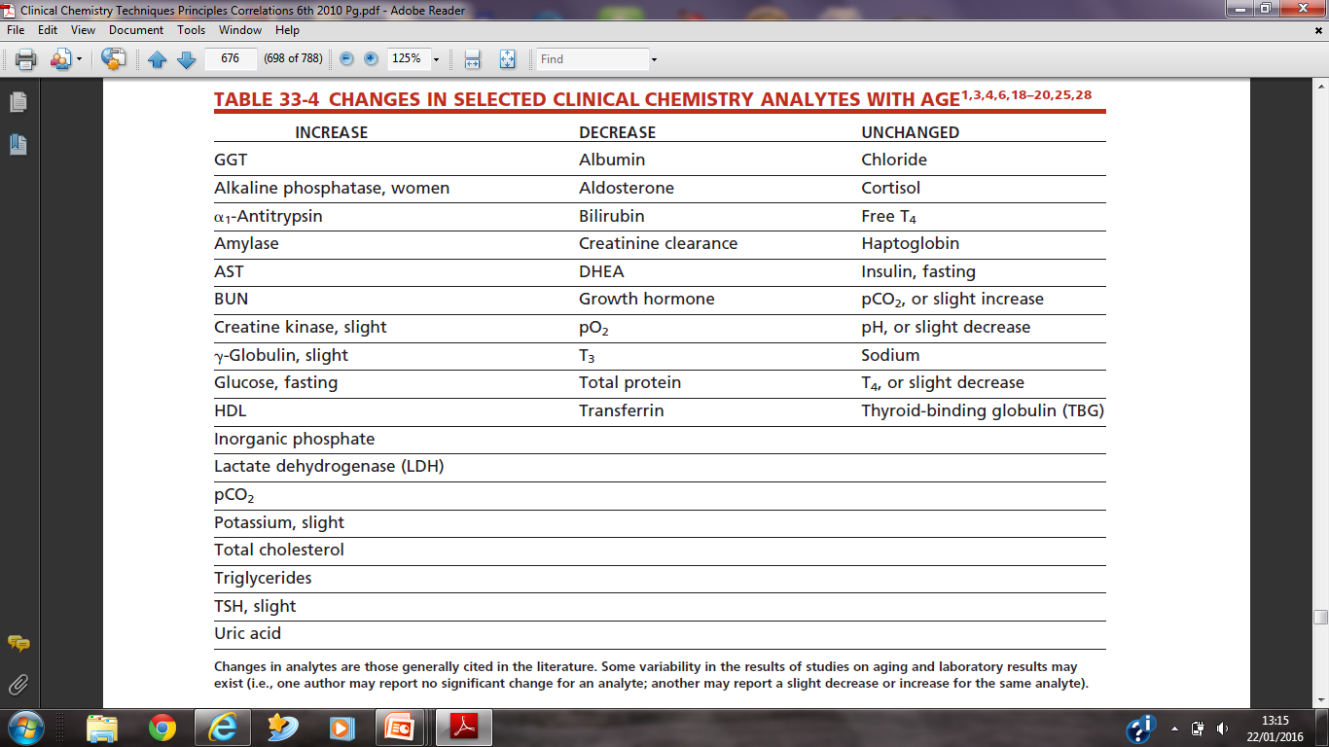

Slide 124
Clinical chemistry result and ageing
Reference intervals should be established for the elderly
Therapeutic drug monitoring is important in the elderly

Slide 125
WE SHALL ALL GET THERE!
OUR POPULATION IS AGING, MEANING THAT THE POPULATION OF AGED PEOPLE WILL CONTINUE TO INCREASE.
THEY NEED YOUR CARE, THEY NEED MY CARE AND THEY NEED OUR COLLECTIVE CARE.
LETS BE AVAILABLE FOR THEM, SAVE THEM TO SAVE OURSELVES BECAUSE AGING IS INEVITABLE.

Slide 126
REFERENCES
Martin A. Crook.2006. Clinical Biochemistry at the extremes of ages. In Clinical chemistry and metabolic medicine.7th ed, Pp366 to 367.
Michael L, Bishop, Edward P. Fody, Larry E. Schoeff. 2010, Clinical Chemistry and the Geriatric Patient. In Clinical Chemistry. Techniques principles, Correlations. 6th ed, Pp 673 to 683

Slide 127
Delany M.P, Price C.P, Newman D.J, Lamb E. Kidney function tests.Tietz Textbook of Clinical Chemistry and Molecular Diagnostics: 4thEd;Pg 818-826.

Slide 128
THANK YOU

