Slide 1
CHEMICAL PATHOLOGY OF THE LIVER
DR ADAJA MATTHEW TOMISIN.
[B.Sc, MBBS, MWACP, FMCPath]
CONSULTANT CHEMICAL PATHOLOGIST
DEPT OF CHEMICAL PATHOLOGY
UNIMED

Slide 2
OUTLINE
Introduction
Anatomy and physiology of the liver
Liver function test
Biochemical derangements in liver diseases
Conclusion .

Slide 3
INTRODUCTION
Liver is the largest Organ of the body weighing about 1.5kg.
The liver has essential synthetic and excretory functions and can be thought of as a large ‘metabolic factory’. It also detoxifies and, like the kidneys, excretes the end products of metabolism.

Slide 4
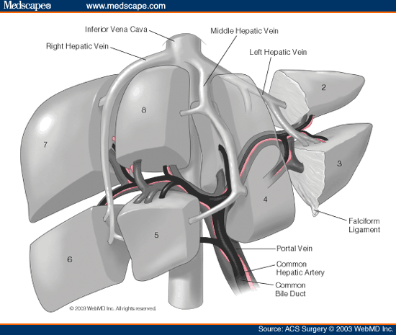
Anatomy of liver

Slide 5
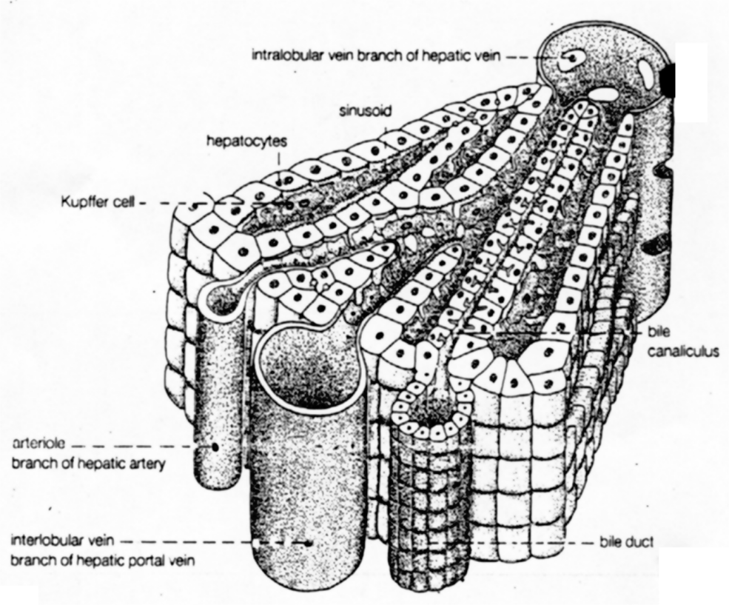

Slide 6
HEPATIC LOBULE

Slide 7
The Function of Liver
Liver is largest and most complex internal organ
All blood flow fm intestine and pancreas reaches liver via portal venous system
Liver is a multifunctional organ that is involved in diverse body functions.
Metabolic Functions
Liver actively participates in carbohydrate metabolism, lipid, protein, mineral and vitamin metabolisms.
Excretory Functions
Bile pigments, bile salts and cholesterol are excreted in bile into intestine.

Slide 8
Protective functions & detoxification
Kupffer cells of liver perform phagocytosis to eliminate foreign compounds. For example ammonia is detoxified to urea and metabolism of xenobiotics (detoxification).
Clearance of hormones such as insulin, parathyroid hormone, oestrogen, cortisol
Hematological and synthetic functions
Liver participates in formation of blood (particularly in embryo)
Synthesis of plasma proteins (albumin and prothrombin), hormones e.g angiotensinogen, insulin-like growth factor and triiodothyronine.
Destruction of erythrocytes (Bilirubin)

Slide 9
5. Storage functions
Glycogen, vitamins A, D and B₁₂
6. Serum enzymes
Acting as markers of liver damage

Slide 10
Liver Function Tests (LFTs)
Noninvasive methods for screening of liver dysfunction
Help in identifying general types of disorder
Assess severity and allow prediction of outcome
Disease and treatment follow up

Slide 11
Test to assess liver function
Liver function tests(LFT) are helpful to detect the abnormalities and extent of liver damage.
LFT assays are frequently more sensitive than clinical signs and symptoms.
Typically the LFT comprises of:
- Total protein
Albumin and globulin
(Prothrombin Time)
Transaminases – AST & ALT
Alkaline PO₄ase
Bilirubin, usually fractionated
Gamma Glutamyl Transpeptidase (GGT)
Urinalysis
5’-nucleotidase

Slide 12
Liver Function Tests (LFTs)
Broadly classified as:
Tests to detect hepatic injury:
Mild or severe; acute or chronic
Nature of liver injury (hepatocellular or cholestasis)
Tests to assess hepatic function

Slide 13
Classification of LFTs
Group I: Markers of liver dysfunction
Serum bilirubin: total and conjugated
Urine: bile salts and urobilinogen
Total protein, serum albumin and albumin/globulin ratio
Prothrombin Time

Slide 14
Classification of LFTs
Group II: Markers of hepatocellular injury
Alanine aminotransferase (ALT)
Aspartate aminotransferase (AST)

Slide 15
Classification of LFTs
Group III: Markers of cholestasis
Alkaline phosphatase (ALP)
γ-glutamyltransferase (GGT)

Slide 16
Limitations of LFTs
Normal LFT values do not always indicate absence of liver disease
Liver a has very large reserve capacity
Asymptomatic people may have abnormal LFT results
Diagnosis should be based on clinical examination

Slide 17
Common serum liver chemistry tests

Slide 18
Bilirubin
A byproduct of red blood cell breakdown
It is the yellowish pigment observed in jaundice
High bilirubin levels are observed in:
Gallstones, acute and chronic hepatitis

Slide 19
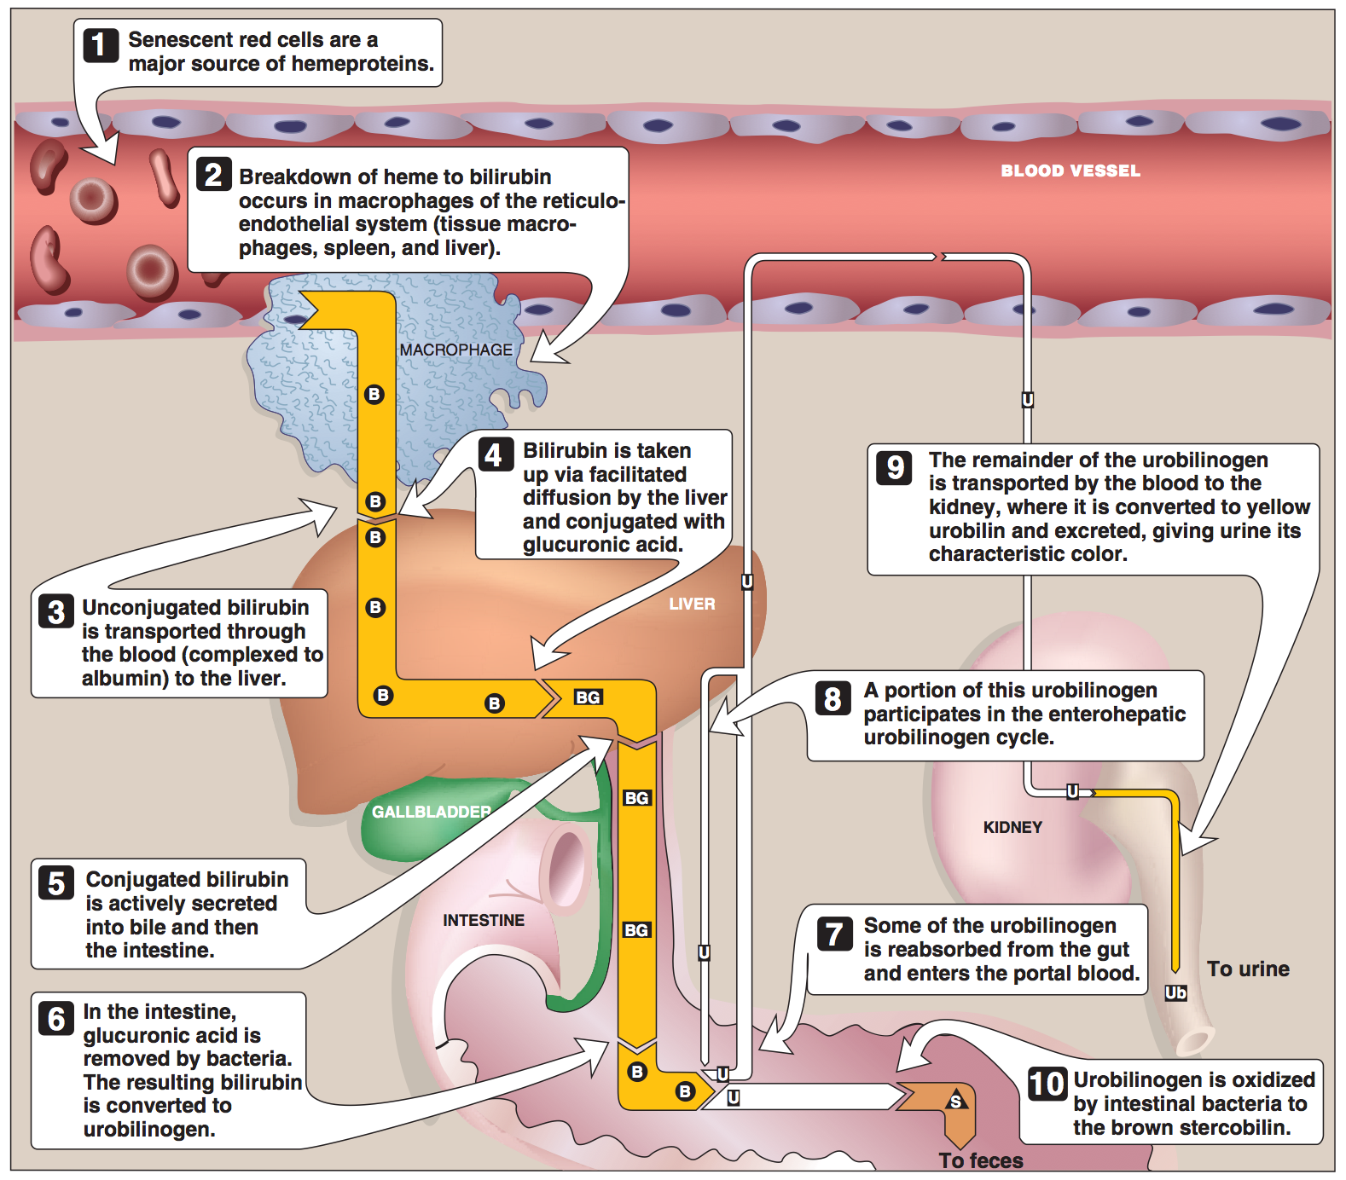

Slide 20
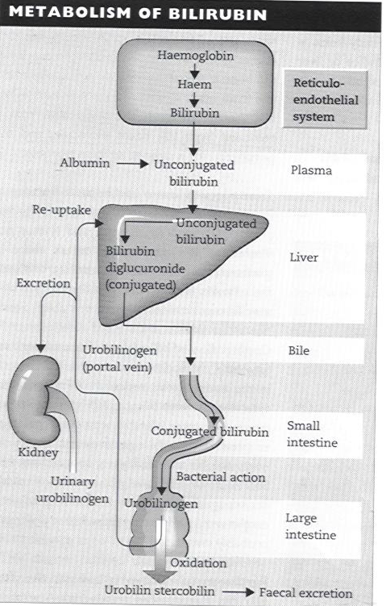

Slide 21
Serum bilirubin levels
Normal
0.2 – 0.8 mg/dL
Unconjugated (indirect):
0.2 – 0.7 mg/dL
Conjugated (direct):
0.1 – 0.4 mg/dL
Latent jaundice:
Above 1 mg/dL
Jaundice:
Above 2 mg/dL

Slide 22
Bilirubin levels and jaundice
Class of Jaundice | Causes
Pre-hepatic or hemolytic | Abnormal red cells; antibodies; drugs and toxins; thalessemia Hemoglobinopathies, Gilbert’s, Crigler-Najjar syndrome
Hepatic or Hepatocellular | Viral hepatitis, toxic hepatitis, intrahepatic cholestasis
Post-hepatic | Extrahepatic cholestasis; gallstones; tumors of the bile duct, carcinoma of pancreas

Slide 23
Urobilinogen (UBG) and bile salts
Most UBG is metabolized in the large intestine but a fraction is excreted in urine (less than 4 mg/day)
Normally bile salts are NOT present in urine
Obstruction in the biliary passages causes:
Leakage of bile salts into circulation
Excretion in urine
Notes:
Obstruction can occur in obstructive jaundice and also in hepatic jaundice due to obstruction of microbiliary channels caused by inflammation

Slide 24
Serum Albumin
The most abundant protein synthesized by the liver
Normal serum levels: 3.5 – 5 g/dL
Synthesis depends on the extent of functioning liver cell mass
Longer half-life: 20 days
Its levels decrease in all chronic liver diseases

Slide 25
Serum Globulin
Normal serum levels: 2.5 – 3.5g/dL
α and β-globulins mainly synthesized by the liver
They constitute immunoglobulins (antibodies)
High serum γ-globulins are observed in chronic hepatitis and cirrhosis:
IgG in autoimmune hepatitis
IgA in alcoholic liver disease

Slide 26
Albumin to globulin (A/G) ratio
Normal A/G ratio: 1.2/1 – 1.5/1
Globulin levels increase in hypoalbuminemia as a compensation

Slide 27
Prothrombin Time (PT)
Prothrombin: synthesized by the liver, a marker of liver function
Half-life: 6 hrs. (indicates the present function of the liver)
PT is prolonged only when liver loses more than 80% of its reserve capacity
Vitamin K deficiency also causes prolonged PT
Intake of vitamin K does not affect PT in liver disease

Slide 28
Prothrombin Time (PT)
Liver is in charge of the synthesis of many clotting factors :
Factor I (fibrinogen)
Factor II (prothrombin)
Factor V
Factor VII
Factor IX
Factor X
Factors XII and XIII
Elevated PT may be reflection of decreased synthetic activity of liver.

Slide 29
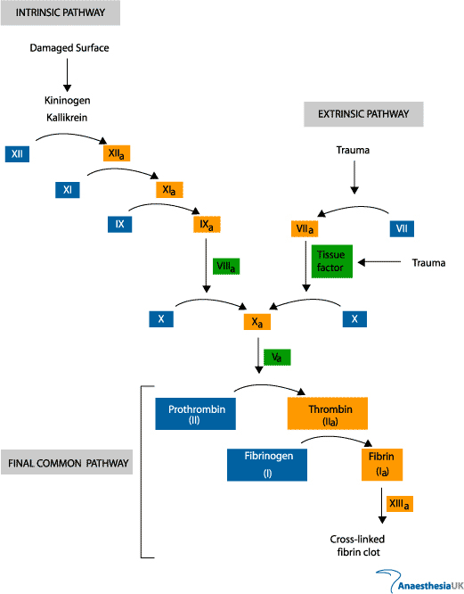

Slide 30
Aspartate aminotransferase (AST)
Normal range: 8 – 20 U/L
A marker of hepatocellular damage
High serum levels are observed in:
Chronic hepatitis, cirrhosis and liver cancer

Slide 31
Alanine aminotransferase (ALT)
More liver-specific than AST
Normal range (U/L):
Male: 13-35
Female: 10-30
High serum levels in acute hepatitis (300-1000U/L)
Moderate elevation in alcoholic hepatitis (100-300U/L)
Minor elevation in cirrhosis, hepatitis C and non-alcoholic steatohepatitis (NASH) (50-100U/L)

Slide 32
Alanine aminotransferase (ALT)
Appears in plasma many days before clinical signs appear
A normal value does not always indicate absence of liver damage
Obese but otherwise normal individuals may have elevated ALT levels

Slide 33
Alkaline phosphatase (ALP)
A non-specific marker of liver disease
Produced by bone osteoblasts (for bone calcification)
Present on hepatocyte membrane
Normal range: 40 – 125 U/L
Moderate elevation observed in:
Infective hepatitis, alcoholic hepatitis and hepatocellular carcinoma

Slide 34
Alkaline phosphatase (ALP)
High levels are observed in:
Extrahepatic obstruction (obstructive jaundice) and intrahepatic cholestasis
Very high levels are observed in:
Bone diseases

Slide 35
γ-glutamyltransferase (GGT)
Used for glutathione synthesis
Normal range: 10 – 30U/L
Moderate elevation observed in:
Infective hepatitis and prostate cancers
GGT is increased in alcoholics despite normal liver function tests
Highly sensitive to detecting alcohol abuse

Slide 36
DETAILS OF THE ENZYMES
AST- liver, heart skeletal muscle, kidneys, brain, RBCs
In liver 20% activity is cytosolic and 80% mitochondrial
Clearance performed by sinusoidal cells, half-life 17hrs
ALT – more specific to liver, v.low concentrations in kidney and skeletal muscles.
In liver totally cytosolic.
Half-life 47hrs
ALP – liver and bone (placenta, kidneys, intestines or WCC)

Slide 37
Transaminases
Tests of liver injury
Hepatocytes contain high levels of enzymes that can leak into the plasma when there is liver injury
Enzymes found in hepatocytes are:
Cytoplasmic = LDH, AST, ALT
Mitochondrial = AST_{m}
Canalicular = ALP, GGT

Slide 38
Alanine Aminotransferase (ALT)
The test is primarily used to diagnose liver disease, to monitor the course of treatment for hepatitis, active postnecrotic cirrhosis, and the effect of drug therapy.
The level of ALT abnormality is increased in conditions where cells of the liver have been inflamed or undergone cell death
As the cells are damaged, the ALT leaks into the bloodstream leading to a rise in the serum levels
Any form of hepatic cell damage can result in an elevation in the ALT
ALT level may or may not correlate with the degree of cell death or inflammation
ALT is the most sensitive marker for liver cell damage. ALT differentiates between hemolytic jaundice and jaundice due to liver disease.

Slide 39
Alanine Aminotransferase (ALT)
Increased ALT levels are found in the following conditions:
Hepatocellular disease
Active cirrhosis (mild increase)
Metastatic liver tumor
Obstructive jaundice or billiary obstruction (mild to moderate increase)
viral, infectious or toxic hepatitis (30-50x normal)
infectious mononucleosis)

Slide 40
Aspartate Aminotransferase (AST)
Also reflects damage to the hepatic cell
It is less specific for liver disease
It may be elevated and other conditions such as a myocardial infarct and muscle disease
Although AST is not a specific for liver as the ALT, ratios between ALT and AST are useful to physicians in assessing the aetiology of liver enzyme abnormalities
Viral heptitis, mononucleosis, and acute hepatotoxicity typically show elevations in ALT that are equal to or greater than AST elevations (AST/ALT less than or equal to 1.0)
ALT is elevated to a lesser degree than AST in alcoholic liver disease and cirrhosis, passive congestion, bile duct obstruction, or metastatic tumor to the liver (AST/ALT greater than 1.0)

Slide 41
Specimens
Stable in whole blood for 24 hrs (then ↑gradually from release fm RBC)
AST/ALT stable at 4ºC for up to 3 weeks
AST stable indefinitely with freezing
ALT may show ↓ with freezing depending on buffer used

Slide 42
Alkaline Phosphatase
Source: liver, bone, placenta and intestine.
↑ ALP activity in liver disease are the result of increased synthesis of the enzymes by cells lining the bile canaliculli, usually in response to cholestasis (intra or extra-hepatic).
ALP ↑ 2x the reference interval in cholestasis.
Also ↑ in infiltrative diseases of liver, when space occupying lesions (e.g tumours) are present.
Growing bones need ALP.
↑ serum ALP by osteoblast-rapid growth of bone (growth, healing of fracture, bone cancer, Paget’s disease,rickets).
For pregnant women, ALP is produce by the placenta.
ALP from the intestine is increased in a person with inflammatory bowel disease such as ulcerative colitis.

Slide 43
Gamma Glutamyl Transferase (GGT) Enzyme
GGT is used by the body to synthesize glutathione tri peptide
GGT is present in liver, kidney, pancreas, intestinal cells and prostrate glands
Elevated levels (> 10 - 30 IU/l) are observed in :
chronic alcoholism, pancreatic disease, myocardial infarction, renal failure, chronic obstructive pulmonary disease and in diabetes mellitus
In liver diseases, GGT elevation parallels that of ALP
In alcoholic liver disease GGT levels may be parallel to alcohol intake

Slide 44
5’ – Nucleotidase - Normal 2 to 15 U/l
It is elevated in obstructive jaundice, Hepatitis, liver ischaemia, liver tumour
Advantage of this enzyme is that it is not elevated in bone disease.

Slide 45
SPECIAL TESTS FOR LIVER DISEASES
Bile acid levels
✓ Blood ammonia
✓ α1- antitrypsin
✓ α1-Fetoprotein
✓ Hepatitis markers
✓ Immunoglobulins
✓ Ceruloplasmin
✓ Ferritin
Notes:
HBsAg
HBsAb
HBcAg
HBeAg

Slide 46
Some example of liver dysfunction
Hepatocellular disease
Cholestasis (obstruction of bile flow)
Cirrhosis
Hepatitis
Jaundice
Liver cancer
Steatosis (fatty liver)
Genetic Disorders
Hemochromatosis (iron storage)

Slide 47
Abnormal in... | Liver Test
Cirrhosis, severe hepatocellular injury | Albumin
Cholestasis, hepatocellular enzyme induction, canalicular injury, children during bone growth, bone disease, pregnancy (placenta origin) | Alkaline phosphatase
Hepatocellular injury (ethanol, drug-induced hepatitis, hepatitis B and C, ischemic injury, chronic liver disease, NAFLD, chronic viral hepatitis, alcoholism, nonspecific viral injury, and cholestatic or replacement disease); acute biliary obstruction; rarely in hyperthyroidism, celiac disease, skeletal muscle disease | Aminotransferases (AST, ALT)
Any acute or chronic liver disease; congenital disorders of bilirubin metabolism. | Bilirubin
Cholestasis | 5′ nucleotidase
Cholestasis; medications, ethanol; rarely anorexia nervosa, hyperthyroidism, myotonic dystrophy | GGT
Impaired synthesis of vitamin K-dependent coagulation factors | INR
Ischemic injury, Epstein-Barr virus infection, hemolysis, solid tumor | Lactate dehydrogenase
Alcohol consumption, gout | Uric acid

Slide 48
.

Slide 49
.

Slide 50
Biochemical Markers of Specific Liver Diseases

Slide 51
Etiology-specific Liver Tests
Viral hepatitis serologies
Serum ferritin level
Ceruloplasmin level
Alpha₁-antitrypsin level
Antimitochondrial antibody titer

Slide 52
Viral Hepatitis Serology
HAV – anti-HAV IgM and IgG
HBV – HBsAg, anti-HBsAg, and anti-HBcAg
HCV – anti-HCV, HCV RNA

Slide 53
Serum Ferritin
Widely distributed storage protein
Levels reflect body iron stores
Elevated in primary hemochromatosis
Elevated in acute inflammation and cirrhosis

Slide 54
Serum Ceruloplasmin
Copper-binding protein
Decreased in 95% of patients with Wilson’s disease
20% of heterozygotes have decreased levels

Slide 55
α₁-Antitrypsin
Inhibits serum trypsin
Major component of α₁-globulin
Deficiency cause of neonatal hepatitis

Slide 56
Antimitochondrial Antibody (AMA)
Directed against mitochondrial enzyme pyruvate dehydrogenase complex
Positive in 90% of patients with primary biliary cirrhosis

Slide 57
Interpretation of Abnormal LFT’s
Examine multiple tests
Consider non-hepatic causes
Determine the most abnormal tests

Slide 58
BILIRUBIN METABOLISM AND DISORDERS
DR ADAJA TM
UNIMED
CHEMPATH

Slide 59
OUTLINE
Introduction
Production of Bilirubin
Bilirubin Transport
Hepatic Action on Bilirubin
Excretion of Bilirubin
Disorders of Bilirubin Metabolism
Bilirubin assay

Slide 60
Introduction
Bilirubin is an orange yellow pigment derived from the breakdown of heme
Approx 200-300mg produced daily
Secreted by the liver

Slide 61
Production of Bilirubin
Red blood cell breakdown in the reticuoloendothelial system
After completing their lifespan, RBC phagocytosed to release hemoglobin
Hemoglobin broken down into heme, globin and iron

Slide 62
Production of Bilirubin
The iron binds to transferrin and is returned to iron stores in the liver or bone marrow for reuse
The globin is degraded to its constituent amino acids, and reused
The heme portion of hemoglobin is converted to bilirubin

Slide 63
Production of Bilirubin
Approx 80% of bilirubin is derived from heme within the RES
Other sources;
The breakdown of immature red cells in the bone marrow
Breakdown of compounds chemically related to hemoglobin, such as myoglobin and the cytochromes and peroxidases

Slide 64
Production of Bilirubin
Protoporphyrin is broken down by microsomal heme oxygenase to produce Biliverdin
Biliverdin is subsequently reduced to Bilirubin
Reduction to bilirubin catalyzed by (NADPH)-dependent cytosolic enzyme, biliverdin reductase
One mole each of carbon monoxide, bilirubin, and ferric iron is produced for each mole of heme catabolized

Slide 65
Bilirubin Transport
In blood, bilirubin is bound to Albumin for transport to the liver
At the sinusoidal membrane of the hepatocyte, it dissociates from albumin and is transported across the membrane
Inside the liver cells, bilirubin reversibly binds to Ligandin, a soluble cytosolic protein

Slide 66
Hepatic Action on Bilirubin
Bilirubin is then conjugated with glucuronic acid to produce bilirubin monoglucuronide and diglucuronide, which then are excreted into bile
The microsomal enzyme bilirubin uridine diphosphate (UDP)–glucuronyltransferase catalyzes this process
Conjugated bilirubin is excreted into bile against a marked concentration gradient by a process thought to be an energy dependent active transport

Slide 67
Excretion of Bilirubin
In the intestine bilirubin glucoronides hydrolyzed by β-glucuronidase from the liver, intestinal epithelial cells, and bacteria
This unconjugated bilirubin is then reduced by anaerobic intestinal microbial flora to form urobilinogens (stercobilinogen, mesobilinogen, or urobilinogen)
About 20% of the urobilinogen is reabsorbed to enter the entero-hepatic circulation

Slide 68
Excretion of Bilirubin
Most of the reabsorbed urobilinogen taken up by the liver for re-excretion in bile
A small fraction (2 to 5%) enters the general circulation and appears in urine
In the lower intestinal tract, the three urobilinogens are spontaneously oxidized to produce the corresponding bile pigments stercobilin, mesobilin, and urobilin
These oxidized product are orange-brown and the major pigments of stool.

Slide 70
Disorders of Bilirubin Metabolism
Defect can occur at each step of the pathway of bilirubin metabolism
This usually results in build up of bilirubin (Hyperbilirubinemia)

Slide 71
Disorders of Bilirubin Metabolism
Clinically, hyperbilirubinemia can manifest as jaundice or icterus
This is as a result of deposition of bile pigment in the skin, mucous membranes, and sclera with a resulting yellow appearance of the patient
Jaundice becomes clinically evident when bilirubin concentration ≥5mg /dl
Reference interval for total bilirubin < 1mg/dl

Slide 73
PRE-HEPATIC HYPERBILIRUBINEMIA
HEMOLYTIC
Increased bilirubin production from excessive RC destruction
Increased destruction of RBCs leads to increased bilirubin turnover and unconjugated hyperbilirubinemia
With normal liver function, hyperbilirubinemia usually not more than 4mg/dl
The direct-reacting fraction ≤15% of the total serum bilirubin
Hemolytic conditions could be hereditary or acquired

Slide 74
PRE-HEPATIC HYPERBILIRUBINEMIA (cont)
Causes of hemolytic hyperbilirubinemia:
-Hereditary eg sickle cell anemia, thalassaemia, G6PD deficiency triggered by drugs like sulphonamides
-Acquired eg malaria, sepsis, significant hematomas

Slide 75
INCREASED BILIRUBIN PRODUCTION(Cont’d)
Ineffective Erythropoiesis: During erythroid maturation, small amounts of Hb may be lost at the time of nuclear extrusion, and a fraction of developing erythroid cells is destroyed within the marrow.
In various disorders, including thalassemia major, megaloblastic anemias, lead poisoning, the fraction of total bilirubin production derived from ineffective erythropoiesis is increased
This may be sufficient to produce modest degrees of unconjugated hyperbilirubinemia.

Slide 76
HEPATIC HYPERBILIRUBUNEMIA
IMPAIRED CONJUGATION:
-Physiologic jaundice of the Newborn: Bilirubin concentrations reach a peak within 3 to 5 days of birth and remain elevated for less than 2 weeks
Bilirubin usually less than 5 mg/dL, with 90% unconjugated
Contributory factors include:
(1) An increased bilirubin load in the newborn because the RBCs have a shortened lifespan;
(2) The appearance of “shunt” bilirubin, which is bilirubin derived from ineffective erythropoiesis or non-RBC sources;

Slide 77
Physiologic jaundice of the Newborn (Cont)
(3) Decreased conjugation of bilirubin owing to a relative lack of glucuronyl transferase in the first few days following birth;
(4) Increased absorption of bilirubin in the intestine caused by β-glucuronidase in meconium, which hydrolyzes bilirubin conjugates to unconjugated bilirubin that can be passively reabsorbed;

Slide 78
Physiologic jaundice of the Newborn (Cont)
Physiologic jaundice generally is not harmful, but bilirubin concentrations above 10 mg/dL (170 μmol/L), may increase the risk for kernicterus
Physiologic jaundice of the newborn is treated with phototherapy
The infant is exposed to light of approximately 450 nm
This yields several photoisomers that are more water soluble, and thus are excreted in the bile

Slide 79
Factors that can increase risk of Brain damage in Neonatal Jaundice
Pre term babies
Low birth weight
Poor feeding
Maternal DM
Hypoglycemia
Metabolic acidosis
Respiratory distress syndrome
Drugs like Sulphonamides

Slide 80
CAUSES OF HEPATIC HYPERBILIRUBINEMIA
Acquired causes:
Some degree of reduction in bilirubin conjugating capacity may be caused by;
Hepatitis or cirrhosis
Eg, the vial hepatitis group of infections- Hepatitis A, Hepatitis B and Hepatitis C

Slide 81
Alcoholic liver disease
Drugs, including paracetamol overdose, chloramphenicol, and gentamicin

Slide 82
HEREDITARY DEFECTS IN BILIRUBIN CONJUGATION
Characterized by differing degrees of unconjugated hyperbilirubinemia
Crigler-Najjar Syndrome, Type I
Crigler-Najjar Syndrome (Type II)
Gilbert Syndrome
Lucey-Driscoll Syndrome

Slide 83
Crigler-Najjar Syndrome, Type I
First described in 1952
A rare disorder
Estimated prevalence of 0.6–1.0 per million
Inherited as an autosomal recessive trait
There is complete absence of UDP-glucuronyltransferase

Slide 84
Crigler-Najjar Syndrome, Type I
Characterized by very high concentrations of unconjugated bilirubin, often exceeding 20 mg/dL (340 μmol/L)
Most patients die of severe brain damage caused by kernicterus within the first year of life
Phlebotomy and plasmapheresis can reduce the serum bilirubin, but encephalopathy usually develops
The only effective therapy is early liver transplantation

Slide 85
Crigler-Najjar Syndrome (Type II)
A rare autosomal dominant disorder
There is partial deficiency of UDP-glucuronyltransferase
Unconjugated bilirubin is usually 5 to 20 mg/dL (85 to 340 μmol/L)
Not frequently associated with Kernicterus

Slide 86
Crigler-Najjar Syndrome (Type II)
Bilirubin glucuronides are present, with a striking, characteristic increase in the proportion of monoglucuronides
Typically detected in infancy and in some cases, later in life
It responds dramatically to phenobarbital and a normal life is expected

Slide 87
Gilbert Syndrome
A benign condition manifested by mild unconjugated hyperbilirubinemia
Affects 3 to 5% of the population
Males predominate over females by reported ratios ranging from 1.5:1 to >7:1.
Often misdiagnosed as chronic hepatitis
Serum concentration of bilirubin fluctuates between 1.5 and 3 mg/dL (26 and 51 μmol/L)

Slide 88
Gilbert Syndrome
More elevated values are associated with stress, fatigue, alcohol use, reduced caloric intake, and intercurrent illness
Increased caloric intake or administration of enzyme-inducing agents produces lower bilirubin levels
Hepatic glucuronyltransferase activity is low as a consequence of a mutation in the bilirubin-UDP-glucuronosyltransferase (UGT1A1) gene

Slide 89
Gilbert Syndrome
In most cases, this mutation is a repeat in the promoter, so that there are seven rather than the “normal” six ATs
Occasionally, five or eight repeats noted; the transcription of the gene is inversely proportional to the number of repeats
Distinguished from chronic hepatitis by the absence of anemia and bilirubin in urine, and by normal liver function tests

Slide 90
Gilbert Syndrome
Diagnosis is usually made by chance on routine medical examination or when jaundice occurs following an intercurrent infection or fasting
No treatment is needed, but patients must be reassured that they do not have liver disease

Slide 91
Lucey-Driscoll Syndrome
A familial form of unconjugated hyperbilirubinemia caused by a circulating inhibitor of bilirubin conjugation
The hyperbilirubinemia is mild and lasts for the first 2 to 3 weeks of life

Slide 93
FAMILIAL DEFECTS IN HEPATIC EXCRETORY FUNCTION
Dubin-Johnson Syndrome
Rotor Syndrome
Benign Recurrent Intrahepatic Cholestasis (BRIC)
Progressive Familial Intrahepatic Cholestasis (FIC)

Slide 94
Dubin-Johnson Syndrome
A rare autosomal recessive disorder
Characterized by jaundice with predominantly elevated conjugated bilirubin and a minor elevation of unconjugated bilirubin
Excretion of various conjugated organic anions and bilirubin, but not bile salts, into bile is impaired
Underlying defect in canalicular excretion

Slide 95
Dubin-Johnson Syndrome
Intravenous cholangiography does not show the gallbladder, but a 99mTc-hepatobiliary iminodiacetic acid (HIDA) scan does
A derangement in the excretion of urinary coproporphyrin occurs
The normal ratio of coproporphyrin I to III is reversed
The liver has a characteristic greenish black appearance, and liver biopsy reveals a dark brown pigment in hepatocytes and Kupffer cells that looks like lipofuscin but probably is melanin

Slide 96
Dubin-Johnson Syndrome
Serum ALT and ALP are usually normal
Pruritus is absent
The condition is benign, although patients may develop jaundice during pregnancy or while taking oral contraceptives

Slide 97
Rotor Syndrome
A benign, autosomal recessive disorder clinically similar to DJS
The liver in patients with Rotor syndrome has no increased pigmentation and appears totally normal
The abnormality in routine laboratory tests is an elevation of total serum bilirubin, due to a predominant rise in conjugated bilirubin
This is accompanied by bilirubinuria

Slide 98
Rotor Syndrome
The gallbladder is seen on intravenous cholecystography.
Total urinary coproporphyrins are elevated, with about two thirds being coproporphyrin I
The prognosis is excellent

Slide 99
Benign Recurrent Intrahepatic Cholestasis (BRIC)
A rare disorder characterized by recurrent attacks of pruritus and jaundice
Typical episode begins with mild malaise and elevations in serum aminotransferase levels, followed rapidly by rises in alkaline phosphatase and conjugated bilirubin and onset of jaundice and itching.
The cholestatic episodes, which may begin in childhood or adulthood, can vary in duration from several weeks to months, followed by a complete clinical and biochemical resolution

Slide 101
Post Hepatic Hyperbilirubinemia
Bile duct system damage, inflammation or obstruction
Gallbladder is unable to move bile into the digestive system
Mostly conjugated hyperbilirubunemia
Conjugated bilirubin being water soluble is also passed in urine (bilirubinuria)
Also passage of pale-colored stool

Slide 102
Post Hepatic Hyperbilirubinemia
May be due to
Gallstones
Ca of the head of pancreas
Gallbladder cancer or bile duct cancer
Pancreatitis

Slide 103
Bilirubin Assay Methods
DIAZO METHOD (Colorimetric)
Diazotized sulfanilic acid (the diazo reagent) reacts with bilirubin to produce two azodipyrroles (azopigments) which are reddish purple at neutral pH and blue at low or high pH values
It is then measured by spectrophotometry

Slide 104
DIAZO METHOD
In the absence of an accelerator, (such as ethanol, caffeine), unconjugated bilirubin reacts slowly
Whereas conjugated bilirubin reacts rapidly (Direct Bilirubin)
Total bilirubin is measured in the presence of an accelerator, while directly reacting bilirubin is measured in the absence of an accelerator

Slide 105
Bilirubin Analytical Methods
HIGH-PERFORMANCE LIQUID CHROMATOGRAPHY
HPLC has been helpful in separating, detecting and quantifying the various bilirubin photoisomers produced during phototherapy in newborns
It thus helps in elucidating the mechanism by which phototherapy lowers the concentration of bilirubin in newborn blood

Slide 106
Summary
A defect at any point in the metabolism of bilirubin can cause hyperbilirubinemia
Clinical findings and assay for the bilirubin fractions are key in diagnosis and management

Slide 107
VIRAL HEPATITIS

Slide 108
Serological Tests important in liver function
Acute viral Hepatitis
Common form of infection worldwide, caused by varieties of RNA viruses- hepatitis A, C, D, E, G and a DNA virus, hepatitis B virus
Severity of disease varies from asymptomatic, through mild hepatitis, to severe fulminant hepatitis which can be fatal
Responsible for the majority of chronic liver disease which is in turn associated with hepatocellular carcinoma.

Slide 109
Hepatitis B virus: consists of a central core containing the viral genome, DNA polymerase, hepatitis B core antigen (HBcAg), hepatitis B e antigen (HBeAg), and an outer lipoprotein coat containing the hepatitis B surface antigen (HBsAg). The complete virus is called the Dane particle
Transmission: parenteral, sexual, vertical
Has a major association with hepatocellular carcinoma
Disease can result in a carrier state or in chronic liver disease
The sequence in which the various antigens exist in the serum is of clinical significance.
Hepatitis C virus: parenteral transmisson, often leads to carrier states and chronic liver disease, frequently associated with hepatocellular carcinoma

Slide 110
Chronic hepatitis
Hepatic inflammation persisting for more than 6 months. The common antecedent causes are viral, toxic or autoimmune.
Two categories are commonly used
Chronic persistent hepatitis: characterized by mildly elevated liver enzymes, not associated with extrahepatic manifestation and with good prognosis
Chronic active hepatitis: may be associated with autoimmune diseases of other organs( thyroiditis, arthritis, colitis ).

Slide 111
Serology tests
HAVAg and HAV IgM antibody: current infection
HAV IgG antibody: previous infection and immunity
HBsAg= current infection (>6mths:carrier state)
HBeAg= current infection(>3mths:active carrier status)
HBcAb IgM= current infection(present btw HBsAg disappearing and HBsAb appearing)
HBsAb, HBeAb, HBcAb IgG= previous exposure and non carrier state
HCV antibodies which often become positive after a long delay

Slide 112
Current trends in non-invasive evaluation of liver disease
Hepatic fibrosis is potentially reversible with early intervention and adequate treatment.
Present liver chemistry test indicates liver disease, not staging
Liver biopsy
A need for non-invasive technique due to the disadvantages of biopsy

Slide 113
What are the conditions Ideal non invasive test must satisfy
Simple
readily available
Inexpensive
Reproducible
Accurate prediction of full spectrum of disease
Sensitive to treatment effect
Useful in tracking disease progression

Slide 114
Serum fibrosis marker
Physiology of fibrosis includes inflammation, cell death and collagen deposits in the liver
Serum fibrosis markers includes:
sICAM-1, sIL-2R, IL-6, and anti-p53
Micro RNA: miR-122, miR-34a and miR-16 in chronic hepatitis C patients
human microfibril–associated protein 4 (MFAP-4)
Endoglin (CD105): biomarker of angiogenesis in HCC
α- fetoprotein, CA- 19-9, CA- 15-3, tumor markers also increased in chronic fibrosis

