Slide 1
APUD SYSTEM &CARCINOID SYNDROME
DR TM ADAJA 2021

Slide 2
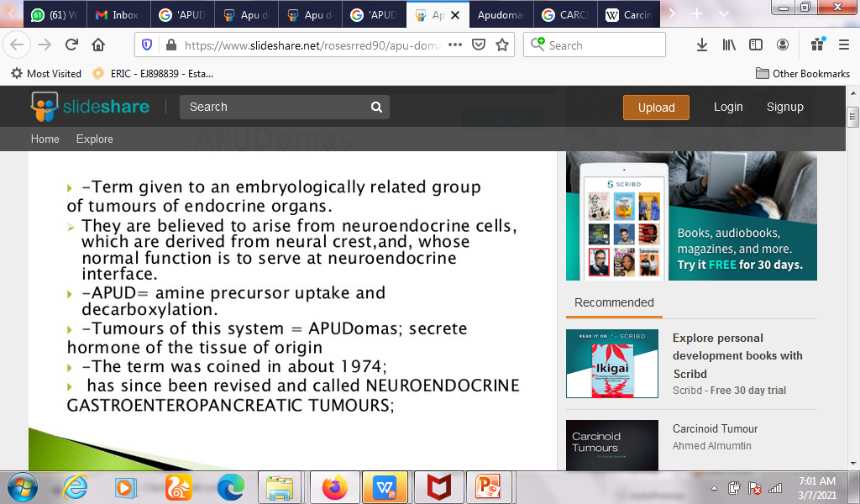
APUDomas

Slide 3
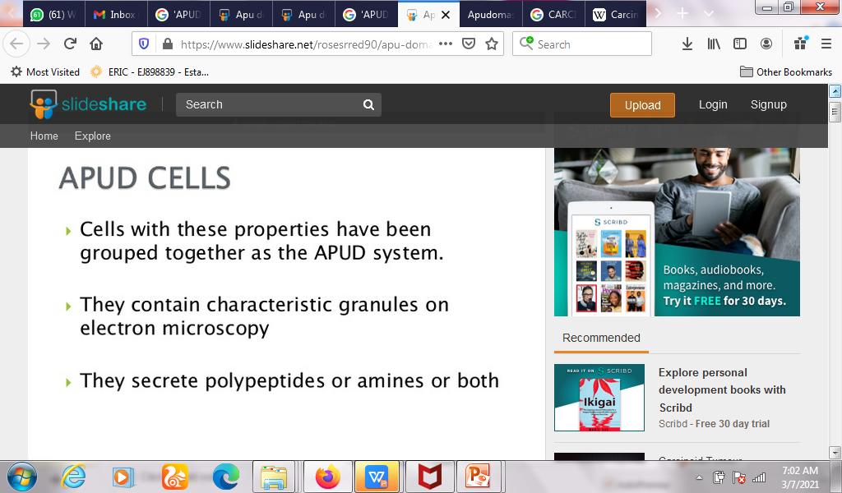
.

Slide 4
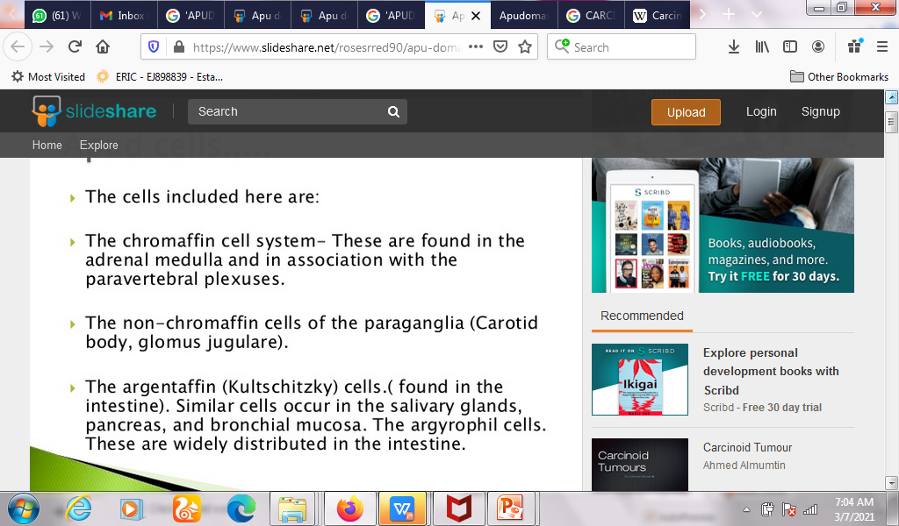
.

Slide 5
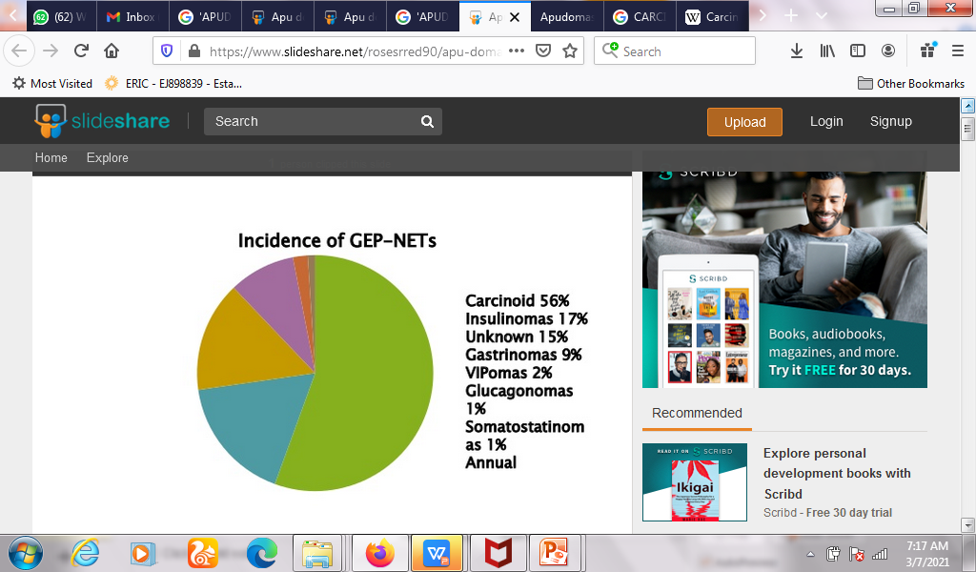
.

Slide 6
Carcinoid syndrome
Carcinoid syndrome is a paraneoplastic syndrome comprising the signs and symptoms that occur secondary to carcinoid tumors.
The syndrome includes flushing and diarrhea, and less frequently, heart failure, vomiting and bronchoconstriction.
It is caused by endogenous secretion of mainly serotonin and kallikrein.

Slide 7
The carcinoid syndrome occurs in approximately 5% of carcinoid tumors and becomes manifest when vasoactive substances from the tumors enter the systemic circulation escaping hepatic degradation

Slide 8
FEATURES OF CS
Flushing: The most important clinical finding is flushing of the skin, usually of the head and the upper part of thorax.
Diarrhea: It may be associated with abdominal cramping. This symptom is due to the action of serotonin, histamine, and gastrin.
Abdominal pain: It is due to hepatomegaly, small bowel obstruction or lack of oxygen to small bowel.

Slide 9
Bronchoconstriction, which may be histamine or serotonin-induced, affects about 15% of those having carcinoid syndrome and often accompanies flushing, sneezing, and shortness of breath.
Carcinoid heart disease: About 19% to 60% of the those affected by carcinoid syndrome develops carcinoid heart disease. Serotonin induces fibrosis in valves of the right heart especially tricuspid valve

Slide 10
PATHOBIOLOGY
Carcinoid tumors produce several vasoactive substances, most prominently serotonin.
It is commonly thought that serotonin is the cause of the flushing, but this is only partially correct.
The flushing also results from secretion of kallikrein, the enzyme that catalyzes the conversion of kininogen to lysyl-bradykinin.
The latter is further converted to bradykinin, one of the most powerful vasodilators known

Slide 11
Other components of the carcinoid syndrome are diarrhea (probably caused by the increased serotonin, which greatly increases peristalsis, leaving less time for fluid absorption),
A pellagra-like syndrome (probably caused by diversion of large amounts of tryptophan from synthesis of the vitamin B₃ niacin, which is needed for NAD production, to the synthesis of serotonin and other 5-hydroxyindoles),

Slide 12
Fibrotic lesions of the endocardium, particularly on the right side of the heart resulting in insufficiency of the tricuspid valve and, less frequently, the pulmonary valve and, uncommonly, bronchoconstriction.

Slide 13
LAB INVESTIGATION
With a certain degree of clinical suspicion, the most useful initial test is the 24-hour urine levels of 5-HIAA (5-hydroxyindoleacetic acid), the end product of serotonin metabolism.
Patients with carcinoid syndrome usually excrete more than 25 mg of 5-HIAA per day

Slide 14
TREATMENT
For symptomatic relief of carcinoid syndrome:
Octreotide (a somatostatin analogue which decreases the secretion of serotonin by the tumor and, secondarily, decreases the breakdown product of serotonin (5-HIAA))
Telotristat ethyl (Xermelo) along with a somatostatin analogue in patients not responding to somatostatin analogue monotherapy.It is a tryptophan hydroxylase inhibitor and reduces the production of serotonin.

Slide 15
Peptide receptor radionuclide therapy (PRRT) with lutetium-177, yttrium-90 or indium-111 labeled to octreotate is highly effective
Methysergide maleate (antiserotonin agent but not used because of the serious side effect of retroperitoneal fibrosis)
Cyproheptadine (an antihistamine drug with antiserotonergic effects)

Slide 16
Alternative treatment for qualifying patients:
Surgical resection of tumor and chemotherapy (5-FU and doxorubicin)
Endovascular, chemoembolization, targeted chemotherapy directly delivered to the liver through special catheters mixed with embolic beads (particles that block blood vessels), used for patients with liver metastases.

Slide 17
STRESS RESPONSES
The activity of the sympathetic nervous system drives what is called the "fight or flight" response.
The fight or flight response to emergency or stress involves
mydriasis, increased heart rate and force contraction, vasoconstriction, bronchodilation,
glycogenolysis, gluconeogenesis, lipolysis,
sweating, decreased motility of the digestive system,
secretion of the epinephrine and cortisol from the adrenal medulla, and relaxation of the bladder wall

Slide 18
BIOCHEMICAL RESPONSE TO STRESS
- Sympathetic arousal and activation of HPA axis.
-Chronic stimulation of both mechanism leads to hyperarousal and subsequent wear and tear on body system and suppression of key components of the body system.
-Stress causes structural changes in the brain: atgrhy & decreased weight
-Activation of stress result in the production and release of glucocorticoid( cortisol ,) IL-6 and TNF

Slide 19
.
Stress affects memory (hippocampus), cognition &learning (basolateral amygdala)
Stress leads to the release of CRH, ACTH.
Glucorticoids are anti inflammatory and immuno suppressant.
They inhibit lymphocytes and macrophages.
Severe stress can lead to malignancy by suppressing the immune system (decreases the activity of cytotoxic T- lympocytes and Nk- cells).
Catecholammes & opoids released during stress have immune suppressant effect

