Slide 1
CLINICAL GENETICS AND MOLECULAR TECHNIQUES
DR TM ADAJA 2022
UNIMED

Slide 2
Definition
Genetics comes from the ancient Greek word ‘’genetive’’ which comes from genesis or origin.
Genetics a discipline of biology, is the science of genes, heredity and variation in living organisms

Slide 3
Clinical Genetics is the medical specialty which provides a diagnostic service and genetic counseling for individuals or families with, or at risk of, conditions which may have a genetic basis.
Genetic disorders can affect any body system and any age group.

Slide 4
Chromosomal abnormalities, which cause birth defects, mental retardation and/or reproductive problems.
Single gene disorders such as cystic fibrosis, muscular dystrophy, Huntington's disease and sickle cell disease.
Familial cancer and cancer-prone syndromes such as inherited breast or colorectal cancer and neurofibromatosis.
Birth defects with a genetic component such as neural tube defects and cleft lip and palate.

Slide 5
The “Central Dogma”
Flow of genetic information in a cell
transcription
translation
DNA
RNA
protein
replication
Notes:
5

Slide 6
Genetical View of Disease
Disease is the result of mismatch between integrated, but variable,homeostatic systems and some experience(s) of an equally variable environment.
Incongruence may be potential (susceptibility) or inevitable.
Environment may be internal or external, physical or social.
Continuity of health and disease
Notes:
Undermined by mutation OR overwhelmed by environment
Inevitable—TSD or cyanide

Slide 7
Genetical View of Disease II
Disease is an (almost) inevitable consequence of our diversity.
Focus is on the Individual.
Management is directed at whichever component is most amenable.
Care rather than cure
Prevention of disease

Slide 8
Types of Genetic Disease
Chromosomal
Single gene---Mendelian
Multifactorial---common complex diseases
Somatic cell ---cancers

Slide 9
Molecular genetics
Molecular genetics involves the discovery of and laboratory testing for DNA mutations that underlie many single gene disorders.
Examples of single gene disorders include achondroplasia, cystic fibrosis, Duchenne muscular dystrophy, hereditary breast cancer (BRCA1/2), Huntington disease, Marfan syndrome, Noonan syndrome, and Rett syndrome.
Molecular tests are also used in the diagnosis of syndromes involving epigenetic abnormalities, such as Angelman syndrome, Beckwith-Wiedemann syndrome, Prader-willi syndrome, and uniparental disomy.

Slide 10
Mitochondrial genetics
Mitochondrial genetics concerns the diagnosis and management of mitochondrial disorders, which have a molecular basis but often result in biochemical abnormalities due to deficient energy production.
There exists some overlap between medical genetic diagnostic laboratories and molecular pathology.

Slide 11
Basic Principles
Genes are located on chromosomes.
A gene is a unique sequence of nucleotides that codes for a particular protein or peptide
Genes can be represented by one or more alleles
Genes comprise a sequence of bases on deoxyribonucleic acid (DNA) and code for the synthesis of proteins by ribonucleic acid(RNA) in its messenger form.

Slide 12
Basic Principles
Replication of genetic material occurs during the S phase of the cell cycle
DNA polymerase needs a pre-existing DNA to form two new double bond strands identical to the original strand
Every new double strand is semi-conservative(half old and half new)
Antiparallel strands are formed since DNA polymerase moves from 3’ to 5’ end on the template strand.

Slide 13
Basic Principles
The protein-coding instructions from the genes, as contained in DNA, are transcribed indirectly through messenger RNA.
mRNA moves from the nucleus to the cytoplasm and serves as a template for protein synthesis
The ribosomal system translates the codon into amino acid chain for protein synthesis
Genetic code contains codons that instruct which amino acids are required for specific protein and polypeptide synthesis

Slide 14
Genetic disorders
Genetic disorders fall into 3 main categories
Chromosomal disorders occur either due to the absence or abnormal arrangement of chromosomes affecting many genes and gene products such as Down’s syndrome (trisomy for chromosome 21)
Monogenic disorders occur as a result of abnormality of a single gene which is the primary determinant of the disorder and is inherited in a predictable pattern

Slide 15
Genetic disorders
Monogenic disorders may be due either to abnormality in a structural gene with the production of an abnormal protein or to abnormality in a controlling (enhancing) gene which alters the rate at which one or more structural genes function affecting the quantity of one or more structurally normal peptides.

Slide 16
Genetic disorders
Multifactorial or polygenic disorders occur as a result of interaction of multiple genes with the environment or other exogenous factors, such as diabetes mellitus.

Slide 17
Patterns of inheritance
All inherited characteristics are governed by a pair of genes on homologous chromosomes, one gene is received from each parent
Different genes governing the same characteristics are known as alleles.
An individual with two identical alleles is homozygous for that gene.
An individual with two different alleles is heterozygous for that gene.
Genes may be carried on autosomes or sex chromosomes with different patterns of inheritance

Slide 18
Autosomal dominant inheritance
The metabolic consequences of an abnormal genes depends on the effectiveness of that gene in comparison with the normal gene.
Dominant abnormal genes affect both heterozygotes and homozygotes with homozygotes being severely affected.
All affected persons have at least one affected parent
Offspring in successive generations are usually affected.

Slide 19
Autosomal dominant inheritance
Offspring that appear clinically normal are not carriers of the abnormal gene.
If both parents are heterzygotes, three in four children are affected.
With one heterozygous parent there is a one in two chance of an affected offspring
Familial hypercholesterolaemia is an example

Slide 20
Autosomal recessive inheritance
Recessive abnormal genes are known only to affect homozygous offspring.
Heterozygous parents are usually not clinically affected.
Clinical consequences may miss successive generations of offspring.
Heterozygous children will appear clinically normal and are carriers of the abnormal gene.
One in four children of heterozygous parents are clinically affected.
Autosomal recessive disorders have a lower expression frequency in families even though more severe than autosomal dorminant disorders. Cystic fibrosis is an example.

Slide 21
X linked recessive inheritance
Some abnormal chromosomes are carried on the sex (mostly X) chromosomes.
An abnormal X chromosome is latent when combined with a normal X chromosome but active when combined with Y chromosome.
Inherited disease manifesting in male offspring with female carriers is typical.
Females are clinically affected if they are homozygous for the abnormal gene.
Haemophilia is an exampe.

Slide 22
X linked dominant inheritance
Individuals with the affected gene whether male or females are affected,
Familial hypophosphataemia is an example
Penetrance ameliorates the manifestation of dominant and recessive disorders

Slide 23
Multiple alleles
Several alleles may govern the same characteristic
Different pair combinations may produce different disease patterns such as haemoglobinopathies.

Slide 24
DNA technologies
Hybridization
DNA polymorphism
Southern blotting
Northern blotting
Micro-arrays
Polymerase chain reaction

Slide 25
DNA diagnosis
Cystic fibrosis due to 3 base pair deletion in codon 508 is detected by PCR and polyacrylamide gel
Duchenne’s and Becker’s muscular dystrophy due to deletions on dystrophin gene on chromosome 21 is detected by PCR
Alpha₁₋ antitrypsin deficiency is due to a polymorphic gene and can be detected by PCR.
Familial hypercholesterolaemia is an autosomal defect of low density lipoprotein receptor on chromosome 19 , it is detected by PCR.

Slide 26
DNA diagnosis
Phenylketonuria can be detected prenatally by PCR
Haemochromatosis due to C282y or H63d HFE mutation can be detected by DNA techniques
Sickle cell anaemia due to A-T substitution of sixth codon of β- globin gene is detected during amniocentesis by allele-specific hybridization
Thalassaemia due to absence or size alteration of globin mRNA is detected by northern blot techniques.
DNA technology is used to identify the genetic father in paternity disputes and for identification of body fluids and tissues in forensic medicine

Slide 27
3.3 Cloning
Cloning a fragment of DNA requires a specially engineered vector.
recombinant DNA – A DNA molecule that has been created by joining together two or more molecules from different sources.
ligating (or ligation) – The process of joining together two DNA fragments.

Slide 28
3.3 Cloning
subclone – The process of breaking a cloned fragment into smaller fragments for further cloning.
multiple cloning site (MCS) – A sequence of DNA containing a series of tandem restriction endonuclease sites used in cloning vectors for creating recombinant molecules.

Slide 29
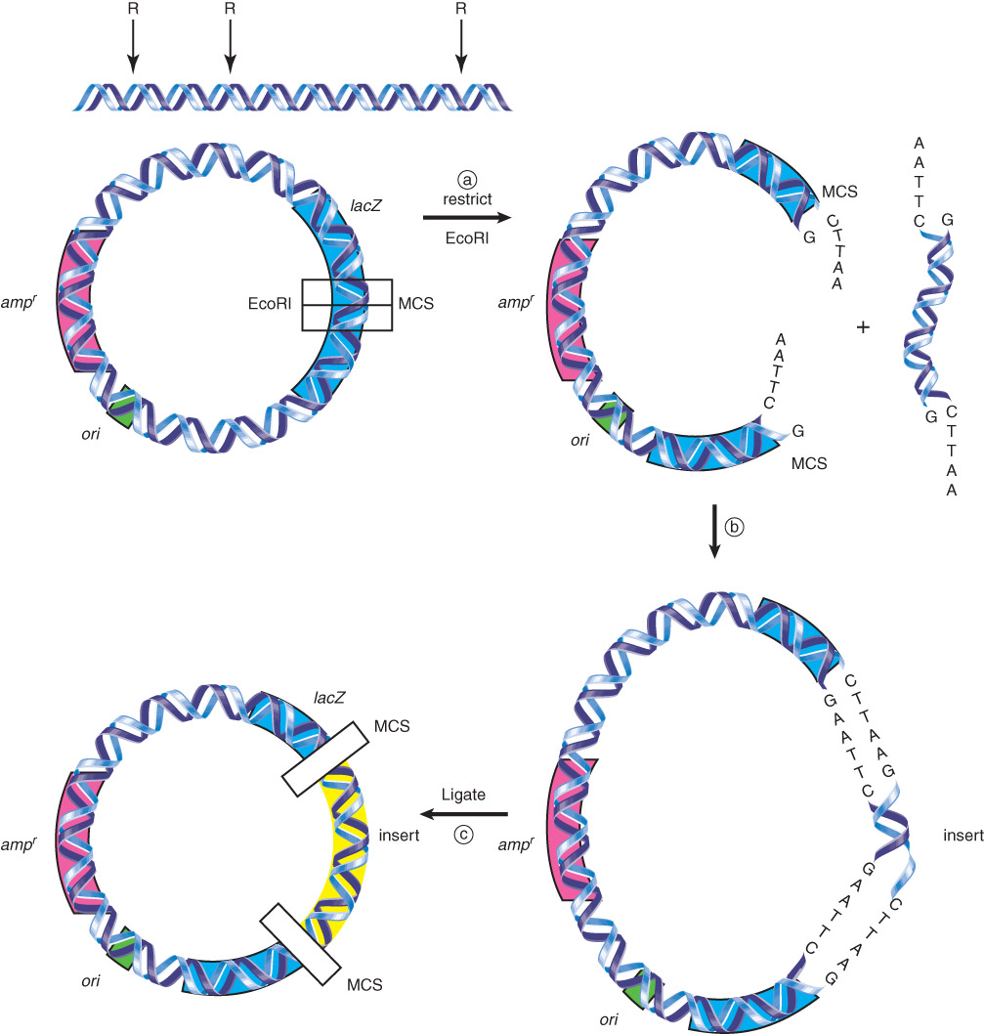
3.3 Cloning
Figure 03.04: (a) A plasmid together with insert DNA (b) Restricted insert fragments and vector will be combined and (c) ligated together.

Slide 30
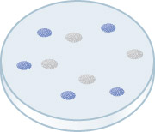
3.3 Cloning
transformation – The acquisition of new genetic material by incorporation of added exogenous, nonviral DNA.
Blue/white selection allows the identification of bacteria that contain the vector plasmid and vector plasmids that contain an insert.
Figure 03.05: The white colonies will be used to prepare DNA for further analysis.

Slide 31
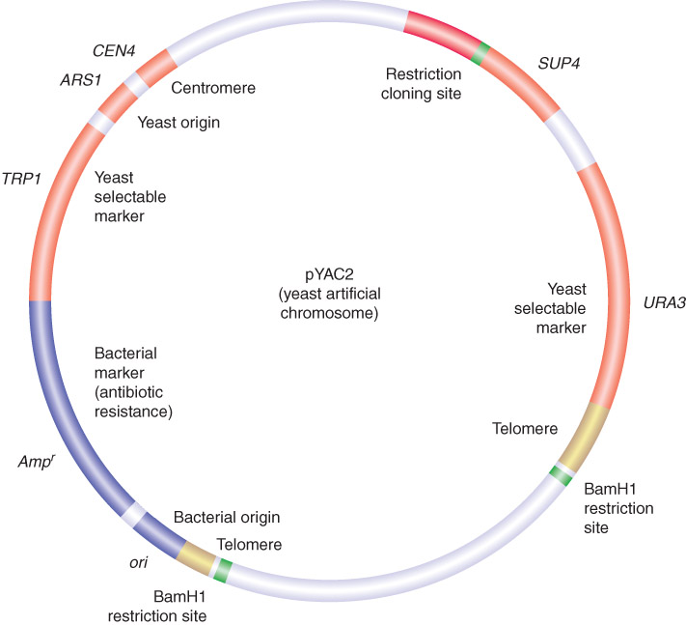
3.4 Cloning Vectors Can Be Specialized for Different Purposes
Figure 03.07: pYac2 is a cloning vector

Slide 32
3.4 Cloning Vectors Can Be Specialized for Different Purposes
Cloning vectors may be bacterial plasmids, phages, cosmids, or yeast artificial chromosomes.
Shuttle vectors can be propagated in more than one type of host cell.
Expression vectors contain promoters that allow transcription of any cloned gene.

Slide 33
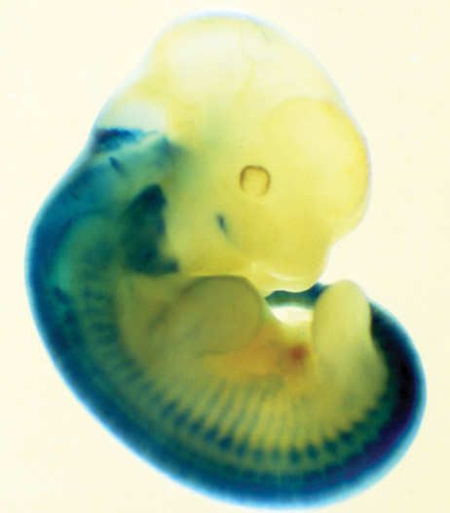
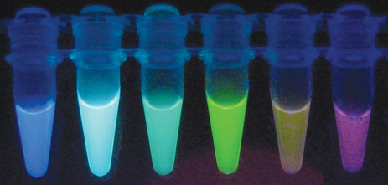
3.4 Cloning Vectors Can Be Specialized for Different Purposes
Reporter genes can be used to measure promoter activity or tissue-specific expression.
Courtesy of Joachim Goedhart, Molecular Cytology, SILS, University of Amsterdam.
Photo courtesy of Robb Krumlauf, Stowers Institute for Medical Research
Figure 03.10A: (a) Since the discovery of GFP, derivatives that fluoresce in different colors have been engineered.
Figure 03.09: Expression of a lacZ gene can be followed in the mouse by staining for b-galactosidase (in blue).

Slide 34
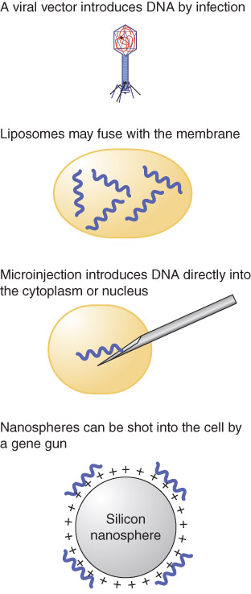
3.4 Cloning Vectors Can Be Specialized for Different Purposes
Numerous methods exist to introduce DNA into different target cells.
Figure 03.11: DNA can be released into target cells by methods that pass it across the membrane naturally.

Slide 35
3.5 Nucleic Acid Detection
Hybridization of a labeled nucleic acid to complementary sequences can identify specific nucleic acids.
probe – A radioactive nucleic acid, DNA or RNA, used to identify a complementary fragment.

Slide 36
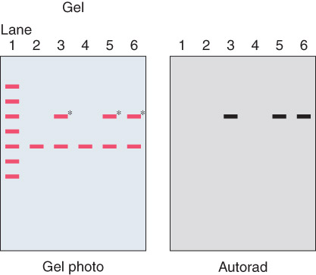
3.5 Nucleic Acid Detection
autoradiography – A method of capturing an image of radioactive materials on film.
Figure 03.12: An autoradiogram of a gel prepared from the colonies described in Figure 3.5.

Slide 37
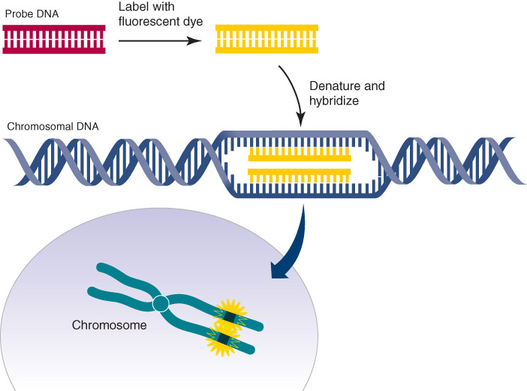
3.5 Nucleic Acid Detection
in situ hybridization – Hybridization of a probe to intact tissue to locate its complementary strand by autoradiography.
Figure 03.13: Fluorescence in situ hybridization (FISH).
Adapted from an illustration by Darryl Leja, National Human Genome Research Institute (www.genome.gov).

Slide 38
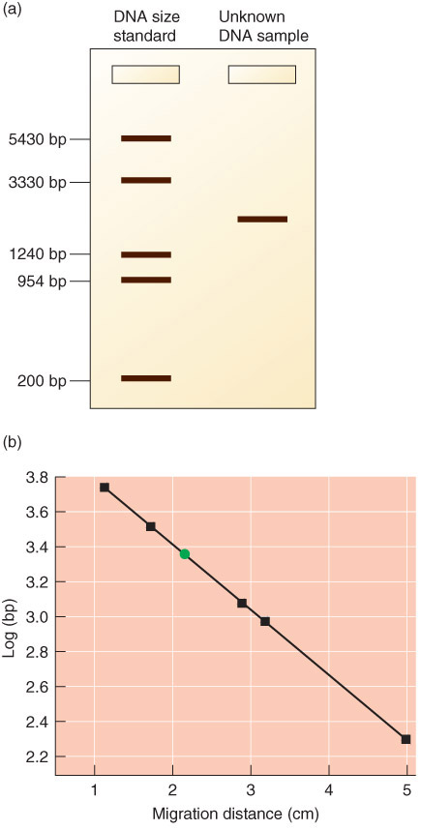
3.6 DNA Separation Techniques
Gel electrophoresis separates DNA fragments by size, using an electric current to cause the DNA to migrate toward a positive charge.
Figure 03.14: DNA sizes can be determined by gel electrophoresis.
Adapted from an illustration by Michael Blaber, Florida State University.

Slide 39
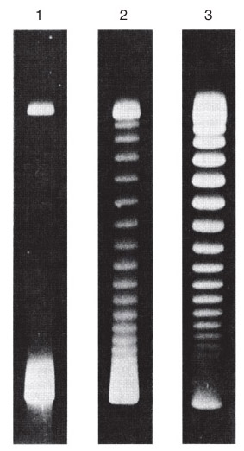
Figure 03.15: Supercoiled DNAs separated by agarose gel electrophoresis.
Reproduced from W. Keller, Proc. Natl. Acad. Sci. USA 72 (1975): 2550-2554. Photo courtesy of Walter Keller, University of Basel.

Slide 40
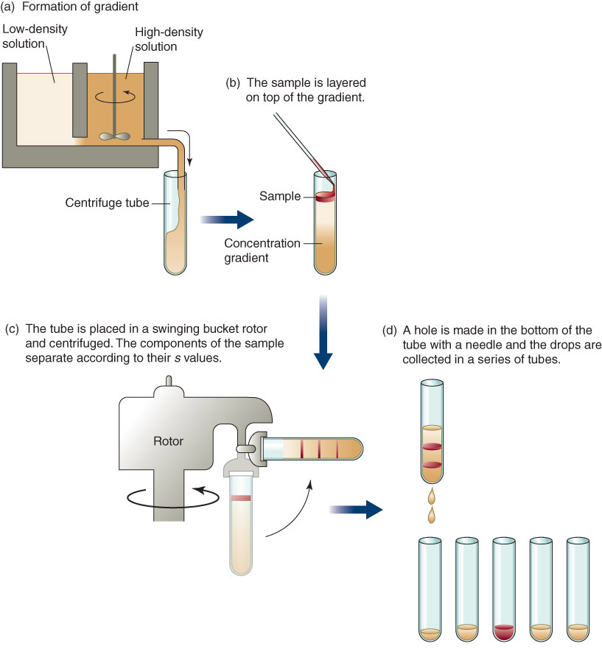
3.6 DNA Separation Techniques
DNA can also be isolated using density gradient centrifugation.
Figure 03.16: Gradient centrifugation separates samples based on their density.

Slide 41
3.7 DNA Sequencing
Classical chain termination sequencing uses dideoxynucleotides (ddNTPs) to terminate DNA synthesis at particular nucleotides.
Primer - A single stranded nucleic acid molecule with a 3′ –OH used to initiate DNA polymerase replication of a paired template strand.

Slide 42
3.7 DNA Sequencing
Fluorescently tagged ddNTPs and capillary gel electrophoresis allow automated, high-throughput DNA sequencing.
The next generations of sequencing techniques aim to increase automation and decrease time and cost of sequencing.

Slide 43
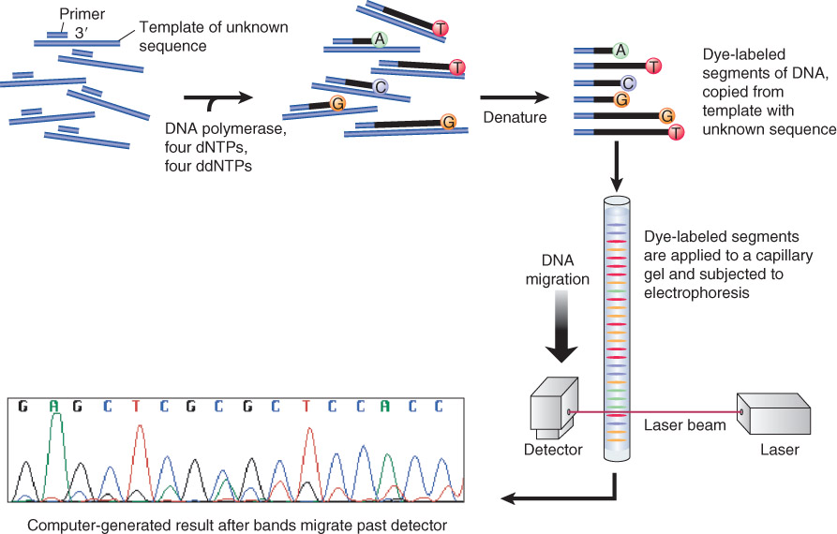
Figure 03.17: DideoxyNTP sequencing using fluorescent tags.
Photo courtesy of Jan Kieleczawa, Wyzer Biosciences

Slide 44
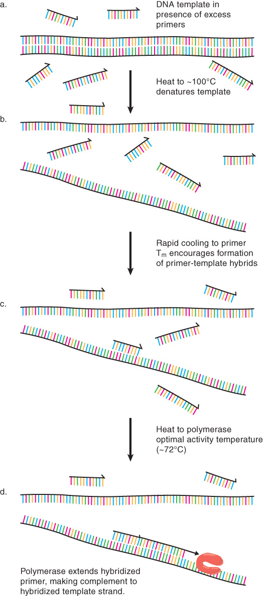
3.8 PCR and RT-PCR
Polymerase chain reaction (PCR) permits the exponential amplification of a desired sequence, using primers that anneal to the sequence of interest.
https://www.intechopen.com/books/synthetic-biology-new-interdisciplinary-science/polymerase-chain-reaction-pcr-principle-and-applications
Figure 03.18: Denaturation (a) and rapid cooling (b) of a DNA template molecule in the presence of excess primer.

Slide 45
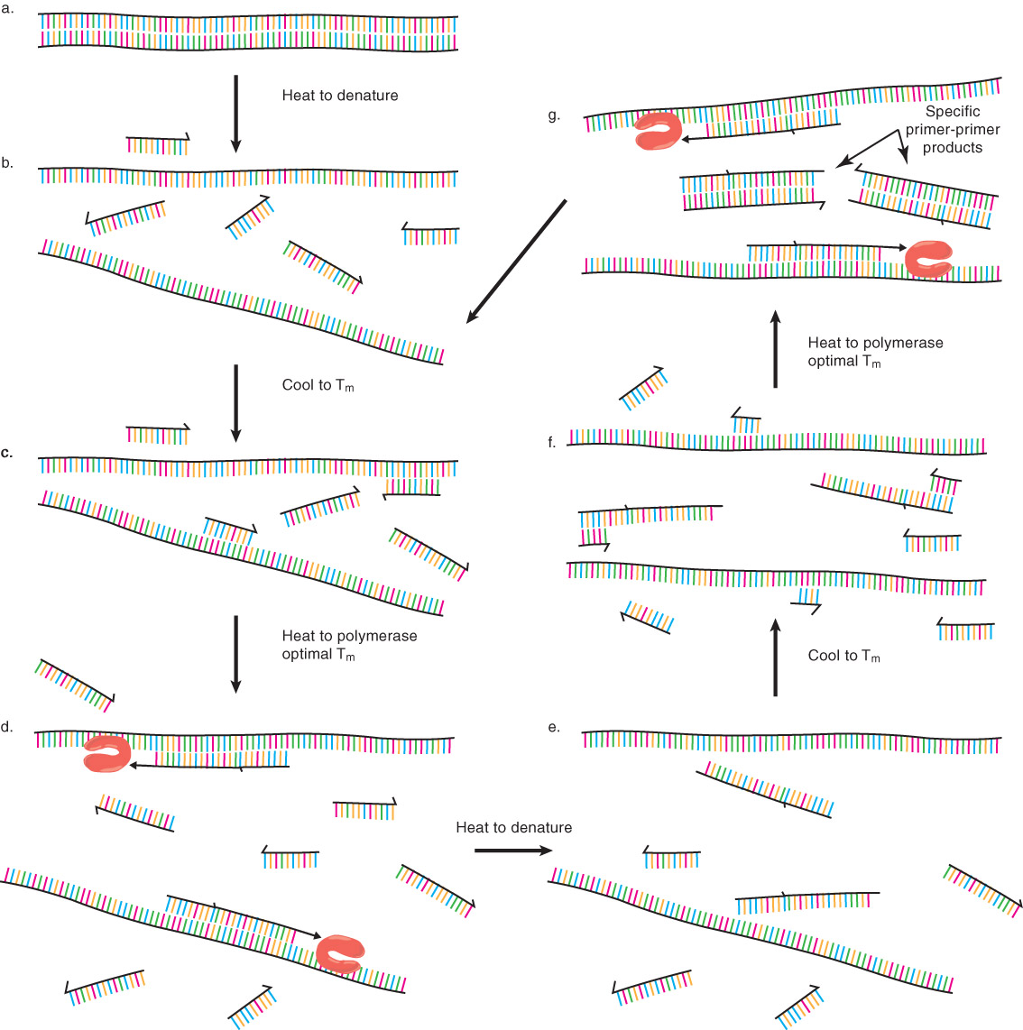
3.8 PCR and RT-PCR
RT-PCR uses reverse transcriptase to convert RNA to DNA for use in a PCR reaction.
Figure 03.19: Thermally driven cycles of primer extension.

Slide 46
3.8 PCR and RT-PCR
Real-time, or quantitative, PCR detects the products of PCR amplification during their synthesis, and is more sensitive and quantitative than conventional PCR.
PCR depends on the use of thermostable DNA polymerases that can withstand multiple cycles of template denaturation.

Slide 47
PCR
Polymerase chain reaction (PCR) is an extremely versatile technique for copying DNA.
In brief, PCR allows a specific DNA sequence to be copied or modified in predetermined ways.
The reaction is extremely powerful and under perfect conditions could amplify one DNA molecule to become 1.07 billion molecules in less than two hours.

Slide 48
PCR amplifies a specific region of a DNA strand (the DNA target).
Most PCR methods amplify DNA fragments of between 0.1 and 10 kilo base pairs (kbp) in length, although some techniques allow for amplification of fragments up to 40 kbp.

Slide 49
.
A basic PCR set-up requires several components and reagents, including:
a DNA template that contains the DNA target region to amplify
a DNA polymerase; an enzyme that polymerizes new DNA strands; heat-resistant Taq polymerase is especially common, as it is more likely to remain intact during the high-temperature DNA denaturation process
two DNA primers that are complementary to the 3′ ends of each of the sense and anti-sense strands of the DNA target (DNA polymerase can only bind to and elongate from a double-stranded region of DNA; without primers, there is no double-stranded initiation site at which the polymerase can bind);specific primers that are complementary to the DNA target region are selected beforehand, and are often custom-made in a laboratory or purchased from commercial biochemical suppliers

Slide 50
.
deoxynucleoside triphosphates, or dNTPs (sometimes called "deoxynucleotide triphosphates"; nucleotides containing triphosphate groups), the building blocks from which the DNA polymerase synthesizes a new DNA strand
a buffer solution providing a suitable chemical environment for optimum activity and stability of the DNA polymerase
bivalent cations, typically magnesium (Mg) or manganese (Mn) ions; Mg²⁺ is the most common, but Mn²⁺ can be used for PCR-mediated DNA mutagenesis, as a higher Mn²⁺ concentration increases the error rate during DNA synthesis;^{[10]} and monovalent cations, typically potassium (K) ions

Slide 51
Typically, PCR consists of a series of 20–40 repeated temperature changes, called thermal cycles, with each cycle commonly consisting of two or three discrete temperature steps (see figure below).
The cycling is often preceded by a single temperature step at a very high temperature (>90 °C (194 °F)), and followed by one hold at the end for final product extension or brief storage.

Slide 52
The temperatures used and the length of time they are applied in each cycle depend on a variety of parameters, including the enzyme used for DNA synthesis, the concentration of bivalent ions and dNTPs in the reaction, and the melting temperature (T_{m}) of the primers.^{[11]} The individual steps common to most PCR methods are as follows:

Slide 53
Initialization: This step is only required for DNA polymerases that require heat activation by hot-start PCR.^{[12]} It consists of heating the reaction chamber to a temperature of 94–96 °C (201–205 °F), or 98 °C (208 °F) if extremely thermostable polymerases are used, which is then held for 1–10 minutes.

Slide 54
Denaturation: This step is the first regular cycling event and consists of heating the reaction chamber to 94–98 °C (201–208 °F) for 20–30 seconds.
This causes DNA melting, or denaturation, of the double-stranded DNA template by breaking the hydrogen bonds between complementary bases, yielding two single-stranded DNA molecules

Slide 55
.
Annealing: In the next step, the reaction temperature is lowered to 50–65 °C (122–149 °F) for 20–40 seconds, allowing annealing of the primers to each of the single-stranded DNA templates.
Two different primers are typically included in the reaction mixture: one for each of the two single-stranded complements containing the target region.
The primers are single-stranded sequences themselves, but are much shorter than the length of the target region, complementing only very short sequences at the 3′ end of each strand.

Slide 56
Stable hydrogen bonds between complementary bases are formed only when the primer sequence very closely matches the template sequence.
During this step, the polymerase binds to the primer-template hybrid and begins DNA formation.

Slide 57
.
Extension/elongation: The temperature at this step depends on the DNA polymerase used; the optimum activity temperature for the thermostable DNA polymerase of Taq polymerase is approximately 75–80 °C (167–176 °F), though a temperature of 72 °C (162 °F) is commonly used with this enzyme.
In this step, the DNA polymerase synthesizes a new DNA strand complementary to the DNA template strand by adding free dNTPs from the reaction mixture that is complementary to the template in the 5′-to-3′ direction, condensing the 5′-phosphate group of the dNTPs with the 3′-hydroxy group at the end of the nascent (elongating) DNA strand.

Slide 58
.
The precise time required for elongation depends both on the DNA polymerase used and on the length of the DNA target region to amplify.
As a rule of thumb, at their optimal temperature, most DNA polymerases polymerize a thousand bases per minute.
Under optimal conditions (i.e., if there are no limitations due to limiting substrates or reagents), at each extension/elongation step, the number of DNA target sequences is doubled.
With each successive cycle, the original template strands plus all newly generated strands become template strands for the next round of elongation, leading to exponential (geometric) amplification of the specific DNA target region.

Slide 59
The processes of denaturation, annealing and elongation constitute a single cycle. Multiple cycles are required to amplify the DNA target to millions of copies.
The formula used to calculate the number of DNA copies formed after a given number of cycles is 2^{n}, where n is the number of cycles. Thus, a reaction set for 30 cycles results in 2³⁰, or 1,073,741,824, copies of the original double-stranded DNA target region.

Slide 60
Final elongation: This single step is optional, but is performed at a temperature of 70–74 °C (158–165 °F) (the temperature range required for optimal activity of most polymerases used in PCR) for 5–15 minutes after the last PCR cycle to ensure that any remaining single-stranded DNA is fully elongated.

Slide 61
Final hold: The final step cools the reaction chamber to 4–15 °C (39–59 °F) for an indefinite time, and may be employed for short-term storage of the PCR products.

Slide 62
.
It is critical to determine a proper temperature for the annealing step because efficiency and specificity are strongly affected by the annealing temperature.
This temperature must be low enough to allow for hybridization of the primer to the strand, but high enough for the hybridization to be specific, i.e., the primer should bind only to a perfectly complementary part of the strand, and nowhere else.
If the temperature is too low, the primer may bind imperfectly. If it is too high, the primer may not bind at all. A typical annealing temperature is about 3–5 °C below the T_{m} of the primers used.

Slide 63
Blotting techniques
The terms northern, western and eastern blotting are derived from what initially was a molecular biology joke that played on the term Southern blotting, after the technique described by Edwin Southern for the hybridisation of blotted DNA. Patricia Thomas, developer of the RNA blot which then became known as the northern blot, actually didn't use the term

Slide 64
.
Southern blot is a method for probing for the presence of a specific DNA sequence within a DNA sample.
DNA samples before or after restriction enzyme (restriction endonuclease) digestion are separated by gel electrophoresis and then transferred to a membrane by blotting via capillary action.
The membrane is then exposed to a labeled DNA probe that has a complement base sequence to the sequence on the DNA of interest.

Slide 65
.
Southern blotting is less commonly used in laboratory science due to the capacity of other techniques, such as PCR, to detect specific DNA sequences from DNA samples.
These blots are still used for some applications, however, such as measuring transgene copy number in transgenic mice or in the engineering of gene knockout embryonic stem cell lines.

Slide 66
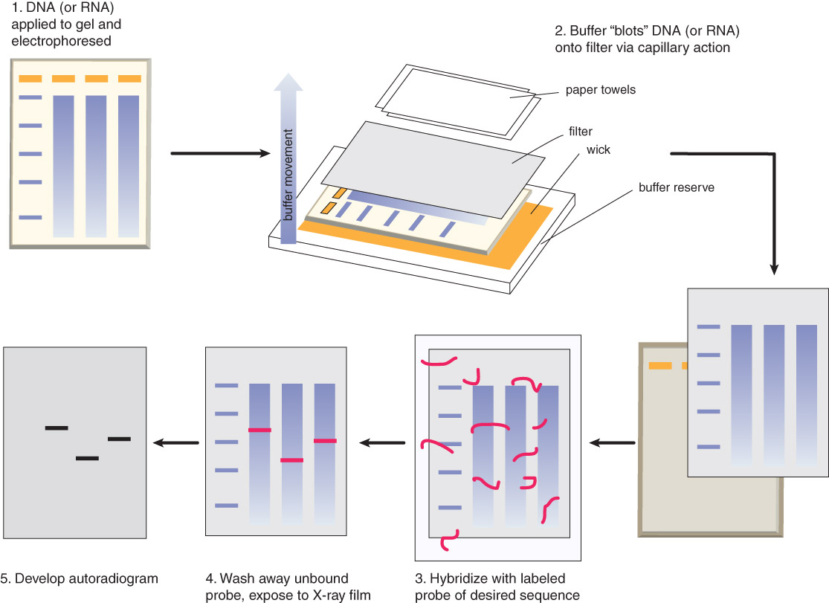
Figure 03.21: Southern blot.

Slide 67
Northern blotting is similar to Southern blotting, but involves the transfer of RNA from a gel to a membrane.
Western blotting entails separation of proteins on a sodium dodecyl sulfate (SDS) gel, transfer to a nitrocellulose membrane, and detection of proteins of interest using antibodies.
Notes:
Northern blotting
The northern blot is used to study the expression patterns of a specific type of RNA molecule as relative comparison among a set of different samples of RNA. It is essentially a combination of denaturing RNA gel electrophoresis, and a blot. In this process RNA is separated based on size and is then transferred to a membrane that is then probed with a labeled complement of a sequence of interest. The results may be visualized through a variety of ways depending on the label used; however, most result in the revelation of bands representing the sizes of the RNA detected in sample. The intensity of these bands is related to the amount of the target RNA in the samples analyzed. The procedure is commonly used to study when and how much gene expression is occurring by measuring how much of that RNA is present in different samples. It is one of the most basic tools for determining at what time, and under what conditions, certain genes are expressed in living tissues

Slide 68
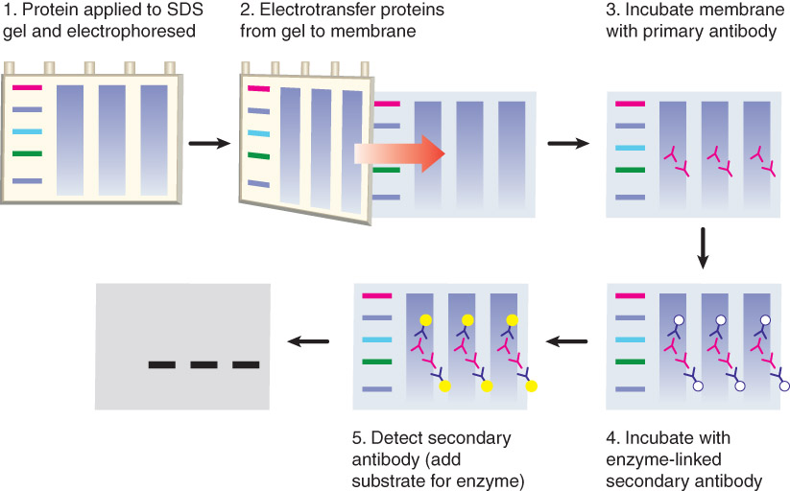
Figure 03.24: In a western blot, proteins are separated by size on an SDS gel, transferred to a nitrocellulose membrane, detected using an antibody.
Notes:
Western blotting
In western blotting, proteins are first separated by size, in a thin gel sandwiched between two glass plates in a technique known as SDS-PAGE. The proteins in the gel are then transferred to a polyvinylidene fluoride (PVDF), nitrocellulose, nylon, or other support membrane. This membrane can then be probed with solutions of antibodies. Antibodies that specifically bind to the protein of interest can then be visualized by a variety of techniques, including colored products, chemiluminescence, or autoradiography. Often, the antibodies are labeled with enzymes. When a chemiluminescent substrate is exposed to the enzyme it allows detection. Using western blotting techniques allows not only detection but also quantitative analysis. Analogous methods to western blotting can be used to directly stain specific proteins in live cells or tissue sections.
Eastern blotting
The eastern blotting technique is used to detect post-translational modification of proteins. Proteins blotted on to the PVDF or nitrocellulose membrane are probed for modifications using specific substrates.

Slide 69
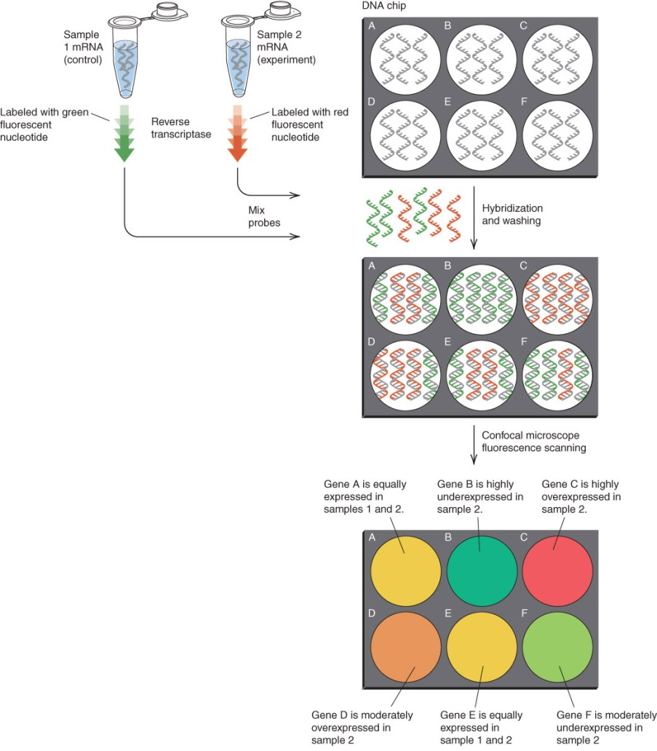
DNA Microarrays
DNA microarrays comprise known DNA sequences spotted or synthesized on a small chip.
Figure 03.25: Gene expression arrays are used to detect the levels of all the expressed genes in an experimental sample.
Notes:
MICROARRAYS
A DNA microarray is a collection of spots attached to a solid support such as a microscope slide where each spot contains one or more single-stranded DNA oligonucleotide fragments. Arrays make it possible to put down large quantities of very small (100 micrometre diameter) spots on a single slide. Each spot has a DNA fragment molecule that is complementary to a single DNA sequence. A variation of this technique allows the gene expression of an organism at a particular stage in development to be qualified (expression profiling). In this technique the RNA in a tissue is isolated and converted to labeled complementary DNA (cDNA). This cDNA is then hybridized to the fragments on the array and visualization of the hybridization can be done. Since multiple arrays can be made with exactly the same position of fragments, they are particularly useful for comparing the gene expression of two different tissues, such as a healthy and cancerous tissue. Also, one can measure what genes are expressed and how that expression changes with time or with other factors. There are many different ways to fabricate microarrays; the most common are silicon chips, microscope slides with spots of ~100 micrometre diameter, custom arrays, and arrays with larger spots on porous membranes (macroarrays). There can be anywhere from 100 spots to more than 10,000 on a given array. Arrays can also be made with molecules other than DNA.

Slide 70
3.10 DNA Microarrays
Genome-wide transcription analysis is performed using labeled cDNA from experimental samples hybridized to a microarray containing sequences from all ORFs of the organism being used.
SNP arrays permit genome-wide genotyping of single-nucleotide polymorphisms.
Array comparative genome hybridization (array-CGH) allows the detection of copy number changes in any DNA sequence compared between two samples.

Slide 71
NEXT GENERATION SEQUENCING NGS
DNA sequencing is the process of determining the nucleic acid sequence – the order of nucleotides in DNA.
It includes any method or technology that is used to determine the order of the four bases: adenine, guanine, cytosine, and thymine. The advent of rapid DNA sequencing methods has greatly accelerated biological and medical research and discovery.
Notes:
Knowledge of DNA sequences has become indispensable for basic biological research, and in numerous applied fields such as medical diagnosis, biotechnology, forensic biology, virology and biological systematics. Comparing healthy and mutated DNA sequences can diagnose different diseases including various cancers,characterize antibody repertoire,and can be used to guide patient treatment.
Having a quick way to sequence DNA allows for faster and more individualized medical care to be administered, and for more organisms to be identified and cataloged. The rapid speed of sequencing attained with modern DNA sequencing technology has been instrumental in the sequencing of complete DNA sequences, or genomes, of numerous types and species of life, including the human genome and other complete DNA sequences of many animal, plant, and microbial species.

Slide 72
NGS
Next-generation sequencing (NGS) is a technology for determining the sequence of DNA or RNA to study genetic variation associated with diseases or other biological phenomena. Introduced for commercial use in 2005, this method was initially called “massively-parallel sequencing”, because it enabled the sequencing of many DNA strands at the same time, instead of one at a time as with traditional Sanger sequencing by capillary electrophoresis (CE).

Slide 73
.
Each of these technologies has utility in today’s genetic analysis environment. Sanger sequencing is best for analyzing small numbers of gene targets and samples and can be accomplished in a single day.
It is also considered the gold-standard sequencing technology, so NGS results are often verified using Sanger sequencing.
NGS enables the interrogation of hundreds to thousands of genes at one time in multiple samples, as well as discovery and analysis of different types of genomic features in a single sequencing run, from single nucleotide variants (SNVs), to copy number and structural variants, and even RNA fusions.

Slide 74
NGS provides the ideal throughput per run, and studies can be performed quickly and cost-effectively.
Additional advantages of NGS include lower sample input requirements, higher accuracy, and ability to detect variants at lower allele frequencies than with Sanger sequencing.

Slide 75
A typical NGS experiment shares similar steps regardless of the instrument technology used
1. Construct library
A sequencing “library” must be created from the sample. The DNA (or cDNA) sample is processed into relatively short double-stranded fragments (100–800 bp).
Depending on the specific application, DNA fragmentation can be performed in a variety of ways, including physical shearing, enzyme digestion, and PCR-based ampilfication of specific genetic regions.
The resulting DNA fragments are then ligated to technology-specific adaptor sequences, forming a fragment library.
These adaptors may also have a unique molecular “barcode”, so each sample can be tagged with a unique DNA sequence. This allows for multiple samples to be mixed together and sequenced at the same time.

Slide 76
For example, barcodes 1-20 can be used to individually label 20 samples and then analyze them in a single sequencing run. This approach, called “pooling” or “multiplexing”, saves time and money during sequencing experiments and controls for workflow variation, as pooled samples are processed together.

Slide 77
In addition to fragment libraries, there are two other specialized methods of library preparation: paired-end libraries and mate-pair libraries. Paired-end libraries allow users to sequence the DNA fragment from both ends, instead of typical sequencing which occurs only in a single direction.
Paired-end libraries are created like regular fragment libraries, but they have adaptor tags on both ends of the DNA insert that enable sequencing from two directions.
This methodology makes it easier to map reads and can be used to improve detection of genomic rearrangements, repetitive sequence elements, and RNA gene fusions or splice variants.
However, improvements in modern library prep methods and analysis tools have made it possible to detect these features with single direction sequencing as well.

Slide 78
Mate-pair libraries are more complex to create than fragment or paired-end libraries and involve much larger-sized DNA inserts (over 2 kb and up to 30 kb).
Sequencing of mate-pair libraries generates two reads that are distal to each other and in the opposite orientation.
Using the physical information associated between the two sequencing reads, mate pair sequencing is useful for de novo assembly, large structural variant detection, and identification of complex genomic rearrangements.

Slide 79
.
Clonal amplification
Prior to sequencing, the DNA library must be attached to a solid surface and clonally amplified to increase the signal that can be detected from each target during sequencing.
During this process, each unique DNA molecule in the library is bound to the surface of a bead or a flow-cell and PCR amplified to create a set of identical clones.
In the case of Ion Torrent technology, a process called “templating” is used to add library molecules to beads.

Slide 80
3. Sequence library
All of the DNA in the library is sequenced at the same time using a sequencing instrument.
Although each NGS technology is unique, they all utilize a version of the "sequencing by synthesis" method, reading individual bases as they grow along a polymerized strand.
This is a cycle with common steps: DNA base synthesis on single stranded DNA, followed by detection of the incorporated base, and then subsequent removal of reactants to restart the cycle.

Slide 81
Most sequencing instruments use optical detection to determine nucleotide incorporation during DNA synthesis. Ion Torrent instruments use electrical detection to sense the release of hydrogen ions, which naturally occurs when nucleotides are incorporated during DNA synthesis.

Slide 82
Analyze data
Each NGS experiment generates large quantities of complex data consisting of short DNA reads. Although each technology platform has its own algorithms and data analysis tools, they share a similar analysis ‘pipeline’ and use common metrics to evaluate the quality of NGS data sets.
Analysis can be divided into three steps: primary, secondary, and tertiary analysis. Primary analysis is the processing of raw signals from instrument detectors into digitized data or base calls.

Slide 83
These raw data are collected during each sequencing cycle. The output of primary analysis is files containing base calls assembled into sequencing reads (FASTQ files) and their associated quality scores (Phred quality score).
Secondary analysis involves read filtering and trimming based on quality, followed by alignment of reads to a reference genome or assembly of reads for novel genomes, and finally by variant calling.
The main output is a BAM file containing aligned reads. Tertiary analysis is the most challenging step, as it involves interpreting results and extracting meaningful information from the data.

Slide 84
PATERNITY TESTING
DNA paternity testing is the use of DNA profiles to determine whether an individual is the biological parent of another individual.
Paternity testing can be especially important when the rights and duties of the father are in issue and a child's paternity is in doubt.
Tests can also determine the likelihood of someone being a biological grandparent.
Though genetic testing is the most reliable standard, older methods also exist, including ABO blood group typing, analysis of various other proteins and enzymes, or using human leukocyte antigen antigens.

Slide 85
The current techniques for paternity testing are using polymerase chain reaction (PCR) and restriction fragment length polymorphism (RFLP). Paternity testing can now also be performed while the woman is still pregnant from a blood draw.
DNA testing is currently the most advanced and accurate technology to determine parentage.
In a DNA paternity test, the result (called the 'probability of parentage) is 0% when the alleged parent is not biologically related to the child, and the probability of parentage is typically 99.99% when the alleged parent is biologically related to the child.

Slide 86
However, while almost all individuals have a single and distinct set of genes, rare individuals, known as "chimeras", have at least two different sets of genes, which can result in a false negative result if their reproductive tissue has a different genetic make-up from the tissue sampled for the test

Slide 87
Paternity or maternity testing for child or adult
The DNA test is performed by collecting buccal (cheek) cells found on the inside of a person's cheek using a buccal or cheek swab.
These swabs have wooden or plastic stick handles with a cotton on synthetic tip.
The collector rubs the inside of a person's cheek to collect as many buccal cells as possible, which are then sent to a laboratory for testing.
Samples from the alleged father or mother and the child would be needed
Notes:
Prenatal paternity testing for unborn child
Invasive prenatal paternity testing
It is possible to determine who the biological father of the fetus is while the woman is still pregnant through procedures called chorionic villus sampling or amniocentesis. Chorionic villus sampling retrieves placental tissue in either a transcervical or transabdominal manner. Amniocentesis retrieves amniotic fluid by inserting a needle through the pregnant mother's abdominal wall. These procedures are highly accurate because they are taking a sample directly from the fetus; however, there is a small risk for the woman to miscarry and lose the pregnancy as a result. Both CVS and Amnio require the pregnant woman to visit a genetic specialist known as a maternal fetal medicine specialist who will perform the procedure.
Non-invasive prenatal paternity testing
Advances in genetic testing have led to the ability to identify the biological father while the woman is still pregnant. There is a small amount of fetal DNA (cffDNA) present in the mother's blood during pregnancy. This allows for accurate fetal DNA paternity testing during pregnancy from a blood draw with no risk of miscarriage. Studies have shown that cffDNA can first be observed as early as 7 weeks gestation, and the amount of cffDNA increases as the pregnancy progresses.

Slide 88
CRISPR (clustered regularly interspaced short palindromic repeats) is a family of DNA sequences found in the genomes of prokaryotic organisms such as bacteria and archaea.
These sequences are derived from DNA fragments of bacteriophages that had previously infected the prokaryote.
They are used to detect and destroy DNA from similar bacteriophages during subsequent infections. Hence these sequences play a key role in the antiviral (i.e. anti-phage) defense system of prokaryotes.
Notes:
Cas9 (or "CRISPR-associated protein 9") is an enzyme that uses CRISPR sequences as a guide to recognize and cleave specific strands of DNA that are complementary to the CRISPR sequence. Cas9 enzymes together with CRISPR sequences form the basis of a technology known as CRISPR-Cas9 that can be used to edit genes within organisms.^{[9]} This editing process has a wide variety of applications including basic biological research, development of biotechnology products, and treatment of diseases.^{[10][11]} The CRISPR-Cas9 genome editing technique was a significant contributor to the Nobel Prize in Chemistry in 2020 being awarded to Emmanuelle Charpentier and Jennifer Doudna.

Slide 89
.
The CRISPR-Cas system is a prokaryotic immune system that confers resistance to foreign genetic elements such as those present within plasmids and phages and provides a form of acquired immunity.
RNA harboring the spacer sequence helps Cas (CRISPR-associated) proteins recognize and cut foreign pathogenic DNA.
Other RNA-guided Cas proteins cut foreign RNA. CRISPR are found in approximately 50% of sequenced bacterial genomes and nearly 90% of sequenced archaea.

Slide 90
BIOINFORMATICS IN MEDICINE
Bioinformatics is an integrative field in life sciences that combines biology and information technology. Its application includes the study of molecular sequences and genomics data.
Being a combination of different branches of life sciences, the objective of bioinformatics is to develop methodologies and tools to study large volumes of biological data in order to organize, store, systematize, visualize, annotate, query, understand and interpret those data.

Slide 91
Bioinformatics utilizes modern computer science that includes cloud computing, statistics, mathematics and even pattern recognition, reconstruction, machine learning, simulation and iterative approaches, and molecular modelling /algorithms.
In simpler terms, bioinformatics involves the application of computer technology to manage large volumes of biological information.
Bioinformatics has proven quite useful in medicine as the complete sequencing of the human genome has helped to unlock the genetic contribution for many diseases. Its applications include drug discovery, personalized medicine, preventative medicine and gene therapy.

Slide 92
END
Assignment
Describe the steps in PCR and NGS.
Common problems that could arise with paternity test report.
Describe the clinical applications of PCR in clinical medicine.
SUBMIT BEFORE THE NEXT LECTURE.

