Slide 1
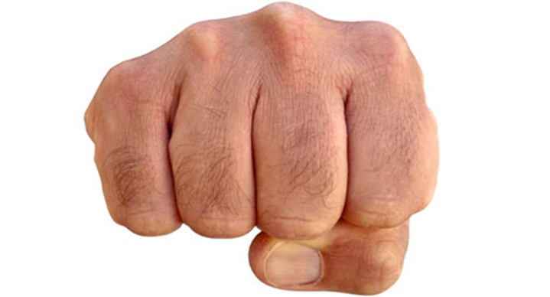
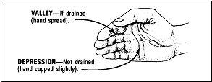
Hilltop
Saddle
Ridgeline
Draw
Spur

