Slide 1
بسم الله الرحمن الرحيم

Slide 2
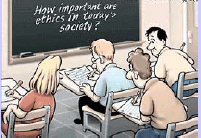
How to Write Scientific Paper ,Publication and Ethical Issues in Publication
Assistant professor
Dr \ Awadia Greeballah Suliman Ali
AAU – Sudan

Slide 4
Publishing is one of the necessary steps embedded in the scientific research process. It is also necessary for graduation and career progression.
What to publish:
New and original results or methods
Reviews or summaries of particular subject
Manuscripts that advance the knowledge and understanding in a certain scientific field
What NOT to publish:
Reports of no scientific interest
Out of date work
Duplications of previously published work
Incorrect/unacceptable conclusions
You need a GOOD manuscript to present your contributions to the scientific community

Slide 5
Questions to answer before you write
Think about WHY you want to publish your work.
Is it new and interesting?
Is it a current hot topic?
Have you provided solutions to some difficult problems?
Are you ready to publish at this point?
If all answers are “yes”, then start preparations for your manuscript

Slide 6
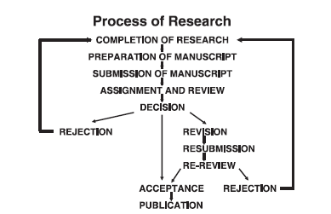
Publication
Publication of results is an integral and essential component of research.
The University encourages all researchers to promote their work through publishing and other forms of dissemination.
Flow diagram of review and publication process for a manuscript
submitted to a journal
Dale J. Benos, Jorge Fabres, John Farmer, et al Ethics and scientific publication// Adv Physiol Educ 29: 59–74, 2005

Slide 7
Without publication, science is dead.
—Gerard Piel

Slide 8
Paper contents
Title
Authors
Abstract
Keywords
Main text (IMRAD)
Introduction
Methods
Results
And
Discussion (Conclusions)
Acknowledgements
References
Supplementary material

Slide 9
The term scientific writing commonly denotes the reporting of original research in journals, through scientific papers in standard format. In its broader sense, scientific writing also includes communication about science through other types of journal articles, such as review papers summarizing and integrating previously published research. And in a still broader sense, it includes other types of professional communication by scientists—for example, grant proposals, oral presentations, and poster presentations.

Slide 10
A scientific paper is a written and published report describing original research results. That short definition must be qualified, however, by noting that a scientific paper must be written in a certain way, as defined by tradition, editorial practice, scientific ethics, and the interplay of printing and publishing procedures.

Slide 11
What is publishable….
Journals like to publish papers that are going to be widely read and useful to the readers
• Papers that report “original and significant” findings that are likely to be of interest to a broad spectrum of its readers
• Papers that are well organized and well written, with clear statements regarding how the findings relate to and advance the understanding/development of the subject
• Papers that are concise and yet complete in their presentation of the findings

Slide 12
What is not acceptable…
• Papers that are routine extensions of previous reports and that do not appreciably advance fundamental understanding or knowledge in the area
• Incremental / fragmentary reports of research results
• Verbose, poorly organized, papers cluttered with unnecessary or poor quality illustrations
• Violations of ethical guidelines, including plagiarism of any type or degree (of others or of oneself) and questionable research practices (QRP)

Slide 13
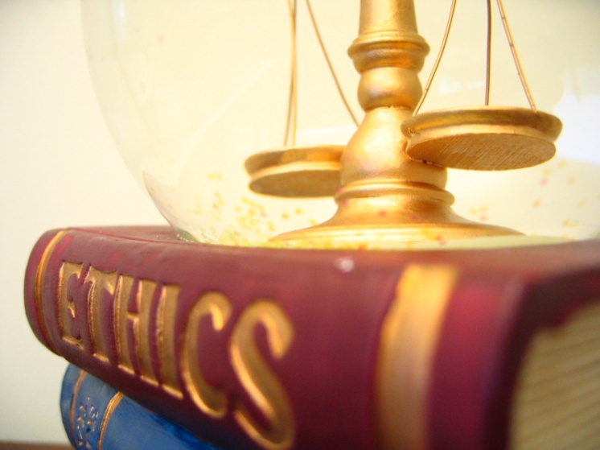
Ethics of publication

Slide 15
Introduction
Publication is the final stage of research and therefore a responsibility for all researchers.
Scholarly publications are expected to provide a detailed and permanent record of research.
Because publications form the basis for both new research and the application of findings, they can affect not only the research community but also, indirectly, society at large.

Slide 16
Researchers therefore have a responsibility to ensure that their publications are honest, clear, accurate, complete and balanced, and should avoid misleading, selective or ambiguous reporting.
Journal editors also have responsibilities for ensuring the integrity of the research literature and these are set out in companion guidelines.

Slide 17
Before writing a scientific paper and submitting it to a journal—and indeed, before embarking on your research—you should know the basic ethical norms for scientific conduct and scientific publishing. Some of these norms may be obvious, others not.

Slide 18
To reduce bias ,encourage complete and transparent reporting and to ensure appropriate attribution and accountability, the following was practical guides to the areas in which you need to think about publication ethics while you conduct your research and write your paper

Slide 19
Some areas of research and publication ethics:
1. Research misconduct (falsification, fabrication and plagiarism)
2. Collaboration issues (authorship)
4. Conflicts of interest or obligation
5. funding sources
6. Animal subject research
7. Human subject research

Slide 20
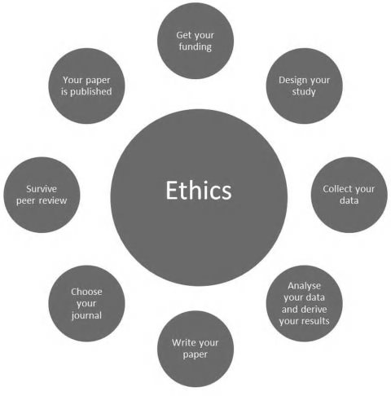
Ethics at the center of research and its publication.

Slide 21
Getting your funding
If you received a grant or another form of funding to conduct your study (or, indeed, to write your paper), then you should state the source of funding in your manuscript.

Slide 22
Designing your study
You may have been required to submit your study design for ethical review board approval within your institution, perhaps for regulatory purposes, and particularly if your study involves people or animals. You should describe these aspects of your study briefly in your paper.
It is good practice to define (and register) your study protocol and to specify your data analysis plan before you start your study. You should describe these aspects of your study design in your paper and, if you registered your study design, give information on this. These approaches are designed to help reduce bias in the resulting research

Slide 23
While you are designing your study it is possible that you will be able to identify who will become a named author on your paper (or papers).

Slide 24
Collecting your data, analyzing your data,
deriving your results
If your study design changed while you were conducting your study, you should explain how (in an ideal world your design wouldn’t change, but if it did then you must clarify). You should describe how your data analysis was performed and whether this was in accordance with or differs from your initial plan (again, it shouldn’t differ)

Slide 25
Writing your paper Authors
Working out who is and who isn’t an author is important, given the rewards that authorship can bring and the importance of appropriate attribution and accountability Some simple principles include the following:
• Your authors should be those who actually did the work.
• You shouldn't ’ t give or accept gift authorship.
• You should demand that everyone who meets your authorship criteria is listed as an author.
• You should require that everyone who has made a significant contribution, but who does not quite meet your authorship criteria, is acknowledged.

Slide 26
The list of authors establishes accountability as well as credit.
—National Academies Committee
on Science, Engineering, and Public Policy

Slide 27
Authorship credit should be based on 1) substantial contributions to conception and design, acquisition of data, or analysis and interpretation of data; 2) drafting the article or revising it critically for important intellectual content; and 3) final approval of the version to be published. Authors should meet conditions 1, 2, and 3.
All persons designated as authors should qualify for authorship, and all those who qualify should be listed

Slide 28
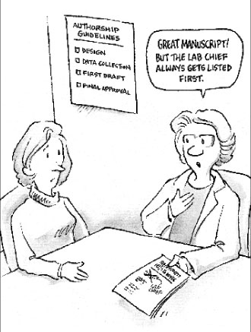
Authorship
guest authors are those who do not meet accepted authorship criteria but are listed because of their seniority, reputation or supposed influence
gift authors are those who do not meet accepted authorship criteria but are listed as a personal favour or in return for payment
ghost authors are those who meet authorship criteria but are not listed

Slide 29
Reporting standards
You should follow established approaches to report your study completely and accurately.
Using these reporting standards will help you ensure that you include all the information that is needed to report your work fully and clearly. It will also help you write an easy- to - understand paper, from an editor’ s, peer reviewer’ s and a reader’s point of view. This may ease your journey through peer review and improve your chances of rapid acceptance and publication.

Slide 30
The EQUATOR network curates a central resource for reporting standards in biomedical research
Types of reporting guidelines curated by EQUATOR
• Biospecimen reporting
• Diagnostic accuracy studies
• Economic evaluations
• Experimental studies
• Mixed methods studies
• Observational studies
• Qualitative research
• Quality improvement studies
• Reliability and agreement studies
• Reporting data
• Sections of research reports
• Specific conditions or procedures
• Statistical methods and analyses
• Systematic reviews and meta -analysis

Slide 31
How many papers from one research study?
How long is a piece of string? We believe that you should make a decision to publish your results in usefully sized pieces, not the smallest possible publishable unit.
More than one paper is fine, if each paper stands alone.
You should take care to reference the original (primary) paper in any papers that follow, and to explain the relationships between the multiple papers and the results they present.
Duplicate publication causes confusion among readers, may distort results of meta - analyses and practice guidelines, and can cause legal problems by infringing copyright.
You must avoid publishing the same results in more than one paper without making it clear to readers that you have already published those results elsewhere

Slide 32
References
You should provide as complete a reference list as is practical, focusing particularly on research that’s related to your own that will help readers put your findings in context.
There are many reasons why people choose particular references to include in their papers, not all of which are ethical or sensible.

Slide 33
Avoiding plagiarism
You should attribute all previously published material whether it is someone else ’ s work or indeed your own. While having to reference your own words from previous publications may seem unnecessary, it is important to remember that the copyright may now be held by the owner of those publications so you must acknowledge prior publication. Most publishers will use programs like CrossCheck to analyze levels of duplication (see ‘ Surviving Peer Review ’ ). It is advisable to attribute all recycled material

Slide 34
Some journals have begun using computerized plagiarism detection systems at this stage, such as CrossCheck (iThenticate) and (Turnitin) to help prevent plagiarism and address duplicate publication before it happens.
These systems compare submitted manuscripts with already published material (in journals and on the Internet) and identify possible cases of plagiarism by matching strings of related text. Human intervention, usually from the journal’s editorial team, is then needed to interpret the algorithm - derived results and to address possible problems appropriately.

Slide 35
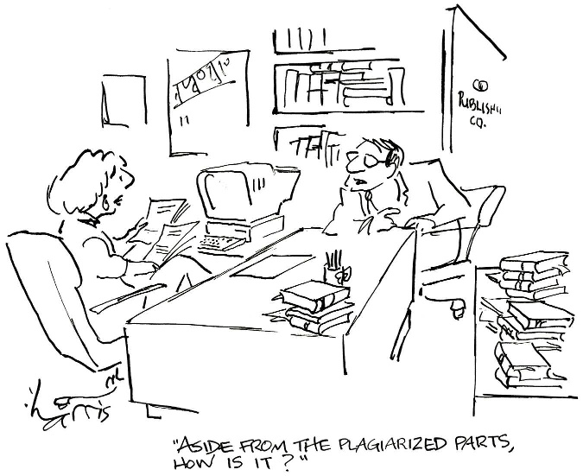

Slide 36
Ethical principles on humans and animals
If your research involves human subjects or animals, the journal to which you submit your paper is likely to require documentation that they were treated ethically. Before beginning your study, obtain all needed permissions with regard to human or animal research.

Slide 37
For experiments involving human subjects, the committee approving the experiments should be identified and the research conducted according to the principles expressed.
The Authors should confirm that informed consent was obtained from all subjects.
Appropriate approval, licensing or registration should be obtained before the research begins and details should be provided in the report (e.g. Institutional Review Board, Research Ethics Committee approval, national licensing authorities for the use of animals)

Slide 38
Manuscript must document that the study was approved by an ethical review board before it was done.

Slide 39
Funding statement
You should describe the grant or other funding sources that support your research, or the absence of such funds.
Disclosures
Conflicts of interest continue to be a hot topic, particularly financial conflicts. You should report potential sources of conflict related to your research that are not only financial, but also political or personal, reporting conflicts of interest should be treated separately from reporting research funding, and that this information should be reported separately in your manuscript. But different journals take different approaches, and you will be doing an ethical job if you report both funding sources and potential conflicts of interest no matter how you report them.

Slide 40
Ethics requires honest reporting of conflicts of interest. More importantly, ethics demands that such involvements not interfere with the objectivity of your research. Some scientists avoid all such involvements to prevent even the possibility of seeming biased

Slide 41
Acknowledgement
You should publish a short acknowledgement to the people who made contributions to your research It’s important to get permission from these people before acknowledging them, which is another reason to consider authorship while you are designing your study

Slide 42
Choosing your journal
You should submit your paper to one journal at a time, and wait for the decision from that journal before moving on to submit to a second journal.
You should not, generally speaking and as discussed above, publish the same results and analysis more than once

Slide 43
Surviving peer review
When you submit your paper to a journal, its editors and peer reviewers will assess the quality of your work according to their journal ’ s particular criteria (usually a mix of soundness of methods, novelty of results, relevance to their audience and priority or possible impact).
As well as assessing the quality of your work, the editors and peer reviewers will assess the ethical aspects of your research and how you have reported these in your manuscript.

Slide 44
(PEANUTS © 1974 Peanuts Worldwide LLC. Dist. By UNIVERSAL UCLICK.
Reprinted with permission. All rights reserved.)

Slide 45
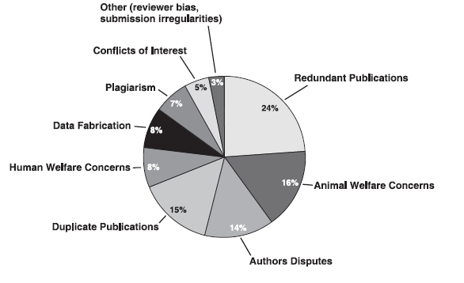
Distribution of ethical issues in American Physiological Society publications (1996 through March 2004)
Dale J. Benos, Jorge Fabres, John Farmer, et al Ethics and scientific publication// Adv Physiol Educ 29: 59–74, 2005

Slide 46
Scientific Misconduct

Slide 47
Fraud definition
•“…when an author, editor or referee makes a false representation to obtain some unfair advantage or to injure deliberately the rights or interests of another person or group”
--M. Laffollett
Fraud includes…
•Fabrication
•Falsification
•Plagiarism
•Misrepresentation of authorship
•Unreasonably delaying review or publication for personal gain

Slide 48
(1) Fabrication means making up data or results and recording or reporting them.
(2) Falsification means manipulating research materials, equipment, or processes, or changing or omitting data or results such that the research
is not accurately represented in the research record.
(3) Plagiarism means the appropriation of another person’s ideas, processes, results or words without giving appropriate credit.

Slide 49
“… the fabrication of research data … hits at the heart of our responsibility to society, the reputation of our institution, the trust between the public and the biomedical research community, and our personal credibility and that of our mentors, colleagues…”
“It can waste the time of others, trying to replicate false data or designing experiments based on false premises, and can lead to therapeutic errors. It can never be tolerated.”
Professor Richard Hawkes
Department of Cell Biology and Anatomy, University of Calgary

Slide 50
“Scientific misconduct means fabrication, falsification, plagiarism, or other practices that seriously deviate from those that are commonly accepted within the scientific community for proposing, conducting or reporting research”
Managing Allegations of Scientific Misconduct: A Guidance Document for Editors, January 2000, Office of Research Integrity, Office of Public Health and Science, U.S. Dept. of Health and Human Services http://ori.dhhs.gov

Slide 51
Plagiarism: using the ideas or words of another person without giving appropriate credit (Nat. Acad. Press document)
Self-Plagiarism: The verbatim copying or reuse of one’s own research
Both types of plagiarism are considered to be unacceptable practice by most scientific publications

Slide 52
A definition of plagiarism from the Office of Research Integrity:
Plagiarism includes both the theft or misappropriation of intellectual property and the substantial unattributed textual copying of another's work. It does not include authorship or credit disputes.
All Authors are required to grant editors an exclusive publishing license before their work can be published.
This license also contains the warranty that the work is the author’s original work.

Slide 53
The available literature on self-plagiarism is concerned with four
major problems:
• The publication of what is essentially the same paper in more than one journal, but without any indication that the paper has been published elsewhere (i.e., redundant and duplicate publication);
• the partitioning of a large study which should have been reported in a single paper into smaller published studies
• copyright infringement; and
• the practice of text recycling( reuse your own words).
“Authors can quote from portions of other works with proper citations, but large portions of text, even quoted and cited can infringe on copyright and would not fall under copyright exceptions or “fair use” guidelines.

Slide 54
Examples of Plagiarism
Sources not cited
“The Ghost Writer”
Turns in another’s work as own
“The Potluck Paper”
Tries to disguise by copying from several sources
“The Self-Stealer”
“borrows” from own work (self plagiarism)
Sources cited
“The Misinformer”
Provides inaccurate information regarding source
“The Too-Perfect Paraphrase”
Cites sources, but does not use quotations for word-for-word sections
plagiarism.org

Slide 55
Credit
Citing sources of information and ideas (also aids credibility, helps in finding out more)
Avoiding excessive use of others’ words
Recording sources when copying items or taking notes
Placing in quotation marks, or indenting, items used verbatim
Perhaps drafting some items while not looking at the source materials
Observing copyright and obtaining neededpermissions

Slide 56
Other Types of Ethical Violations
Duplicate publication/submission of research findings; failure to inform the editor of related papers that the author has under consideration or “in press”
Unrevealed conflicts of interest that could affect the interpretation of the findings
Misrepresentation of research findings - use of selective or fraudulent data to support a hypothesis or claim

Slide 57
Originality
Not republishing the same findings (except under special circumstances, with the original source cited)
Not submitting the same manuscript to two or more journals at once
Not dividing one research project into many little papers (“salami science”)

Slide 58
Adherence to peer review and publication conventions
Authors should follow publishers’ requirements that work is not submitted to more than one publication for consideration at the same time.
Authors should inform the editor if they withdraw their work from review, or choose not to respond to reviewer comments after receiving a conditional acceptance.
Authors should respond to reviewers’ comments in a professional and timely manner.
Authors should respect publishers’ requests for press embargos and should not generally allow their findings to be reported in the press if they have been accepted for publication (but not yet published) in a scholarly publication.
Authors and their institutions should liaise and cooperate with publishers to coordinate media activity (e.g. press releases and press conferences) around publication. Press releases should accurately reflect the work and should not include statements that go further than the research findings.

Slide 59
Balance
New findings should be presented in the context of previous research. The work of others should be fairly represented. Scholarly reviews and syntheses of existing research should be complete, balanced, and should include findings regardless of whether they support the hypothesis or interpretation being proposed.
Editorials or opinion pieces presenting a single viewpoint or argument should be clearly distinguished from scholarly reviews.
Study limitations should be addressed in publications.

Slide 60
Ethical responsibilities of Editors and reviewers
Maintain confidentiality
Not to misappropriate ideas or text
Emit reviews that are justifiable and without bias
Transmit information to authors in a timely fashion
Declare any conflict of interest

Slide 61
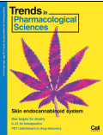
Search
Find out what’s Hot
http://info.scopus.com/topcited/
http://top25.sciencedirect.com/
Find the trends of the subject area
Search tips (including alerts)
Journals, authors, publications per year
Evaluate which journal is right for your article
Impact Factor
Subject Specific Impact Factor (http://tinyurl.com/scopusimpact)
SCImago Journal & Country Ranking (http://scimagojr.com/)
Journal Analyzer
h-Index
Find out more about the journals
Who are the editors?
Guide for authors
Article of the future
http://beta.cell.com/erickson/
IF

Slide 62
References
George M. Hall ,How to Write a Paper, Fifth Edition. John Wiley & Sons, Ltd. Published 2013
Barbara Gastel and Robert A. Day ,How to Write and Publish a Scientific Paper , Eighth Edition,.. Published by Greenwood An Imprint of ABC-CLIO, LLC 2016
Ainur Akilzhanova. Responsible research publication: international standards for authors. Ethical Considerations in the Conduct and Reporting of Research, super-cousre lecture 2012( ppt), available http://www.pitt.edu/~super1/CentralAsia/workshop.htm
An-Rong Lee , Publication Issues, Taiwan , 970129-03 (pdf).
Anthony Newman. How To Get Your Article Published From title to references From submission to revision , Elsevier, Amsterdam Birmingham, Nov. 2010 ( ppt)

