Slide 1
Image Segmentation
using OpenCV

Slide 2
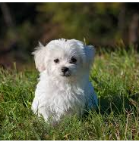
What is Image Segmentation?
Let’s understand image segmentation using a simple example.
There’s only one object here – a dog. We can build a straightforward cat-dog classifier model and predict that there’s a dog in the given image.

Slide 3
But what if we have both a cat and a dog in a single image?
We can train a multi-label classifier, in that instance.
Now, there’s another caveat – we won’t know the location of either animal/object in the image.

Slide 4
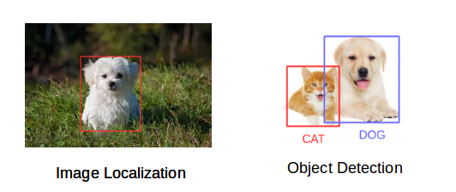
That’s where image localization comes into the picture
It helps us to identify the location of a single object in the given image. In case we have multiple objects present, we then rely on the concept of object detection (OD). We can predict the location along with the class for each object using OD.

Slide 5
Image segmentation
Before detecting the objects and even before classifying the image, we need to understand what the image consists of.

Slide 6
How does image segmentation work?
We can divide or partition the image into various parts called segments. It’s not a great idea to process the entire image at the same time as there will be regions in the image which do not contain any information. By dividing the image into segments, we can make use of the important segments for processing the image.
An image is a collection or set of different pixels. We group together the pixels that have similar attributes using image segmentation.

Slide 7
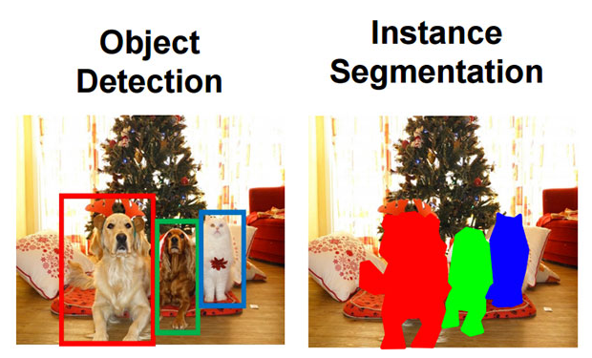

Slide 8
Object detection builds a bounding box corresponding to each class in the image. But it tells us nothing about the shape of the object. We only get the set of bounding box coordinates.
Image segmentation creates a pixel-wise mask for each object in the image. This technique gives us a far more granular understanding of the object(s) in the image.

Slide 9
Why do we need Image Segmentation?
Cancer has long been a deadly illness. Even in today’s age of technological advancements, cancer can be fatal if we don’t identify it at an early stage. Detecting cancerous cell(s) as quickly as possible can potentially save millions of lives.
The shape of the cancerous cells plays a vital role in determining the severity of the cancer. You might have put the pieces together – object detection will not be very useful here. We will only generate bounding boxes which will not help us in identifying the shape of the cells.

Slide 10
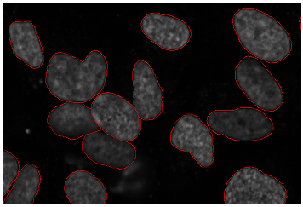
Image Segmentation techniques make a MASSIVE impact here. They help us approach this problem in a more granular manner and get more meaningful results. A win-win for everyone in the healthcare industry.

Slide 11
Here, we can clearly see the shapes of all the cancerous cells. There are many other applications where Image segmentation is transforming industries:
Traffic Control Systems
Self Driving Cars
Locating objects in satellite images

Slide 12
The Different Types of Image Segmentation

Slide 13
Can you identify the difference between these two? Both the images are using image segmentation to identify and locate the people present.
In image 1, every pixel belongs to a particular class (either background or person). Also, all the pixels belonging to a particular class are represented by the same color (background as black and person as pink). This is an example of semantic segmentation
Image 2 has also assigned a particular class to each pixel of the image. However, different objects of the same class have different colors (Person 1 as red, Person 2 as green, background as black, etc.). This is an example of instance segmentation

Slide 15
Let me quickly summarize
If there are 5 people in an image, semantic segmentation will focus on classifying all the people as a single instance.
Instance segmentation, on the other hand. will identify each of these people individually.

