Slide 1
Camera Calibration
Camera Geometry and The Pinhole Model

Slide 2
Camera calibration
Camera calibration estimates the parameters of a pinhole camera model given photograph.
The pinhole camera parameters are represented in a 3 × 4 matrix called the camera matrix.
These parameters are used to estimate the actual size of an object or determine the location of the camera in the world

Slide 3
The Pinhole Model
The pinhole camera model explains the relationship between a point in the world and the projection on the image plane (image sensor).
If we use a wide-open camera sensor, we will end up with blurry images, because the imaging sensor collects light rays from multiple points on the object at the same location on the sensor.
The solution to this problem is to put a barrier in front of the imaging sensor with a tiny hole.
The barrier allows only a limited number of light rays to pass through the hole, and reduces the blurriness of the image.

Slide 4
DOF – Depth of Field

Slide 5
The two most important parameters in a pinhole camera model
Focal length: the distance between the pinhole and the image plane
It affects the size of the projected image.
It affects the camera focus when using lenses.
2. Camera center: The coordinates of the center of the pinhole.

Slide 7
The pinhole camera model is very straightforward. By knowing the focal length and camera’s center, we can mathematically calculate the location where a ray of light that is reflected from an object will strike the image plane.
The focal length and the camera center are the camera intrinsic parameters, K. (K is an industry norm to express the intrinsic matrix.)

Slide 8
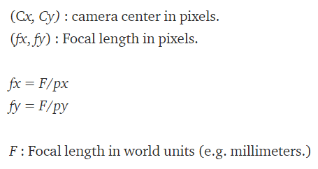
Intrinsic parameters (Aka, the camera matrix.)

Slide 10
Coordinate System Transformation (via Matrix Algebra!)
Why do we want this?
In order to project the point in the world frame to the camera image plane!
To do what?
(If we are talking about self-driving cars) To localize self-driving cars!

Slide 11
Coordinate System Transformation
Light (reflected from the object) travels from the world through the camera aperture (pinhole) to the sensor surface.
The projection onto the sensor surface through the aperture results in flipped images.
To avoid the flipping confusion, we define a virtual image plane (yellow plane) in front of the camera center.

Slide 12
Camera model projection

Slide 13
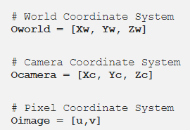
We define a 3 by 3 rotation matrix (R) and a 3 by 1 translation vector (t) in order to model ANY transformation between a world coordinate system and another.
Now we can frame the projection problem (World Coordinates → Image Coordinates) as
World coordinates → Camera coordinates
Camera coordinates → Image coordinate

Slide 14
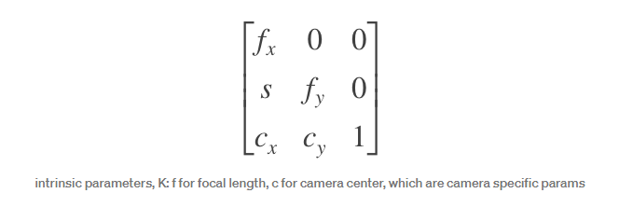
How? by using Linear Algebra!

Slide 15
Both steps 1 and 2 are just matrix multiplications.
Wait, K is (3,3) matrix. [R|t] is (3,4). (| means you are concatenating matrix R with vector t.) Oworld [Xw,Yw,Zw] is (3,1).
Then you can’t multiply K[R|t] (3,4) with Oworld [Xw,Yw,Zw] (3,1)!
😎 We can resolve this by adding one at the end the Oworld vector [Xw,Yw,Zw,1], called homogeneous coordinate (or projective coordinate).

Slide 16
This simple projection principle will be used in every 3d visual perception algorithm, from object detection to 3d scene reconstruction.
In real life, there will be more complex scenarios, e.g. non-square pixels, camera access skew, distortion, non-unit aspect ratio, etc. However, they only change the camera matrix K, and the equations will still be the same.

Slide 17
A few things to note:
a) The rotation matrix (R) and the translation vector (t) are called extrinsic parameters because they are "external" to the camera.
The translation vector t can be interpreted as the position of the world origin in camera coordinates, and the columns of the rotation matrix R represent the directions of the world-axes in camera coordinates. This can be a little confusing to interpret because we are used to thinking in terms of the world coordinates.
b) Usually, multiple sensors (e.g. camera, lidar, radar, etc.) are used for perception in self-driving vehicles. Each sensor comes with its own extrinsic parameters that define the transform from the sensor frame to the vehicle frame.
c) Image coordinate (virtual image plane) [u, v] starts from the top left corner of the virtual image plane. That’s why we adjust the pixel locations to the image coordinate frame.

