Slide 1
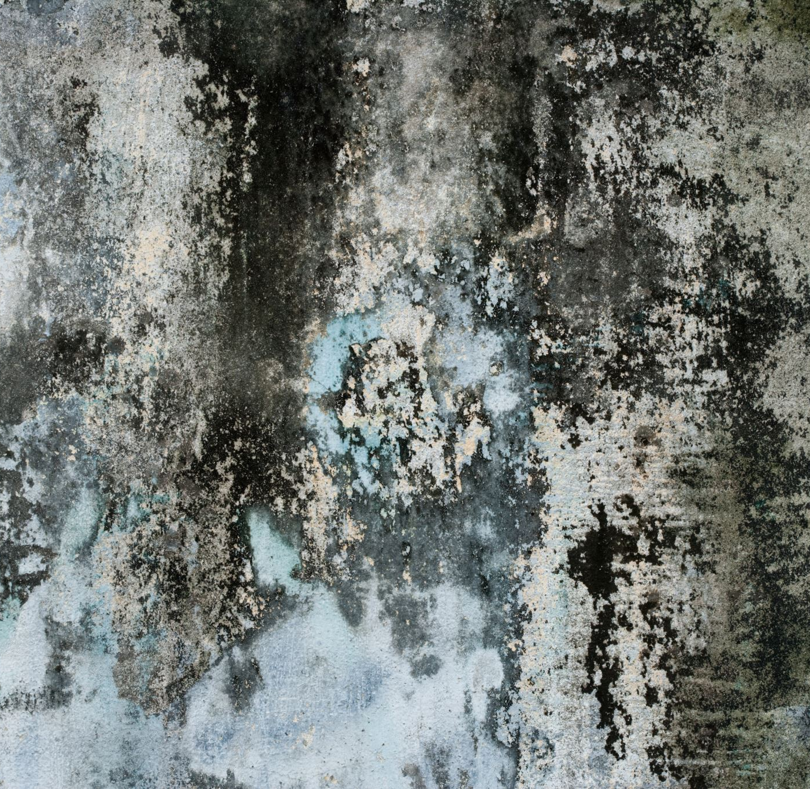
Erosion, Blurring and Border on images

Slide 2
Python OpenCV | cv2.erode() method
cv2.erode() method is used to perform erosion on the image.
The basic idea of erosion is just like soil erosion only, it erodes away the boundaries of foreground object (Always try to keep foreground in white).
It is normally performed on binary images.
It needs two inputs, one is our original image, second one is called structuring element or kernel which decides the nature of operation.
A pixel in the original image (either 1 or 0) will be considered 1 only if all the pixels under the kernel is 1, otherwise it is eroded (made to zero).

Slide 3
Python | Image blurring using OpenCV
Image Blurring refers to making the image less clear or distinct. It is done with the help of various low pass filter kernels.

Slide 4
Advantages of blurring
It helps in Noise removal. As noise is considered as high pass signal so by the application of low pass filter kernel we restrict noise.
It helps in smoothing the image.
Low intensity edges are removed.
It helps in hiding the details when necessary. For e.g. in many cases police deliberately want to hide the face of the victim, in such cases blurring is required.

Slide 5
Important types of blurring
Gaussian Blurring
Median Blur
Bilateral Blur

Slide 6
Gaussian Blurring
Gaussian blur is the result of blurring an image by a Gaussian function.
It is a widely used effect in graphics software, typically to reduce image noise and reduce detail.
It is also used as a preprocessing stage before applying our machine learning or deep learning models.

Slide 7
Median Blur
The Median Filter is a non-linear digital filtering technique, often used to remove noise from an image or signal.
Median filtering is very widely used in digital image processing because, under certain conditions, it preserves edges while removing noise.
It is one of the best algorithms to remove Salt and pepper noise.

Slide 8
Bilateral Blur
A bilateral filter is a non-linear, edge-preserving, and noise-reducing smoothing filter for images.
It replaces the intensity of each pixel with a weighted average of intensity values from nearby pixels.
This weight can be based on a Gaussian distribution. Thus, sharp edges are preserved while discarding the weak ones.

Slide 9
cv2.copyMakeBorder() method
cv2.copyMakeBorder() method is used to create a border around the image like a photo frame.

