Slide 1
Computer Vision (CSA401)
Dr. Saumya Chaturvedi

Slide 2
What is computer vision?
Computer vision is a field of artificial intelligence (AI) that enables computers and systems to derive meaningful information from digital images, videos and other visual inputs — and take actions or make recommendations based on that information.
If AI enables computers to think, computer vision enables them to see, observe and understand.

Slide 3
Computer vision works much the same as human vision, except humans have a head start. Human sight has the advantage of lifetimes of context to train how to tell objects apart, how far away they are, whether they are moving and whether there is something wrong in an image.
Computer vision trains machines to perform these functions, but it has to do it in much less time with cameras, data and algorithms rather than retinas, optic nerves and a visual cortex. Because a system trained to inspect products or watch a production asset can analyze thousands of products or processes a minute, noticing imperceptible defects or issues, it can quickly surpass human capabilities.

Slide 4
How does computer vision work?
Computer vision needs lots of data.
It runs analyses of data over and over until it discerns distinctions and ultimately recognize images. For example, to train a computer to recognize automobile tires, it needs to be fed vast quantities of tire images and tire-related items to learn the differences and recognize a tire

Slide 5
Two essential technologies are used to accomplish computer vision
A type of machine learning called deep learning
A convolutional neural network (CNN)

Slide 6
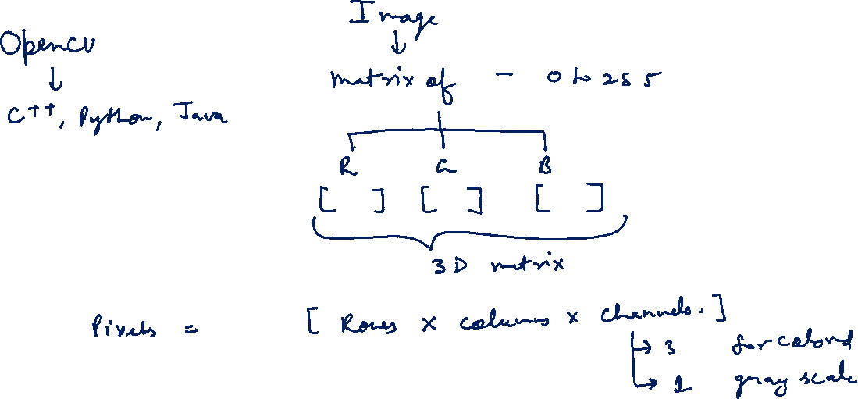

Slide 7
Machine learning uses algorithmic models that enable a computer to teach itself about the context of visual data. If enough data is fed through the model, the computer will “look” at the data and teach itself to tell one image from another.
A CNN helps a machine learning or deep learning model “look” by breaking images down into pixels that are given tags or labels. It uses the labels to perform convolutions (a mathematical operation on two functions to produce a third function) and makes predictions about what it is “seeing.” The neural network runs convolutions and checks the accuracy of its predictions in a series of iterations until the predictions start to come true. It is then recognizing or seeing images in a way similar to humans.

Slide 8
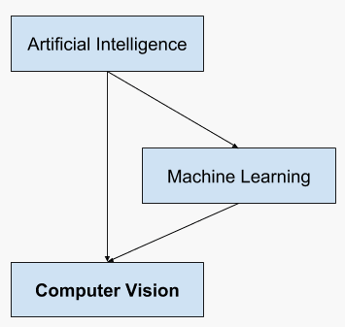
Overview of the Relationship of Artificial Intelligence and Computer Vision

Slide 9
Few examples of established computer vision tasks:
Image classification sees an image and can classify it (a dog, an apple, a person’s face). More precisely, it is able to accurately predict that a given image belongs to a certain class.
Object detection can use image classification to identify a certain class of image and then detect and tabulate their appearance in an image or video.
Object tracking follows or tracks an object once it is detected. This task is often executed with images captured in sequence or real-time video feeds.
Content-based image retrieval uses computer vision to browse, search and retrieve images from large data stores, based on the content of the images rather than metadata tags associated with them.

Slide 10
