Slide 1
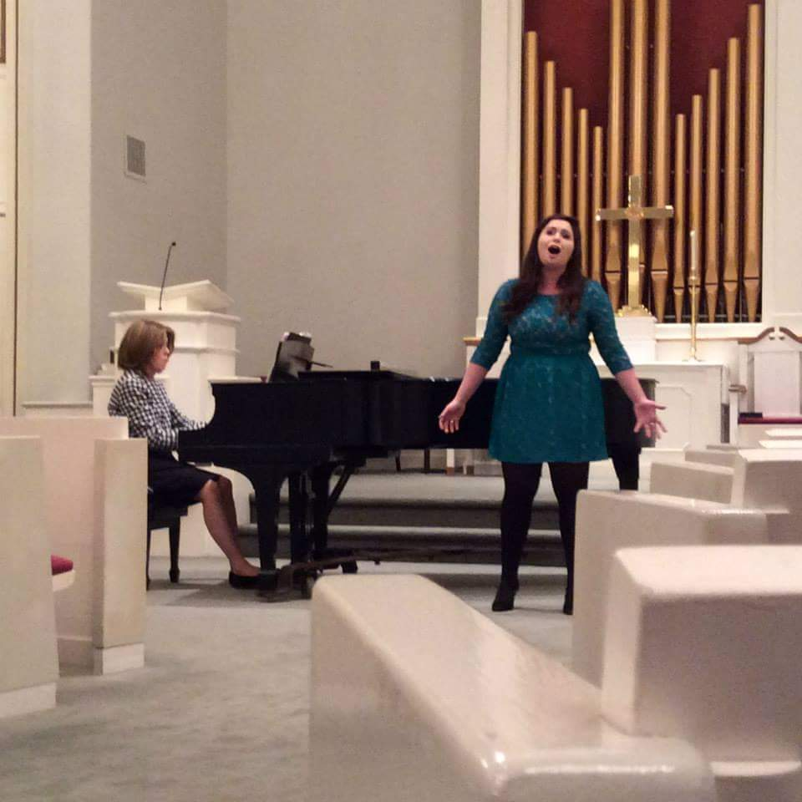
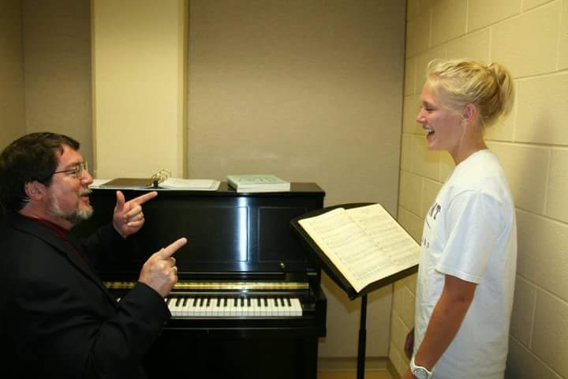
Challenges within the traditional vocal studio model:
Suggested Adaptations to the
Traditional University Voice Studio Model
The traditional University voice studio model:
Weekly one-on-one lessons in offices
First ½ hour = exercises and technique / Second ½ hour = repertoire (with accompanist)
Sometimes weekly or bi-monthly studio classes
I loved being able to take advantage of a better acoustic space rather than being confined to the small office. Meeting multiple times per week helped me to space out my preparation and reinforced technique and memorization throughout the week.
~ Emily, Class of 2017
Observed Results:
Better, more consistent overall preparation
More confidence in abilities
Learning through observation = more efficient learning
Less long gaps between lessons
Greater ease and efficiency in scheduling accompanists
Perspective from peers, desire for peer approval
Greater accuracy and musicality in performance
More fun, social environment
Less risk to instructor hearing
Better project management (recitals, etc.)
Proposed Changes to Vocal Studio Model:
Inconsistent preparation/procrastination
Loss of entire weeks of contact due to disorganization, sickness, miscommunication, or university calendars
Lack of social/peer accountability
Inability to learn through observation
Risks to instructor hearing
Bi-weekly, consecutive 1/2 hour lessons
Exercises and technique M/T, repertoire with accompanist W/Th
Larger acoustical space
Required outside attendance
I absolutely loved observing other lessons because a lot of the things he was saying to other students applied to me. Also, there were techniques that I observed others doing and tried for myself through trial and error and kept the ones that worked for me. Also, listening to your friends sing is very enjoyable! Overall, the 2 weekly lessons is a great idea and it really will benefit students tremendously and will make them more accountable in learning their music and being prepared. I think this model will motivate students to learn their music accurately and efficiently.
~ Alex, Class of 2017
Having two lessons a week prompted me to practice more consistently throughout the week. Rather than becoming overwhelmed with the many different technical, diction, dramatic, and stylistic comments given in one long lesson, my lessons could be a little more focused.
~ Laura, Class of 2017
I found that I was making improvements to my vocal technique quicker and learning repertoire in a more consistent fashion. It allowed me to check-in with my teacher throughout the week, and he was able to address any vocal issues or misunderstandings from my previous lesson quicker. I saw the most growth in my vocal technique when the structure of the weekly applied lessons changed.
~ Nick, Class of 2016
I loved having two 30 minute segments because I felt like I could really focus on the task at hand. My mind was not tired by the end, as it often could be during hour-long sessions, but was rather excited for the next lesson later on in the week.
~ Heather, Class of 2017
Scott MacLeod, DMA | Assistant Professor of Music
smacleod@highpoint.edu
www.highpoint.edu | Choose to be extraordinary!®

