Slide 1

Annual HOA Budget Meeting for 2020

Slide 2
HOA Board Member Introductions
Byron Henderson – President
Gail Forbes – Vice President/Treasurer
McCala Walters – Secretary
Paul Hinty – Director
Jim Forbes – Director
Roslyn Hoy – Director
Donna Murdoch - Director

Slide 3
How Is Our Budget Determined?
Reserve Study
  This is done by an outside company and looks at the size and age of the neighborhood to determine when upkeep projects may need to be done and gives a very generalized estimate of the cost. Dues are adjusted to ensure we have the funds available to cover the cost of the repairs/upgrades that are forecasted.
Recurring Bills – for example:
  Power/water
  Contractors
    Landscapers
    Irrigation Specialists
Management Costs – for example:
  Administrative Fees
    Professional Community Association Management (ProCAM), Martha Tackett (community association manager)
  Lawyer fees

Slide 4
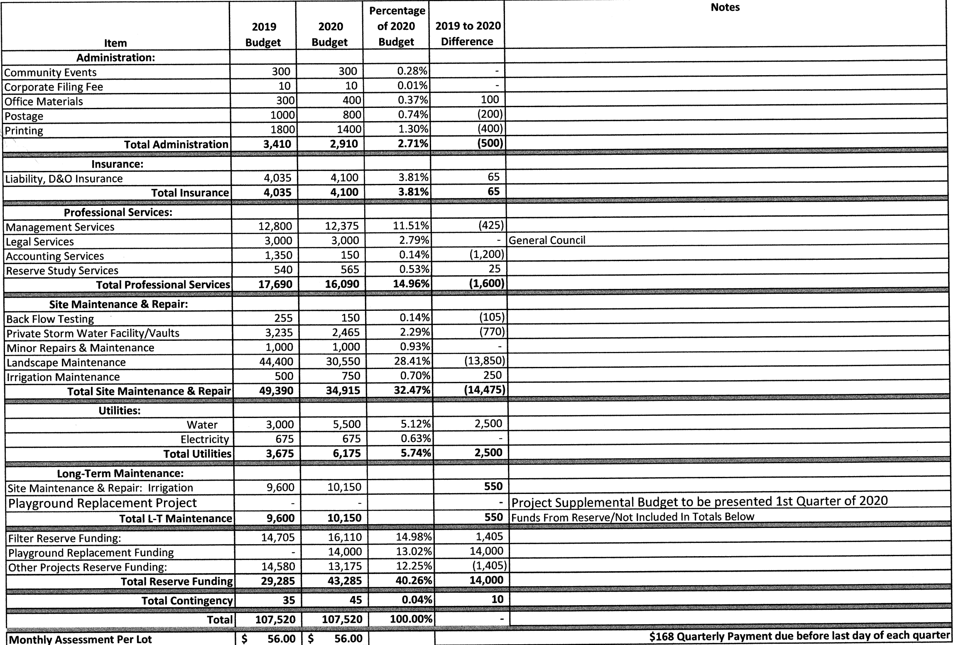
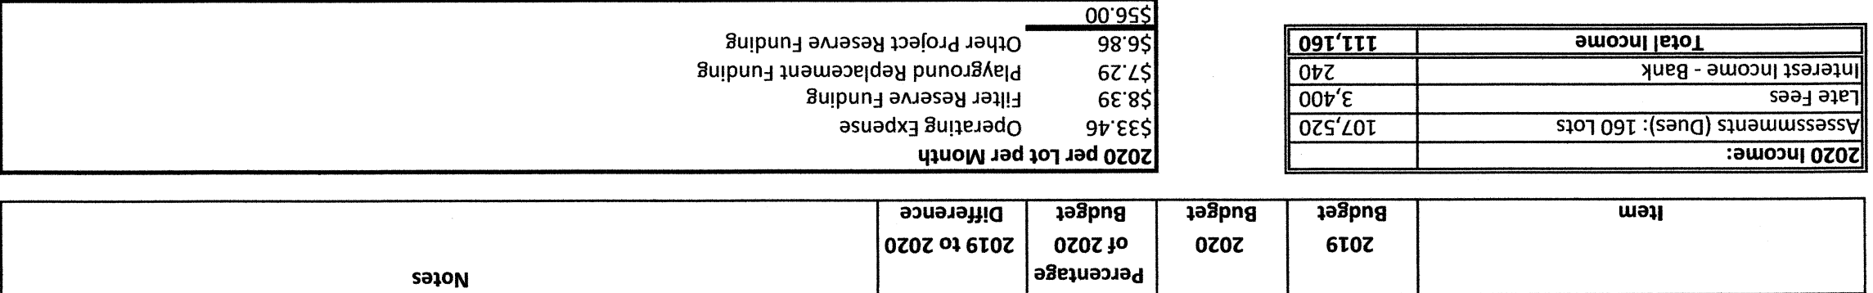
2020 HOA Budget

Slide 5
What Has The HOA Board Done This Year?
Irrigation Survey and Maintenance Projects
Supported National Night-Out Event
Playground Equipment Survey and Replacement Project
Architectural Change Committee Approvals Reviewed
Main Entrance Monument Maintenance
Social Committee formation for newsletter distribution and neighbor night gatherings
Policy Updates
Seasonal Holiday Awards

Slide 6
Unforeseen Costs
Inappropriate yard waste dumping
Removal and replacement of tree along with repair to irrigation line
Irrigation line repair due to damage from real-estate signs
Attorney fees for collection of HOA dues/fines that are delinquent

Slide 7
Project list for 2020
Playground Equipment Replacement
Irrigation System Maintenance
Main Entrance Monument Maintenance
Increasing neighborhood sense of community
Creating a volunteer beautification committee

Slide 8
Playground Project
BOTH parks have outlived there lifespan and are beyond repair.
Existing WEST playground structure shall be replaced with a more durable structure
Existing EAST playground structure may be replaced with a possible pavilion or covered structure.

Slide 9
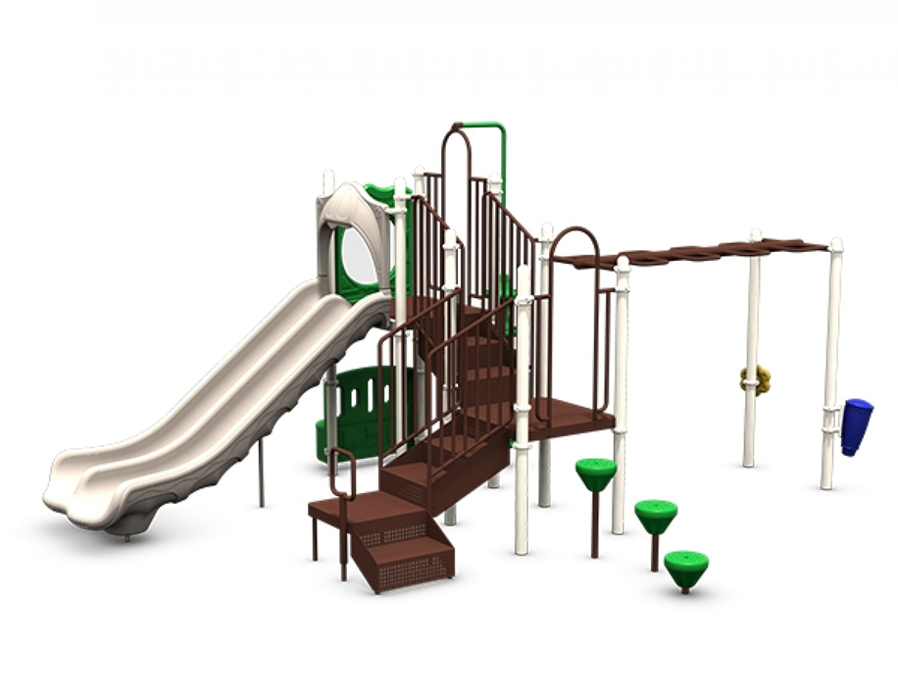
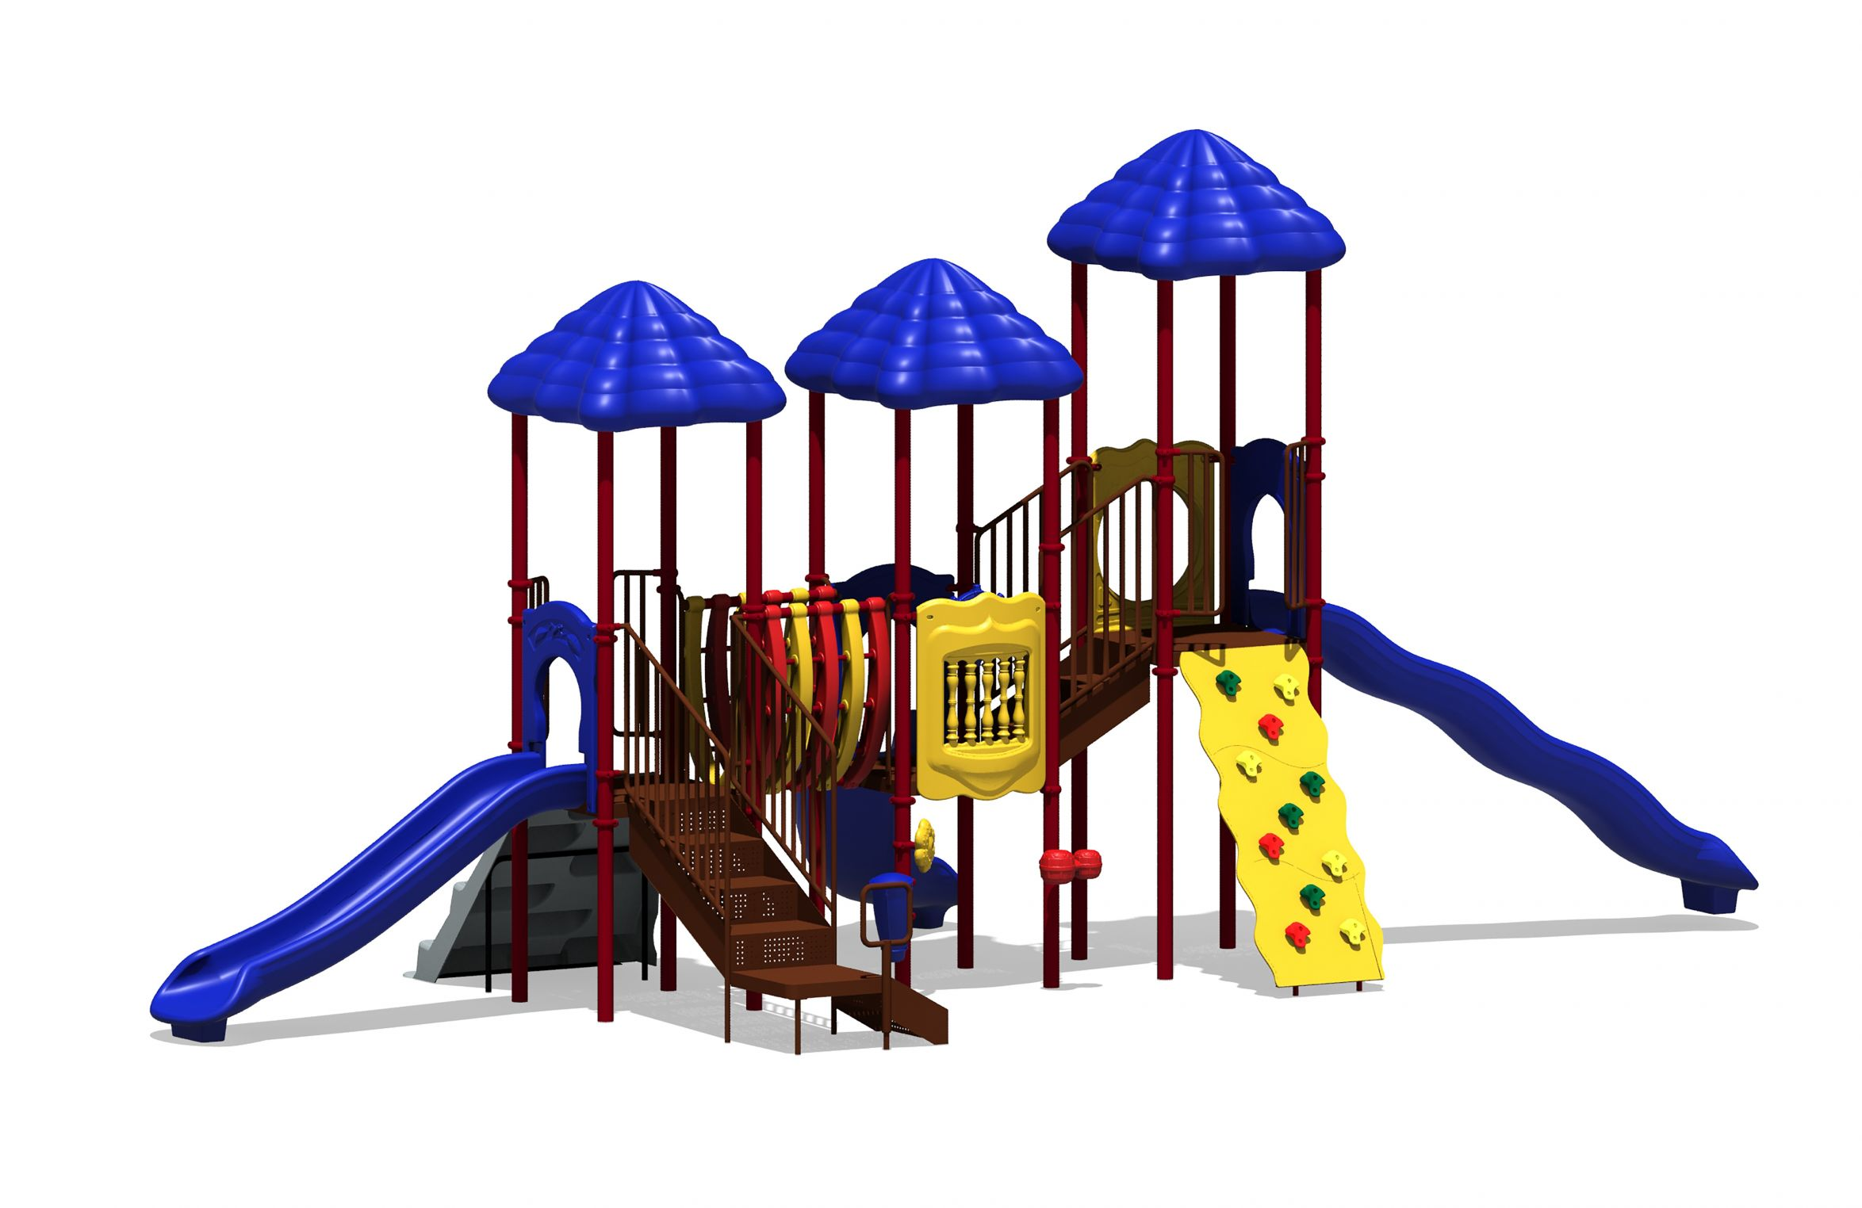
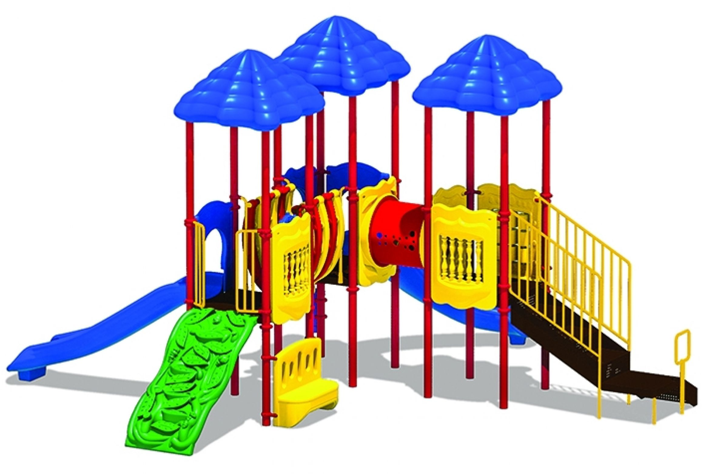
Playground Project
Concerns include – adhering to current code for space allocation, price, durability, and for all age groups.
Our current project is the removal of existing WEST playground equipment to eliminate the damaged equipment. We are currently working with several contractor to find a playground that best accommodates our needs while being competitively priced.
We would like to have the playground replaced by the summer, but limitations in cost and labor may inhibit us.
*** these are just examples, replacement is still to be determined

Slide 10
How Can YOU Get Involved?
Join us at HOA board meetings. The first 15 minutes are always set up as an open forum where you can come bring suggestions and questions
Help out on a project
Participate in community events (like neighbor nights)
Join an HOA committee

Slide 11
Our board is committed to serving the members of the HOA. As volunteers we aim to speak on behalf of the community when making business decisions that impact our community.

