Slide 1
Speaking tasks for intermediate oral exams
Picture descriptions, role plays and a mock debate

Slide 2
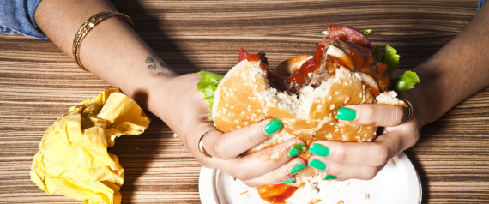
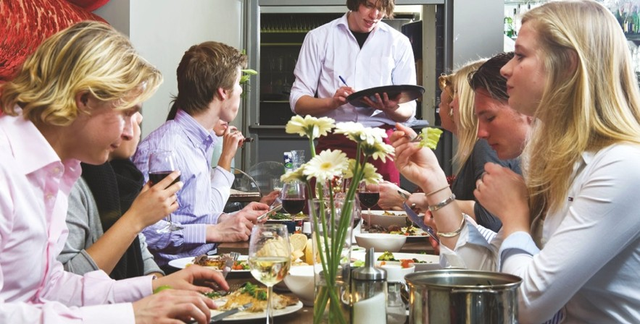
Eating out

Slide 3
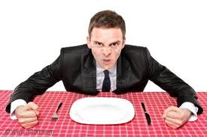
Role play
You are a customer at a restaurant. Sadly, you are dissatisfied with the food you get. Moreover, you find the place cold and dirty. You are not content with the waiter’s behaviour either. You are very upset. Call the manager and…
Complain about the quality of the food and service. (Mention concrete problems, for example, the food is inedible, too cold, too hot, too fatty, too spicy, tasteless, etc.)
Ask for some compensation.

Slide 4
Celebrations

Slide 5
Role play
Your brother/sister has graduated form the university recently and you want to organise a big surprise party for him/her.
Call the owner of a popular pub in your hometown and…
Book a table.
Tell him/her the number of the guests.
Tell him/her when you want to have this party.
Ask him/her about the menu and prices
Ask him/her if he/she can provide you a separate room for dancing.
Ask him/her about the opening hours of the restaurant.

Slide 6
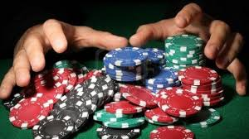
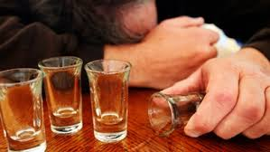

Slide 7
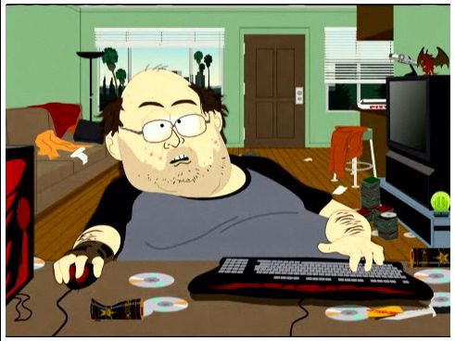
Role play
Your flatmate is addicted to computers, however, he/she is not aware of it. He/she is always sits in front of his/her computer and does nothing else.
Tell him/her about the possible dangers of computers.
Recommend him/her some useful activities instead of playing computer games all the time.
Offer your help.
Be very convincing.

Slide 8
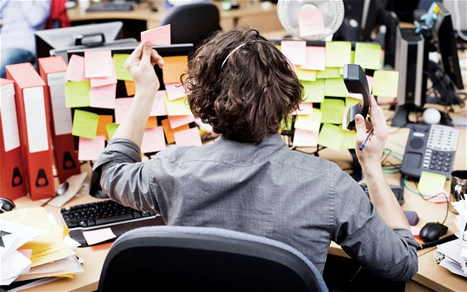
Work and education

Slide 9
Mock debate
You think working at home (teleworking/telecommuting) is really good. However, your partner does not think the same. Try to convince him/her. Tell him/her about the advantages of telework.

Slide 10
Thank you for your participation!☺

