Slide 1

June 2018

Slide 2
Presentation Items
About DubaiStore
Seller Journey
Customer Journey
Front End Website Demo
Instagram Journey
Order Journey
June 2018

Slide 3
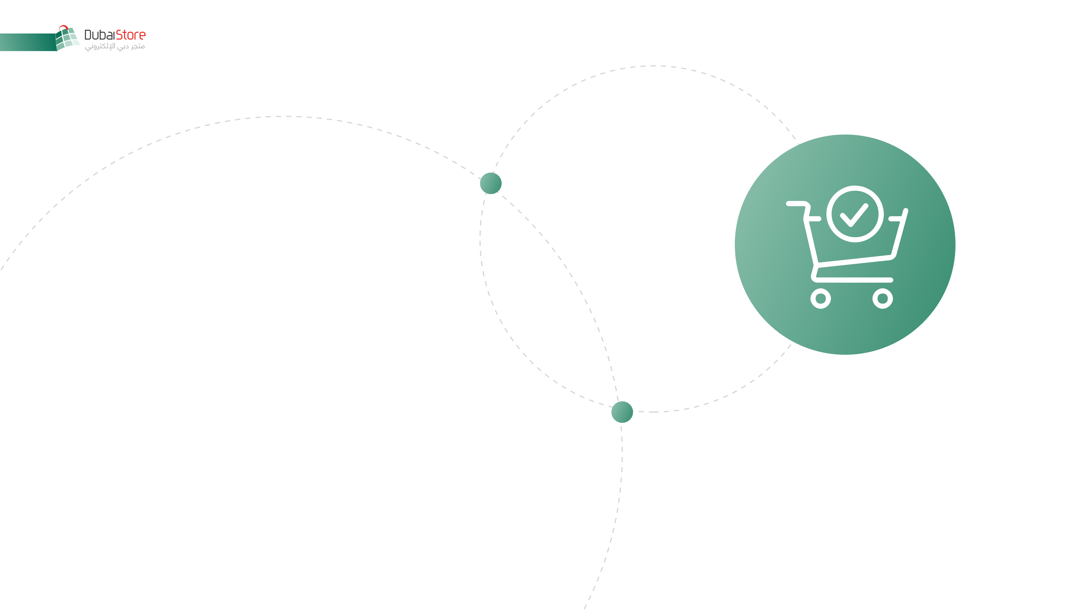
A Marketplace for Dubai
Part of Digital Economy Solutions, a JV between Emaratech and Dubai Economy.
DubaiStore is a true ecommerce marketplace with a unique proposition that thrives on promoting retailers, without competing with them.
DubaiStore aims to
Facilitate trade
Grow the economy

Slide 4

Enable Ecommerce
DubaiStore enables ecommerce marketplace for the licensed businesses in Dubai, including home businesses.
Home Business
SME
Enterprise
One Platform, Multi-Stores: Government - Governance - Businesses

Slide 5
Platform Capabilities 2/2
Sellers’ Brand Identity
Sellers’ Microsites
Customer Information Visibility
Communication between Sellers & Customers Whatsapp, FB Messenger, Message Center
Sellers’ Own Courier & Pickup locations
Integrated Courier (Zajel)
Integrated Payment Gateway (Noqodi)
Social Integrations
Cataloging from Instagram
Functionalities Controlled by Seller
Government Initiative by Dubai Economy
Multi Lingual
Marketplace Standards
Marketing Features

Slide 6

Seller Journey
Store Management
Store Settings
Catalogue Management
Inventory Management
Order Management
Social Media Integration
Reports and Analytics
Seller Whitelabled site
Communication Center
Merchant Profile
Registration
Multiple Stores Creation
Under 1 Profile
Messaging Board
WhatsApp
Messenger

Slide 7
Customer Journey
Customer Account
Profile Management
Order History
Favorite Lists
Communication Center
Checkout Process
Addresses
Delivery Type
Payment
Confirmation
Messaging Board
WhatsApp
Messenger
Browse &
Search
Shopping
Cart
Order Cancelation
and Returns
Manage locations

Slide 8
Catalogue Instagram Journey
Merchant initiates plugin from his dashboard
Merchant sees list of his Instagram posts in his DubaiStore dashboard
Merchant selects desired images
Merchant fills extra info per image such as: price, description, attributes
Customers click on URL and visit Merchant’s storeCustomers click on URL and visit Merchant’s store
Merchant uses his DubaiStore URL and places it in his Instagram profile
Merchant saves information

Slide 9
Order Journey
Customer places order
Merchant receives notification
Merchant prepares order
Courier delivers to customer
Courier picks up product from seller
Merchant triggers button for courier for pickup

Slide 10
info@DubaiStore.com

